Slide 1
Chapter 1:18-2:10

Slide 2
THEME
Freedom in Christ
It was for freedom that Christ set us free; therefore keep standing firm and do not be subject again to a yoke of slavery.
Gal. 5:1

Slide 3
KEY VERSE
Nevertheless knowing that a man is not justified by the works of the Law but through faith in Christ Jesus, even we have believed in Christ Jesus, that we may be justified by faith in Christ, and not by the works of the Law; since by the works of the Law shall no flesh be justified.
Gal. 2:16

Slide 4
OUTLINE
Personal Portion: The Apostle of Liberty. Paul shows that he is an apostle equal in authority and knowledge to Peter, James, and John. Chapters 1-2.
Doctrinal Portion: The Doctrine of Liberty. Paul shows that justification is by "faith working through love" instead of by "works of law." Chapters 3-4.
Practical Portion: The Life of Liberty. Paul exhorts those "having begun in the Spirit" to "walk by the Spirit" and to bear "the fruit of the Spirit." Chapters 5-6.
R.C. Bell

Slide 5
OUTLINE
Personal Portion: The Apostle of Liberty. Paul shows that he is an apostle equal in authority and knowledge to Peter, James, and John. Chapters 1-2.
SALUTATION 1:1-5
DENUNCIATION 1:6-10
AFFIRMATION 1:11-2:14

Slide 6
CHAPTER 1:6-10
⁶ I am amazed that you are so quickly deserting Him who called you by the grace of Christ, for a different gospel;⁷ which is really not another; only there are some who are disturbing you, and want to distort the gospel of Christ.⁸ But even though we, or an angel from heaven, should preach to you a gospel contrary to that which we have preached to you, let him be accursed.⁹ As we have said before, so I say again now, if any man is preaching to you a gospel contrary to that which you received, let him be accursed.¹⁰ For am I now seeking the favor of men, or of God? Or am I striving to please men? If I were still trying to please men, I would not be a bond-servant of Christ.

Slide 7
CHAPTER 1:6-10
⁶ I am amazed that you are so quickly deserting Him who called you by the grace of Christ, for a different gospel;⁷ which is really not another; only there are some who are disturbing you, and want to distort the gospel of Christ.⁸ But even though we, or an angel from heaven, should preach to you a gospel contrary to that which we have preached to you, let him be accursed.⁹ As we have said before, so I say again now, if any man is preaching to you a gospel contrary to that which you received, let him be accursed.¹⁰ For am I now seeking the favor of men, or of God? Or am I striving to please men? If I were still trying to please men, I would not be a bond-servant of Christ.
What then? Shall we sin because we are not under law but under grace? May it never be! Do you not know that when you present yourselves to someone as slaves for obedience, you are slaves of the one whom you obey, either of sin resulting in death, or of obedience resulting in righteousness? But thanks be to God that though you were slaves of sin, you became obedient from the heart to that form of teaching to which you were committed, and having been freed from sin, you became slaves of righteousness.
Romans 6:15-18
“Making Space for Millennials: Equip your team with innovative, cutting-edge research on Millennials' views on worship spaces, church services, social issues and careers. This resource is designed to help you make the most of your current and future partnerships with Millennials.”
“bond-servant”

Slide 8
CHAPTER 1:11-17
¹¹ For I would have you know, brethren, that the gospel which was preached by me is not according to man.¹² For I neither received it from man, nor was I taught it, but I received it through a revelation of Jesus Christ.¹³ For you have heard of my former manner of life in Judaism, how I used to persecute the church of God beyond measure, and tried to destroy it;¹⁴ and I was advancing in Judaism beyond many of my contemporaries among my countrymen, being more extremely zealous for my ancestral traditions.¹⁵ But when He who had set me apart, even from my mother’s womb, and called me through His grace, was pleased¹⁶ to reveal His Son in me, that I might preach Him among the Gentiles, I did not immediately consult with flesh and blood,¹⁷ nor did I go up to Jerusalem to those who were apostles before me; but I went away to Arabia, and returned once more to Damascus.

Slide 9
OUTLINE
AFFIRMATION 1:11-2:14
Paul’s Revelation Did Not Come From Man (1:11-24)
Paul’s Apostleship Had Been Received by the Other Apostles (2:1-10)
Paul Himself Rebuked Peter (2:11-14)

Slide 10
CHAPTER 1:18-24
¹⁸ Then three years later I went up to Jerusalem to become acquainted with Cephas, and stayed with him fifteen days.¹⁹ But I did not see any other of the apostles except James, the Lord’s brother.²⁰ (Now in what I am writing to you, I assure you before God that I am not lying.)²¹ Then I went into the regions of Syria and Cilicia.²² And I was still unknown by sight to the churches of Judea which were in Christ;²³ but only, they kept hearing, “He who once persecuted us is now preaching the faith which he once tried to destroy.”²⁴ And they were glorifying God because of me.

Slide 11
CHAPTER 1:18-24
¹⁸ Then three years later I went up to Jerusalem to become acquainted with Cephas, and stayed with him fifteen days.¹⁹ But I did not see any other of the apostles except James, the Lord’s brother.²⁰ (Now in what I am writing to you, I assure you before God that I am not lying.)²¹ Then I went into the regions of Syria and Cilicia.²² And I was still unknown by sight to the churches of Judea which were in Christ;²³ but only, they kept hearing, “He who once persecuted us is now preaching the faith which he once tried to destroy.”²⁴ And they were glorifying God because of me.
Acts 22:17-21

Slide 12
CHAPTER 1:18-24
¹⁸ Then three years later I went up to Jerusalem to become acquainted with Cephas, and stayed with him fifteen days.¹⁹ But I did not see any other of the apostles except James, the Lord’s brother.²⁰ (Now in what I am writing to you, I assure you before God that I am not lying.)²¹ Then I went into the regions of Syria and Cilicia.²² And I was still unknown by sight to the churches of Judea which were in Christ;²³ but only, they kept hearing, “He who once persecuted us is now preaching the faith which he once tried to destroy.”²⁴ And they were glorifying God because of me.
For we did not follow cleverly devised tales when we made known to you the power and coming of our Lord Jesus Christ, but we were eyewitnesses of His majesty.
2 Peter 1:16

Slide 13
CHAPTER 1:18-24
¹⁸ Then three years later I went up to Jerusalem to become acquainted with Cephas, and stayed with him fifteen days.¹⁹ But I did not see any other of the apostles except James, the Lord’s brother.²⁰ (Now in what I am writing to you, I assure you before God that I am not lying.)²¹ Then I went into the regions of Syria and Cilicia.²² And I was still unknown by sight to the churches of Judea which were in Christ;²³ but only, they kept hearing, “He who once persecuted us is now preaching the faith which he once tried to destroy.”²⁴ And they were glorifying God because of me.

Slide 14
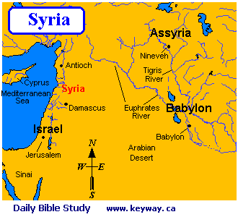

Slide 15
CHAPTER 1:18-24
¹⁸ Then three years later I went up to Jerusalem to become acquainted with Cephas, and stayed with him fifteen days.¹⁹ But I did not see any other of the apostles except James, the Lord’s brother.²⁰ (Now in what I am writing to you, I assure you before God that I am not lying.)²¹ Then I went into the regions of Syria and Cilicia.²² And I was still unknown by sight to the churches of Judea which were in Christ;²³ but only, they kept hearing, “He who once persecuted us is now preaching the faith which he once tried to destroy.”²⁴ And they were glorifying God because of me.
2 Timothy 3:12-17

Slide 16
CHAPTER 1:18-24
¹⁸ Then three years later I went up to Jerusalem to become acquainted with Cephas, and stayed with him fifteen days.¹⁹ But I did not see any other of the apostles except James, the Lord’s brother.²⁰ (Now in what I am writing to you, I assure you before God that I am not lying.)²¹ Then I went into the regions of Syria and Cilicia.²² And I was still unknown by sight to the churches of Judea which were in Christ;²³ but only, they kept hearing, “He who once persecuted us is now preaching the faith which he once tried to destroy.”²⁴ And they were glorifying God because of me.
But you are a chosen race, a royal priesthood, a holy nation, a people for God’s own possession, that you may proclaim the excellencies of Him who has called you out of darkness into His marvelous light;
1 Peter 2:9

Slide 17
OUTLINE
AFFIRMATION 1:11-2:14
Paul’s Revelation Did Not Come From Man (1:11-24)
Paul’s Apostleship Had Been Received by the Other Apostles (2:1-10)
Paul Himself Rebuked Peter (2:11-14)

Slide 18
CHAPTER 2:1-5
¹ Then after an interval of fourteen years I went up again to Jerusalem with Barnabas, taking Titus along also.² And it was because of a revelation that I went up; and I submitted to them the gospel which I preach among the Gentiles, but I did so in private to those who were of reputation, for fear that I might be running, or had run, in vain.³ But not even Titus who was with me, though he was a Greek, was compelled to be circumcised.⁴ But it was because of the false brethren who had sneaked in to spy out our liberty which we have in Christ Jesus, in order to bring us into bondage.⁵ But we did not yield in subjection to them for even an ˚hour, so that the truth of the gospel might remain with you.

Slide 19
CHAPTER 2:6-10
⁶ But from those who were of high reputation (what they were makes no difference to me; God shows no partiality)—well, those who were of reputation contributed nothing to me.⁷ But on the contrary, seeing that I had been entrusted with the gospel to the uncircumcised, just as Peter had been to the circumcised⁸ (for He who effectually worked for Peter in his apostleship to the circumcised effectually worked for me also to the Gentiles),⁹ and recognizing the grace that had been given to me, James and Cephas and John, who were reputed to be pillars, gave to me and Barnabas the right hand of fellowship, that we might go to the Gentiles, and they to the circumcised.¹⁰ They only asked us to remember the poor—the very thing I also was eager to do.

Slide 20
CHAPTER 2:1-5
¹ Then after an interval of fourteen years I went up again to Jerusalem with Barnabas, taking Titus along also.² And it was because of a revelation that I went up; and I submitted to them the gospel which I preach among the Gentiles, but I did so in private to those who were of reputation, for fear that I might be running, or had run, in vain.³ But not even Titus who was with me, though he was a Greek, was compelled to be circumcised.⁴ But it was because of the false brethren who had sneaked in to spy out our liberty which we have in Christ Jesus, in order to bring us into bondage.⁵ But we did not yield in subjection to them for even an ˚hour, so that the truth of the gospel might remain with you.
Acts 14:23-28

Slide 21
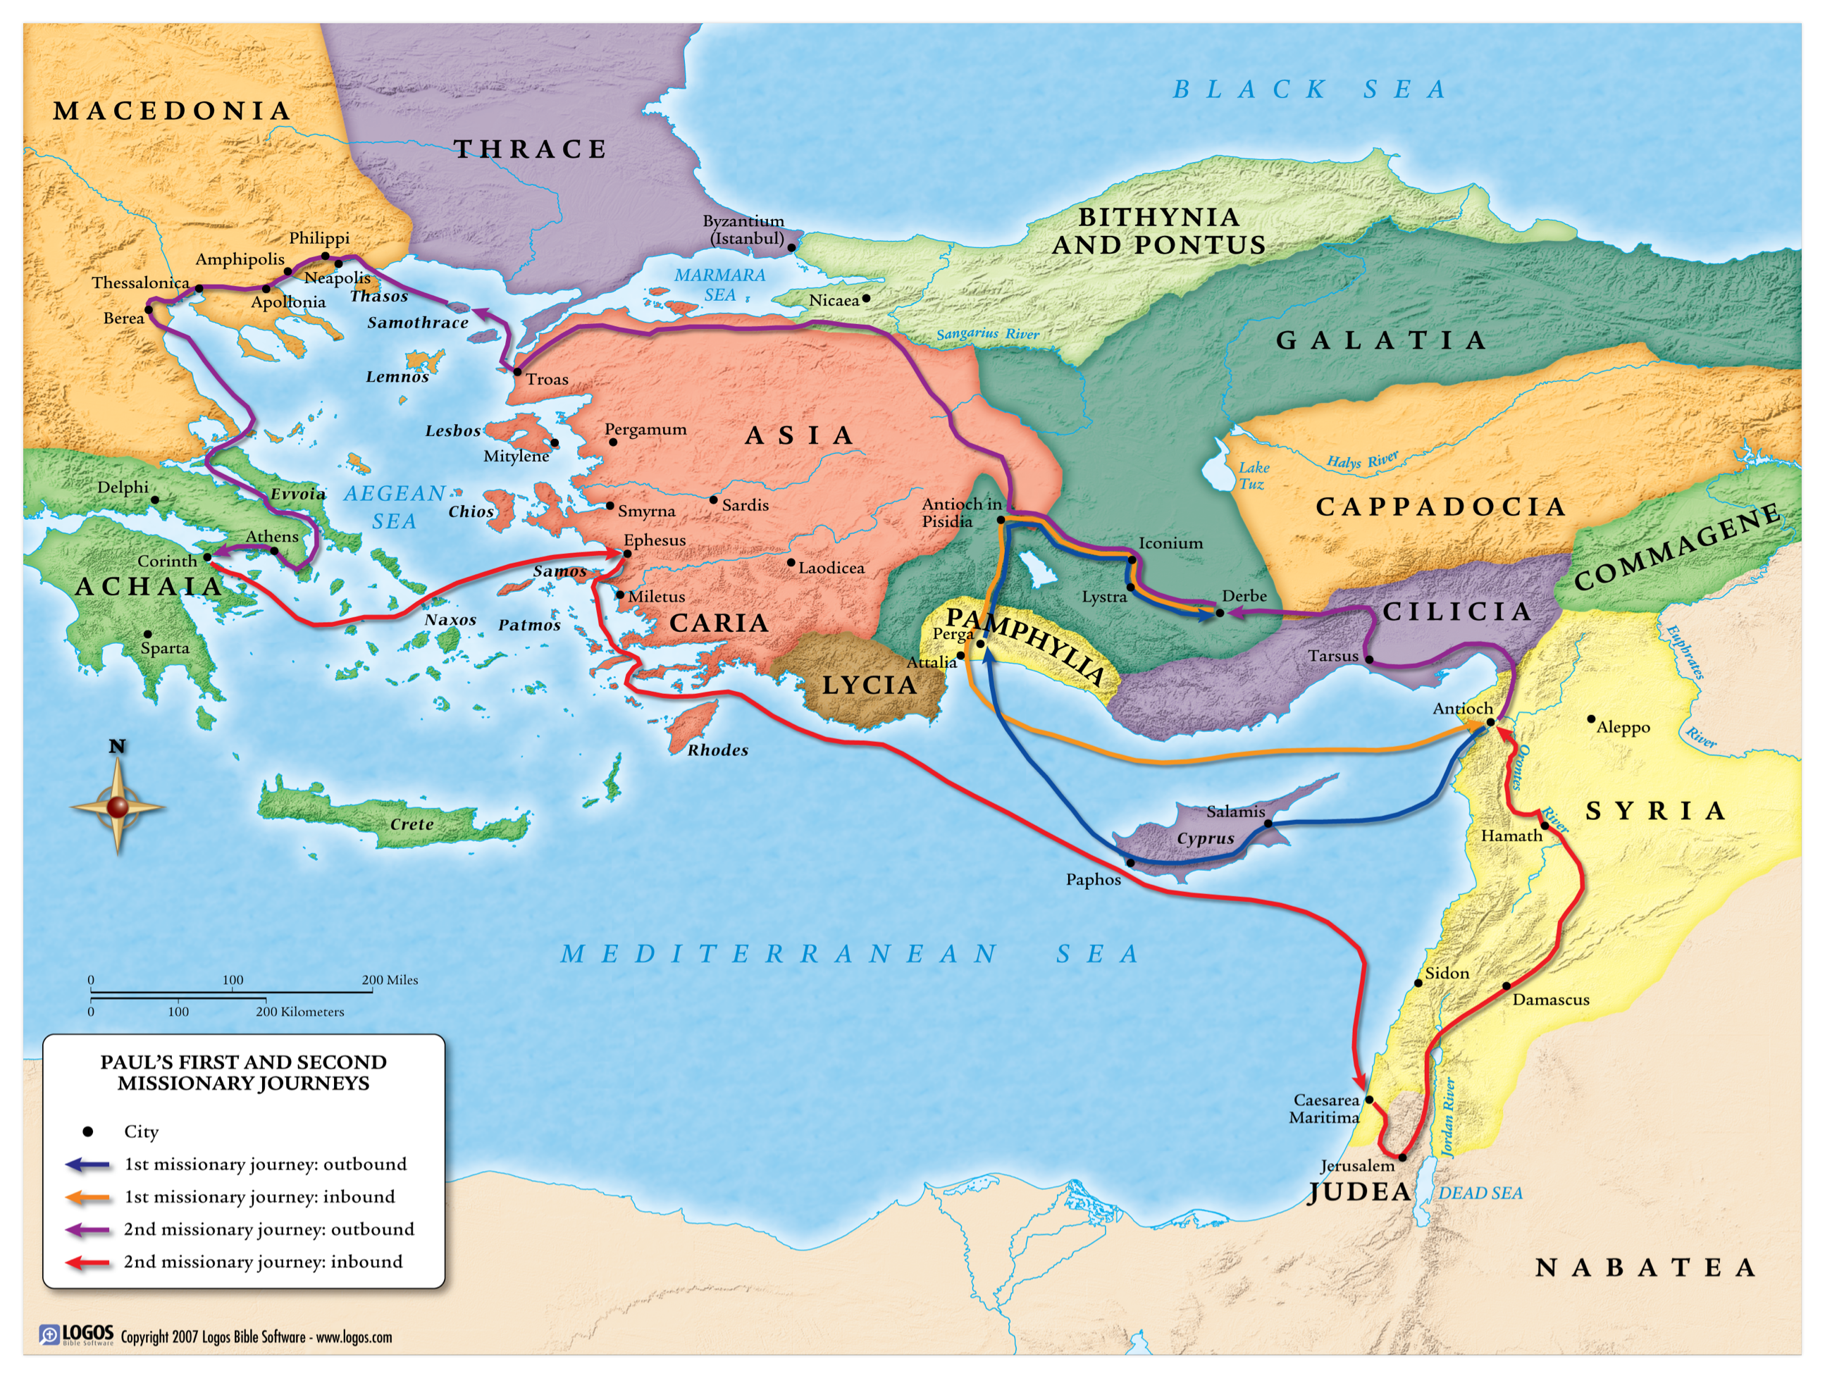

Slide 22
CHAPTER 2:1-5
¹ Then after an interval of fourteen years I went up again to Jerusalem with Barnabas, taking Titus along also.² And it was because of a revelation that I went up; and I submitted to them the gospel which I preach among the Gentiles, but I did so in private to those who were of reputation, for fear that I might be running, or had run, in vain.³ But not even Titus who was with me, though he was a Greek, was compelled to be circumcised.⁴ But it was because of the false brethren who had sneaked in to spy out our liberty which we have in Christ Jesus, in order to bring us into bondage.⁵ But we did not yield in subjection to them for even an ˚hour, so that the truth of the gospel might remain with you.
Acts 15:1-5

Slide 23
CHAPTER 2:1-5
¹ Then after an interval of fourteen years I went up again to Jerusalem with Barnabas, taking Titus along also.² And it was because of a revelation that I went up; and I submitted to them the gospel which I preach among the Gentiles, but I did so in private to those who were of reputation, for fear that I might be running, or had run, in vain.³ But not even Titus who was with me, though he was a Greek, was compelled to be circumcised.⁴ But it was because of the false brethren who had sneaked in to spy out our liberty which we have in Christ Jesus, in order to bring us into bondage.⁵ But we did not yield in subjection to them for even an ˚hour, so that the truth of the gospel might remain with you.

Slide 24
CHAPTER 2:1-5
¹ Then after an interval of fourteen years I went up again to Jerusalem with Barnabas, taking Titus along also.² And it was because of a revelation that I went up; and I submitted to them the gospel which I preach among the Gentiles, but I did so in private to those who were of reputation, for fear that I might be running, or had run, in vain.³ But not even Titus who was with me, though he was a Greek, was compelled to be circumcised.⁴ But it was because of the false brethren who had sneaked in to spy out our liberty which we have in Christ Jesus, in order to bring us into bondage.⁵ But we did not yield in subjection to them for even an ˚hour, so that the truth of the gospel might remain with you.
Acts 15:6-12

Slide 25
CHAPTER 2:1-5
¹ Then after an interval of fourteen years I went up again to Jerusalem with Barnabas, taking Titus along also.² And it was because of a revelation that I went up; and I submitted to them the gospel which I preach among the Gentiles, but I did so in private to those who were of reputation, for fear that I might be running, or had run, in vain.³ But not even Titus who was with me, though he was a Greek, was compelled to be circumcised.⁴ But it was because of the false brethren who had sneaked in to spy out our liberty which we have in Christ Jesus, in order to bring us into bondage.⁵ But we did not yield in subjection to them for even an ˚hour, so that the truth of the gospel might remain with you.

Slide 26
CHAPTER 2:1-5
¹ Then after an interval of fourteen years I went up again to Jerusalem with Barnabas, taking Titus along also.² And it was because of a revelation that I went up; and I submitted to them the gospel which I preach among the Gentiles, but I did so in private to those who were of reputation, for fear that I might be running, or had run, in vain.³ But not even Titus who was with me, though he was a Greek, was compelled to be circumcised.⁴ But it was because of the false brethren who had sneaked in to spy out our liberty which we have in Christ Jesus, in order to bring us into bondage.⁵ But we did not yield in subjection to them for even an ˚hour, so that the truth of the gospel might remain with you.

Slide 27
CHAPTER 2:6-10
⁶ But from those who were of high reputation (what they were makes no difference to me; God shows no partiality)—well, those who were of reputation contributed nothing to me.⁷ But on the contrary, seeing that I had been entrusted with the gospel to the uncircumcised, just as Peter had been to the circumcised⁸ (for He who effectually worked for Peter in his apostleship to the circumcised effectually worked for me also to the Gentiles),⁹ and recognizing the grace that had been given to me, James and Cephas and John, who were reputed to be pillars, gave to me and Barnabas the right hand of fellowship, that we might go to the Gentiles, and they to the circumcised.¹⁰ They only asked us to remember the poor—the very thing I also was eager to do.

Slide 28
CHAPTER 2:6-10
⁶ But from those who were of high reputation (what they were makes no difference to me; God shows no partiality)—well, those who were of reputation contributed nothing to me.⁷ But on the contrary, seeing that I had been entrusted with the gospel to the uncircumcised, just as Peter had been to the circumcised⁸ (for He who effectually worked for Peter in his apostleship to the circumcised effectually worked for me also to the Gentiles),⁹ and recognizing the grace that had been given to me, James and Cephas and John, who were reputed to be pillars, gave to me and Barnabas the right hand of fellowship, that we might go to the Gentiles, and they to the circumcised.¹⁰ They only asked us to remember the poor—the very thing I also was eager to do.

Slide 29
CHAPTER 2:6-10
⁶ But from those who were of high reputation (what they were makes no difference to me; God shows no partiality)—well, those who were of reputation contributed nothing to me.⁷ But on the contrary, seeing that I had been entrusted with the gospel to the uncircumcised, just as Peter had been to the circumcised⁸ (for He who effectually worked for Peter in his apostleship to the circumcised effectually worked for me also to the Gentiles),⁹ and recognizing the grace that had been given to me, James and Cephas and John, who were reputed to be pillars, gave to me and Barnabas the right hand of fellowship, that we might go to the Gentiles, and they to the circumcised.¹⁰ They only asked us to remember the poor—the very thing I also was eager to do.
“That God does not respect man for his person was evidenced by the fact that Paul’s knowledge of the gospel was already so complete and his work was so honoured by God, that those whose person seemed to many so markedly superior to his, found that all they had to do was to frankly recognize his teaching as already adequate and complete, and his work as standing on a perfectly equal footing with their own.”
-Pulpit Commentary
Acts 15:22-29

Slide 30
CHAPTER 2:6-10
⁶ But from those who were of high reputation (what they were makes no difference to me; God shows no partiality)—well, those who were of reputation contributed nothing to me.⁷ But on the contrary, seeing that I had been entrusted with the gospel to the uncircumcised, just as Peter had been to the circumcised⁸ (for He who effectually worked for Peter in his apostleship to the circumcised effectually worked for me also to the Gentiles),⁹ and recognizing the grace that had been given to me, James and Cephas and John, who were reputed to be pillars, gave to me and Barnabas the right hand of fellowship, that we might go to the Gentiles, and they to the circumcised.¹⁰ They only asked us to remember the poor—the very thing I also was eager to do.
Romans 15:25-29

Slide 31
TIMELINE

