Slide 1
LESSON 2
1. Creation, the Bible record
2. Evolution, mans theory
3. Conclusion based on the facts

Slide 2
THE NATURE OF FAITH
In the last lesson we looked at 60 reasons to believe the Bible.
Belief is based on sound, rational thinking that is usually combined with physical proofs or evidence.
When we cross over a bridge we are exercising a belief or trust that the bridge will hold us up while we are crossing it.
This belief or confident acceptance is what the Bible sometimes calls faith.
Notice how faith is described in this passage as it relates to Gods creation.
Hebrews 11:1,3
1Now faith is the substance of things hoped for, the evidence of things not seen.
³ By faith we understand that the worlds were framed by the word of God, so that the things which are seen were not made of things which are visible.

Slide 3
These couple of versus from Hebrews 11 express the fundamental difference in the two apposing explanations of the origin of the universe and of life itself.
In creation God brings the material universe into existence from nothing, “the things which are seen were not made of things which are visible.” that is that the universe is not self existent.

Slide 4
The theory of evolution doesn't address the issue of the origin of matter but rather assumes that matter is self existent and eternal .
One thing is certain someone or something has to be eternal because if their ever was a time when nothing existed, nothing ever could have!

Slide 5
We will examine first the record of Genesis, which means beginning, and see the logical sequence of the six days of creation, not unlike an artist who would began with the raw materials and then separate things for particular use and mold them according to his desire, large things first and details later.
There are no persuasive arguments given nor flowery language used, just the straight forward declaration of the facts in the amazing calmness and brevity that is characteristic of the entire Bible.

Slide 6
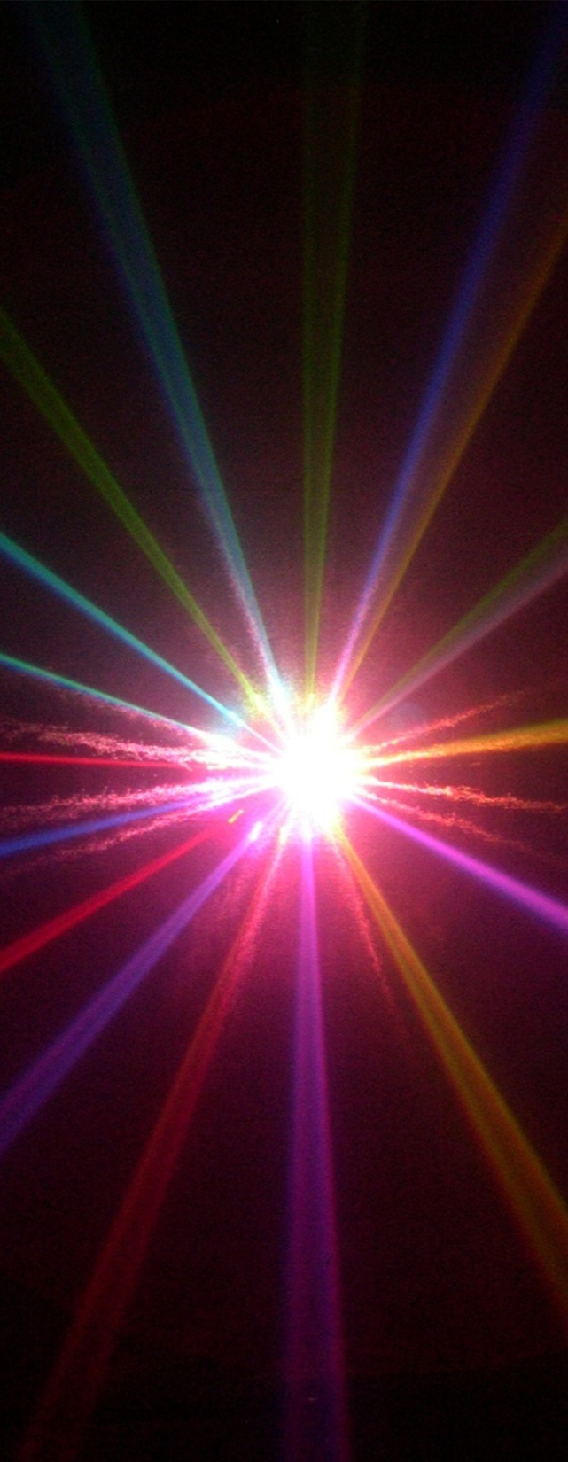
THE FIRST DAY
GENESIS 1:1-5
1 In the beginning God created the heavens and the earth. ² The earth was without form, and void; and darkness was on the face of the deep. And the Spirit of God was hovering over the face of the waters.
³ Then God said, “Let there be light”; and there was light. ⁴ And God saw the light, that it was good; and God divided the light from the darkness. ⁵ God called the light Day, and the darkness He called Night. So the evening and the morning were the first day.

Slide 7
THE FIRST DAY
GENESIS 1:1-5
Notes
1. The universe had a beginning and is therefore is not self existent.
2. All things begin with God, not with matter or mankind.
3. The first verse of the Bible states the basic elements of physics, time, force, space and matter.
4.The Hebrew word for “God” is “ELOHIM” which is the plural noun form, this is the first indication of Gods nature which becomes more clear as the record unfolds.

Slide 8
THE FIRST DAY
GENESIS 1:1-5
5.The phrase “evening and the morning “ defines each day of creation, the Hebrew word “YOM” always means a 24 hour day when accompanied by a number.
6. God is the only one in a position to know what was done before mankind was created, this point is made in Job 38 1-6
7. “and it was good” This is another phrase that occurs throughout the account, every thing that God does is good, goodness is an innate quality of God.

Slide 9
THE SECOND DAY
GENESIS 1: 6-8
⁶ Then God said, “Let there be a firmament in the midst of the waters, and let it divide the waters from the waters.”⁷ Thus God made the firmament, and divided the waters which were under the firmament from the waters which were above the firmament; and it was so. ⁸ And God called the firmament Heaven. So the evening and the morning were the second day.

Slide 10
THE SECOND DAY
GENESIS 1: 6-8
God continues to organize the inanimate materials that he created into the distribution required for life, the division of liquids and gases, the creation of the expanse of atmosphere and abundant liquid water being prepared for its inhabitance.

Slide 11
THE THIRD DAY
GENESIS 1: 9-13
⁹ Then God said, “Let the waters under the heavens be gathered together into one place, and let the dry land appear”; and it was so. ¹⁰ And God called the dry land Earth, and the gathering together of the waters He called Seas. And God saw that it was good.

Slide 12
THE THIRD DAY
GENESIS 1: 9-13
¹¹ Then God said, “Let the earth bring forth grass, the herb that yields seed, and the fruit tree that yields fruit according to its kind, whose seed is in itself, on the earth”; and it was so. ¹² And the earth brought forth grass, the herb that yields seed according to its kind, and the tree that yields fruit, whose seed is in itself according to its kind. And God saw that it was good. ¹³ So the evening and the morning were the third day.

Slide 13
THE THIRD DAY
GENESIS 1: 9-13
Notes
Immense amounts of water on the earth is one of the distinguishing features of our planet. 70 percent of the earths surface is water and is one of the essential elements of life.
2. Water absorbs enormous amounts of heat, keeping the earth relatively cool during the day and by releasing the stored heat at night water acts as a temperature stabilizer.

Slide 14
THE THIRD DAY
GENESIS 1: 9-13
Immergence of the dry land prepared the earth to be clothed with colorful and vibrant plant life whose seed was in itself. God made each plant with the genetic code encapsulated in its seed to reproduce after its own kind.
The plant life on earth set the stage for the entire interdependent ecology of the earth as God planned for the provision of all life as he made it.
5. There is no long, gradual, naturalistic process described here, rather everything God does is perfect from the beginning. (Psalms 33:9)

Slide 15
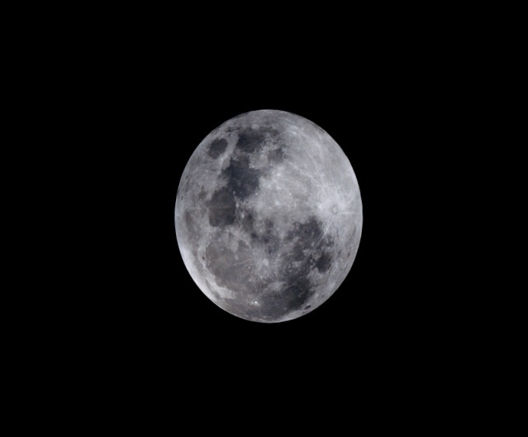
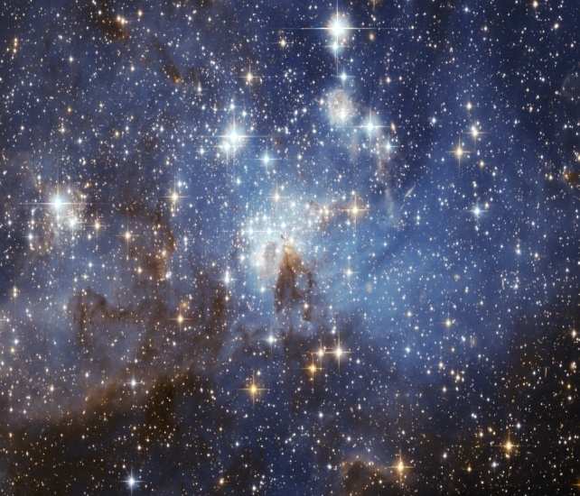
THE FORTH DAY
GENESIS 1: 14-19
¹⁴ Then God said, “Let there be lights in the firmament of the heavens to divide the day from the night; and let them be for signs and seasons, and for days and years; ¹⁵ and let them be for lights in the firmament of the heavens to give light on the earth”; and it was so.

Slide 16
THE FORTH DAY
GENESIS 1: 14-19
¹⁶ Then God made two great lights: the greater light to rule the day, and the lesser light to rule the night. He made the stars also. ¹⁷ God set them in the firmament of the heavens to give light on the earth, ¹⁸ and to rule over the day and over the night, and to divide the light from the darkness. And God saw that it was good. ¹⁹ So the evening and the morning were the fourth day.

Slide 17
THE FORTH DAY
GENESIS 1: 14-19
Notes
1.The light that God created on the first day was apparently coming from one source and the earth was rotating underneath it causing alternating periods of light and dark from earths vantage point which is the location of the narrative given. The first Hebrew word translated light in our English versions indicate a presences of light while the light in Day 4 is a different Hebrew word that could be translated “, light bearers”.

Slide 18
THE FORTH DAY
GENESIS 1: 14-19
Notes
2.The original presence of light was separated into the sun, moon ( reflected light ) and stars, not only for light purposes but apparently for gravitational pull, heavenly structures, and also time keepers for mankind.

Slide 19
THE FORTH DAY
GENESIS 1: 14-19
Notes
3. Keep in mind that creation is a one time, unrepeatable, supernatural event. Some who try to find eons of time per day in a naturalistic interpretation of this account, should consider that the ecology of the entire planet depends on the interrelated systems that make it function so that one cannot exists with out the other, a few normal days are not a problem in this regard, but many years would be.

Slide 20
THE FORTH DAY
GENESIS 1: 14-19
Notes
4. It was Gods awesome power that placed in space the constellations and galaxies without number at distances no man can fathom, the sun and moon at exactly the right size and distance from the earth and the earth itself, an oasis in the desert, specially equipped to sustain life with light, heat, air, water and food.

Slide 21
THE FIFTH DAY
GENESIS 1: 20-23
²⁰ Then God said, “Let the waters abound with an abundance of living creatures, and let birds fly above the earth across the face of the firmament of the heavens.” ²¹ So God created great sea creatures and every living thing that moves, with which the waters abounded, according to their kind, and every winged bird according to its kind. And God saw that it was good. ²² And God blessed them, saying, “Be fruitful and multiply, and fill the waters in the seas, and let birds multiply on the earth.” ²³ So the evening and the morning were the fifth day.

Slide 22
THE FIFTH DAY
GENESIS 1: 20-23
Notes
1.God creates living creatures that move both great and small filling the waters beneath and the sky's above with abundant life.
2. Each “after their kind”. Again God made all kinds complete and perfect from their beginning. This is not a hit and miss experiment of chance, but rather each of the myriads of complex swimming and flying creatures were an intentional, individual design of God.

Slide 23
THE FIFTH DAY
GENESIS 1: 20-23
Notes
3. Each of Gods creatures were made to reproduce after their own kind, most require both male and female of each kind which usually appear very similar on the outside but are in fact very different on the inside, keep in mind that any incompleteness or incompatibility whether chemical, physical or mechanical within a kind would make both useless. There are millions of different kinds of both sea life and birds, even more then than there are now due to many extinctions since the creation.

Slide 24
THE SIXTH DAY
GENESIS 1: 24-31
²⁶ Then God said, “Let Us make man in Our image, according to Our likeness; let them have dominion over the fish of the sea, over the birds of the air, and over the cattle, over all the earth and over every creeping thing that creeps on the earth.” ²⁷ So God created man in His own image; in the image of God He created him; male and female He created them. ²⁸ Then God blessed them, and God said to them, “Be fruitful and multiply; fill the earth and subdue it; have dominion over the fish of the sea, over the birds of the air, and over every living thing that moves on the earth.”

Slide 25
THE SIXTH DAY
GENESIS 1: 24-31
²⁹ And God said, “See, I have given you every herb that yields seed which is on the face of all the earth, and every tree whose fruit yields seed; to you it shall be for food. ³⁰ Also, to every beast of the earth, to every bird of the air, and to everything that creeps on the earth, in which there is life, I have given every green herb for food”; and it was so.³¹ Then God saw everything that He had made, and indeed it was very good. So the evening and the morning were the sixth day.

Slide 26
THE SIXTH DAY
GENESIS 1: 24-31
Notes
1.Large categories of extremely complex and diverse land creatures are summed up very briefly in these few verses. God is the master of the understatement, this deliberately restrained manner of writing is part of the extraordinary character of the Bible. Innumerable books have been written over the course of thousands of years describing and examining the wonders of creation, the Bible takes only 31 verses to tell who did it, what was done, in what order it was done, and how long it took to do it.

Slide 27
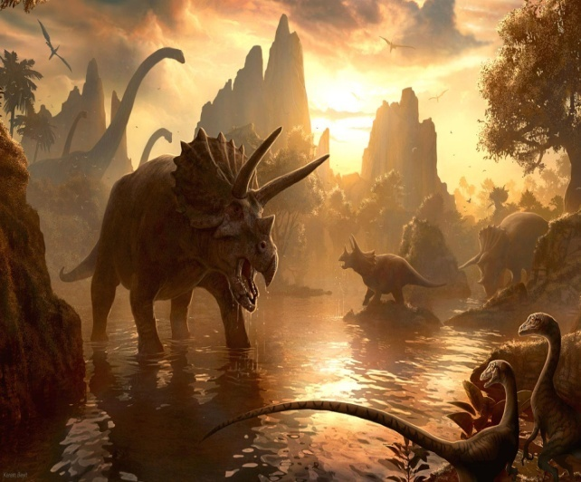
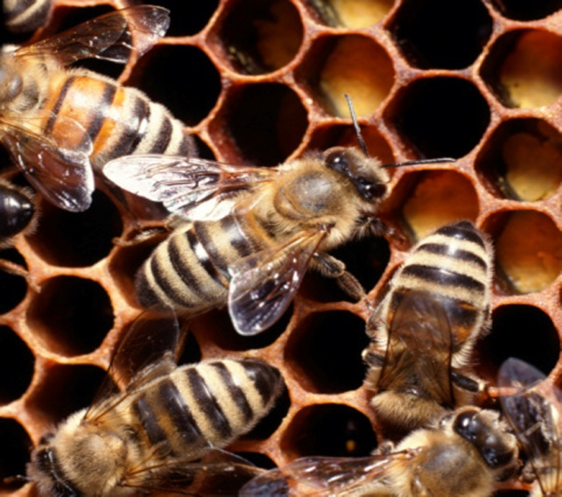
THE SIXTH DAY
GENESIS 1: 24-31
Notes
2. Again every “kind”, was distinct from the beginning and was created with its mate and it was good.
3.Everything from the micro-biotic world up to the largest of dinosaurs are included in these short phrases, “creeping things and beast of the earth,” there is no time separation between any of the land animals, they were all made in one day.

Slide 28
THE SIXTH DAY
GENESIS 1: 24-31
Notes
4. Keep in mind that God is not limited by time like we are, he created time for mankind but he is outside of time. The scripture says that “ one day is with the Lord as a thousand years, and a thousand years is as a day”( II Peter 3:8). That’s why he is God and He is due our most diligent pursuit and study.

Slide 29
THE SIXTH DAY
GENESIS 1: 24-31
Notes
5. “And God (plural form Elohim) said, Let us make man in our image , after our likeness…” As we study who God is, this verse gives us an obvious declaration by way of a conversant agreement, that there is more than one person in the Godhead, His nature will continued to be revealed all the way to the end of the Bible.

Slide 30
THE SIXTH DAY
GENESIS 1: 24-31
Notes
6.God has “made all things beautiful in his time”, as Ecclesiastes 3: 11 says, but Adam and Eve ( mankind) are the pinnacle of his creation in intellect and creativity, in consciousness, in beauty, in emotion, in will, in short in the likeness of his Creator and bearing the unmistakable stamp of His personality.

Slide 31
THE SIXTH DAY
GENESIS 1: 24-31
Notes
7. Notice that the first chapter of the Bible makes sense, it begins at the beginning and is a reasonable explanation for our existence here on earth and can be understood and compared to the physical facts as we observe them in our life times.
8. The creation with all its beauty and complexity is the clearest proof and most concrete evidence of the existence of the eternal God.

Slide 32
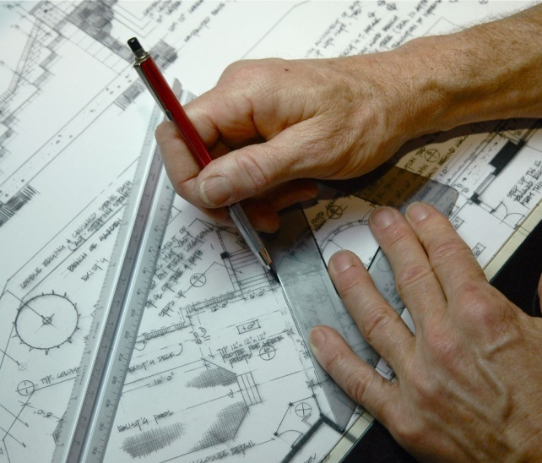
THE SIXTH DAY
GENESIS 1: 24-31
Notes
9. Everything has an origin and maker, there are no exceptions.
Hebrews 3:4 For every house is built by someone, but He who built all things
is God. The Bible makes sense! No house can build itself, someone has to design it, gather the materials and then construct it piece by piece. Everybody recognizes that this is the only way a house is going to come into existence. Something cannot come from nothing and it is clearly unreasonable, irrational, and unscientific to presume otherwise.

Slide 33
THE SIXTH DAY
GENESIS 1: 24-31
Notes
The understanding that God created the heavens and the earth as a one time unrepeatable event is consistent with what we know and can observe. We will see clearly how this is true when we study the evolutionary model of origins which is based on things we do not know and cannot observe in the real world.
Lets read a few more verses into chapter two to finish with the 7th day in this lesson.

Slide 34
22
THE SEVENTH DAY
GENESIS 2: 1-3
2 Thus the heavens and the earth, and all the host of them, were finished. ² And on the seventh day God ended His work which He had done, and He rested on the seventh day from all His work which He had done. ³ Then God blessed the seventh day and sanctified it, because in it He rested from all His work which God had created and made.

Slide 35
22
THE SEVENTH DAY
Notes
Notice that “ the heavens and the earth were finished”, and that God “ended” his work. Not only was everything made but also all of the laws of physics were put into place that govern the complex systems that perpetuate it.
2. God didn’t rest because he was tired, Isaiah 40:28 says “²⁸ Have you not known? Have you not heard? The everlasting God, the Lord, The Creator of the ends of the earth, Neither faints nor is weary. His understanding is unsearchable.

Slide 36
22
THE SEVENTH DAY
Notes
3. If there was ever any doubt that the six day creation account in Genesis 1 is intended to be understood literally, notice these passages where God is speaking to Moses and delivering to him the ten commandments.

Slide 37
22
THE SEVENTH DAY
Notes
Exodus 20:8-11 ⁸ “Remember the Sabbath day, to keep it holy. ⁹ Six days you shall labor and do all your work, ¹⁰ but the seventh day is the Sabbath of the Lord your God. In it you shall do no work: you, nor your son, nor your daughter, nor your male servant, nor your female servant, nor your cattle, nor your stranger who is within your gates. ¹¹ For in six days the Lord made the heavens and the earth, the sea, and all that is in them, and rested the seventh day. Therefore the Lord blessed the Sabbath day and hallowed it.

Slide 38
22
THE SEVENTH DAY
Notes
4. The seven day week which remains the standard of all the earth today has an origin outside of astronomical time markers such as days, months, and years have, not only this, but there is a common pattern of six working days and a day of rest. Every effect must have a cause, our seven day week is a living witness to the truth of the original creation week that established this pattern from the beginning.

Slide 39
22
MANKIND BEGAN WITH THE KNOWLEDGE OF GOD
Adam and Eve knew who their Creator was, but it didn’t take long for them or their generations after them to reject the God that made them. Soon after they were created, mankind began to imagine different gods that they then carved out of wood and stone after their own image and of the forms of the animals that God had created.

Slide 40
22
ROMANS 1:19-23,25,28
¹⁹ because what may be known of God is manifest in them, for God has shown it to them.²⁰ For since the creation of the world His invisible attributes are clearly seen, being understood by the things that are made, even His eternal power and Godhead, so that they are without excuse,

Slide 41
22
ROMANS 1:19-23,25,28
²¹ because, although they knew God, they did not glorify Him as God, nor were thankful, but became futile in their thoughts, and their foolish hearts were darkened. ²² Professing to be wise, they became fools, ²³ and changed the glory of the incorruptible God into an image made like corruptible man—and birds and four-footed animals and creeping things.

Slide 42
22
ROMANS 1:19-23,25,28
²⁵ who exchanged the truth of God for the lie, and worshiped and served the creature rather than the Creator, who is blessed forever. Amen.
²⁸ And even as they did not like to retain God in their knowledge, God gave them over to a debased mind, to do those things which are not fitting;

Slide 43
22
A MYTH TO LIVE BY
When we human beings decide that we don’t want to think about God, we are nevertheless still faced with the fact of our own existence along with all of the universe, so we must then invent some alternative reality or explanation to account for ourselves and our behavior, in other words, a myth to live by.

Slide 44
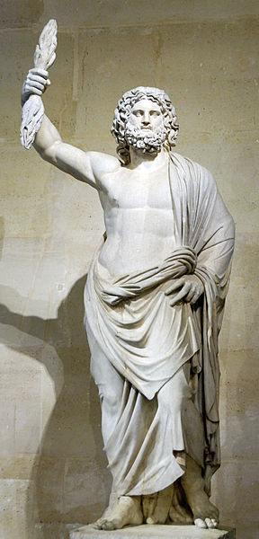
GODS OF THE ANCIENT WORLD
For thousands of years idols made of wood, metal, and stone took up the position that was rightly God’s . Idols like Ashtoreth , Baal, and Zeus were gods that were in many ways just like us with the same frailties and desires. That was characteristic of all the gods of the ancient world that mankind made to replace the one true God that they so quickly rejected.

Slide 45
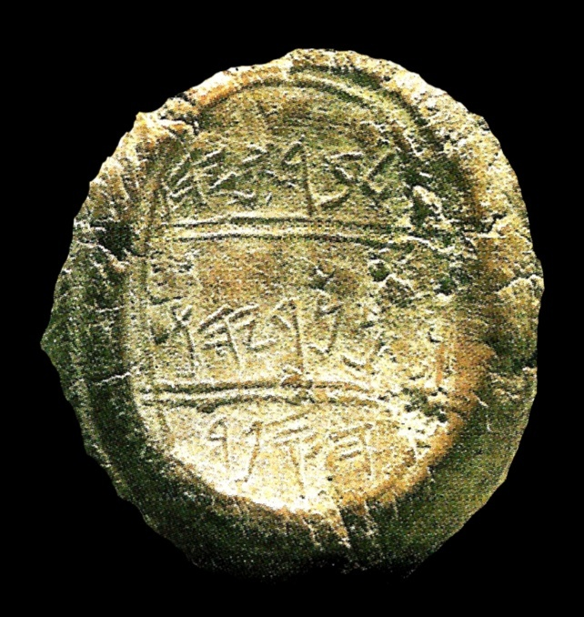
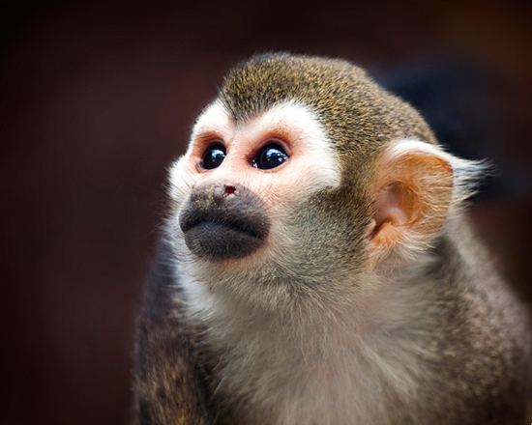
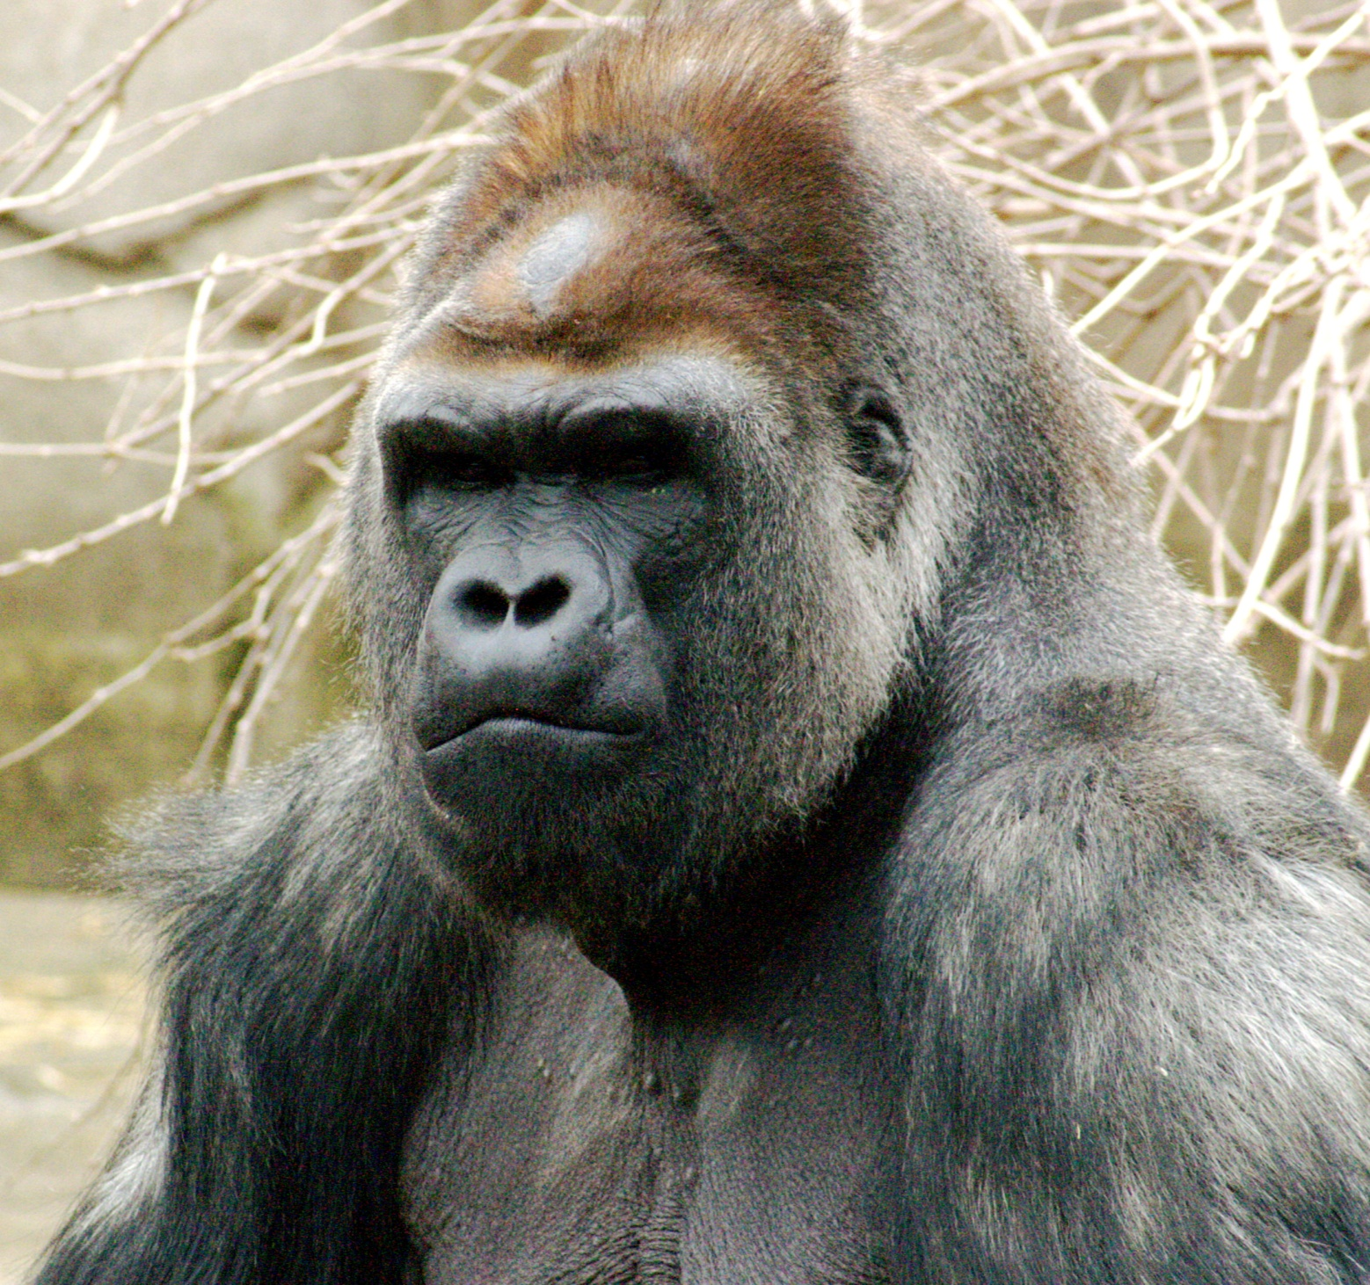
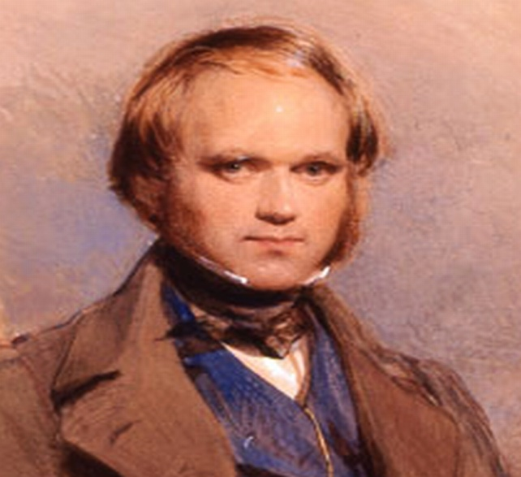
THE GOD OF THE MODERN WORLD
For over a hundred and fifty years now we’ve had a new alternative reality that has taken the place of those ancient, outdated idols of the past. Our new god is supposedly based on science and is espoused by the great intellects of our time and taught in universities the world over as well as public schools, nature programming ,and other popular media.
Our new god that answers all of the big questions in life is Darwin’s THEORY OF EVOLUTION.

Slide 46
EVOLUTION THEORY
Briefly stated, Evolution is the theory that millions of years ago, non-living matter acting upon natural forces gave origin to one or more living organisms which have since evolved into all living and extinct plants and animals including man.
Charles Darwin’s theory explained in his book , “The Origin of Species”, published in 1859, has since become the dominant world view concerning the origins of life, widely accepted as fact throughout the world.

Slide 47
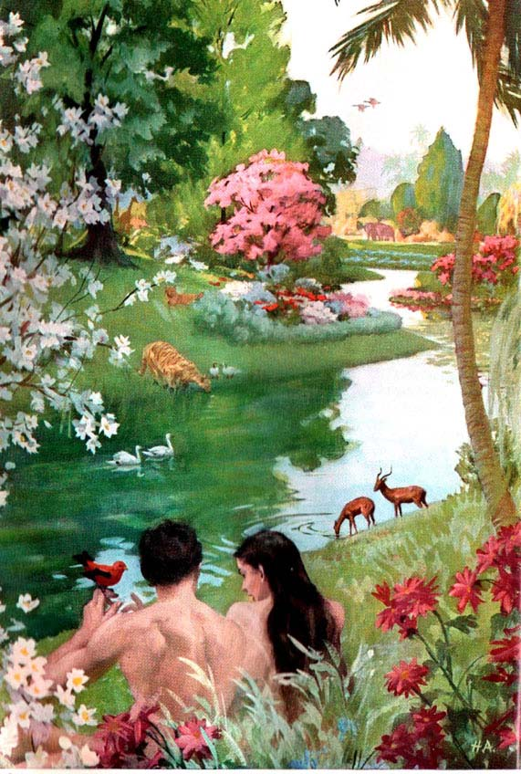
T WO CHOICES
There are really only two choices when it comes to the question of origins. Either we are the product of blind chance, otherwise known as “spontaneous generation”, or we were designed and created along with the rest of the universe with intention and purpose by an awesome and powerful God.

Slide 48
WHICH MODEL FITS THE FACTS ?
In the next few minutes we’ll try to take a very large and often complicated subject and condense it down to some basic concepts that show that the evolutionary model of origins does not fit the facts as found in the real world.
First lets break down the accepted definition of evolution into a brief phrase by phrase analysis.

Slide 49
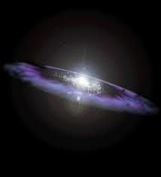
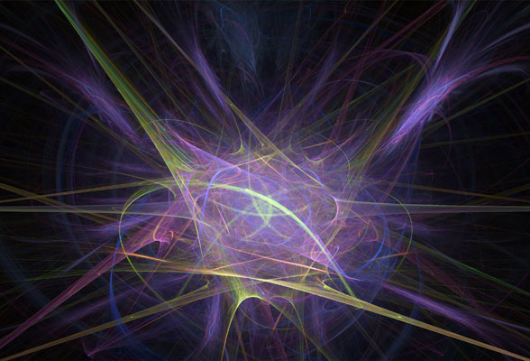
NON-LIVING MATTER
”Non-living matter acting upon natural forces “
1. Notice that the theory does not address the issue of the origins of matter, it is assumed to exist with little or no attempt to explain it, even the popular “Big Bang “ theory assumes the existence of matter even if it was, as proponents suggest, smaller than the period at the end of this sentence. What was it that supposedly exploded and became the entire universe?

Slide 50
NATURAL FORCES ?
2. There is no explanation for the source of the “natural forces “. A theory is only as good as the assumptions that it is founded on ,the entire theory of evolution begins and ends with assumptions upon which there is no supporting evidence. Non-living matter does not look for a way to improve itself, it does not think, design or plan, nor does it have any consciousness. Cosmic evolution is pre-supposed by biological evolution which is, as yet, unproven.

Slide 51
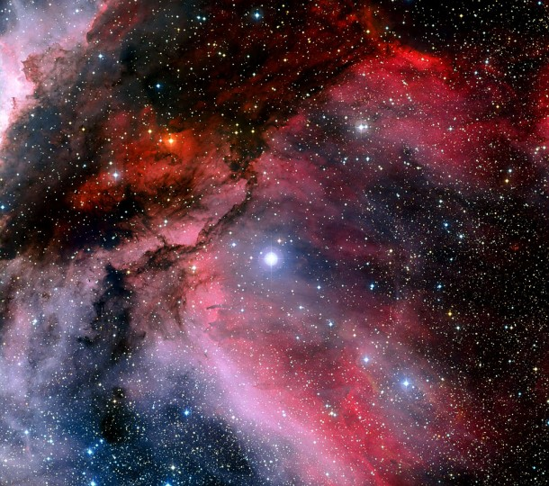
THERMODYNAMICS
The First and Second Laws of Thermodynamics show that the amount of matter in the universe is constant, however the energy in the universe is steadily decreasing because in all of the processes in which matter is being converted into other forms, some of that energy is being permanently lost, this is called the Law of Entropy. Like a wind-up clock that is running down, everything tends toward deterioration.

Slide 52
THERMODYNAMICS
In short, the universe is burning out, our sun and all other stars are consuming their chemical energy and transforming their mass into light and heat energy which cannot be converted back into solid forms. The universe is therefore winding down, which means there was a point in time in which it was wound up, which leads one to believe it was all created at one time.

Slide 53
FIRST LAW OF THERMODYNAMICS
( no new matter being added to the universe)
Long before these laws of physics were known and named by man, the Bible clearly described each.
GENESIS 2:1,2
2 Thus the heavens and the earth, and all the host of them, were finished. ² And on the seventh day God ended His work which He had done, and He rested on the seventh day from all His work which He had done.

Slide 54
SECOND LAW OF THERMODYNAMICS
( Everything tends toward disorder )
PSALM 102 : 25-27
²⁵ Of old You laid the foundation of the earth, And the heavens are the work of Your hands. ²⁶ They will perish, but You will endure; Yes, they will all grow old like a garment; Like a cloak You will change them, And they will be changed. ²⁷ But You are the same, And Your years will have no end.

Slide 55
TRUE SCIENCE AGREES WITH THE BIBLE AND DISAGREES WITH THE THEORY OF EVOLUTION
Again, these verses draw the sharp contrast between the two opposing models of origins. The Bible clearly shows, as do the laws of science, that matter and available energy in the universe are finite and therefore cannot be self existent nor eternal.
Something must be eternal in order for anything to exist, that something is not an impersonal comic energy that is formless and nameless but rather someone that you can come to know, even to his character and his name.

Slide 56
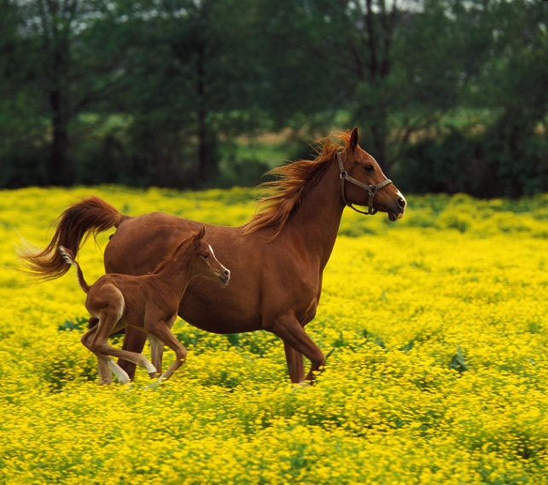
Next in our examination we have:
“NON-LIVING MATTER GIVING ORIGIN TO LIVING ORGANISMS”
1. For something to be truly scientific, by definition, it has to be observable and reproduced in experiments.
2. Something living has never been observed coming from non-living matter.
f
3. For every effect there must be a first cause, a prime mover. For example, every plant on earth today came from a seed, which in turn came from a parent seed, just as every living creature, whether mankind, animal, insect or single celled organism, all came from a parent stock, no exceptions.

Slide 57
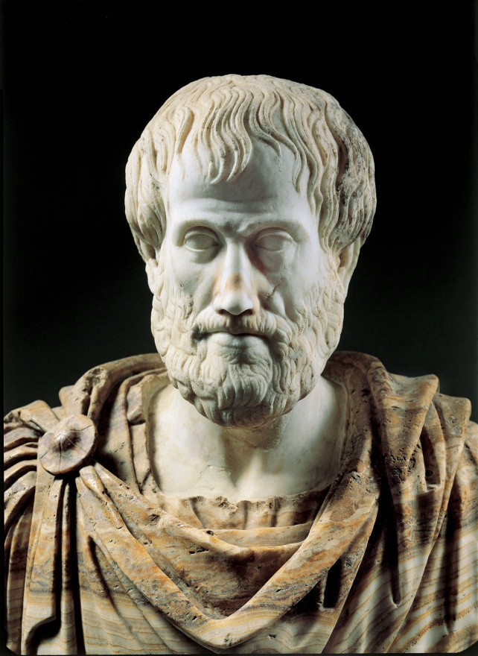
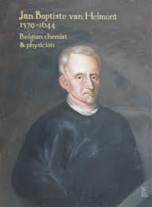
A BRIEF HISTORY OF SPONTANEOUS GENERATION
As far back as the famous Greek philosopher Aristotle, men believed that life simply sprang forth from various materials. In 330 B.C. Aristotle observed that meat, when allowed to decay, seemed to spontaneously generate maggots, this seemed reasonable in 330 B.C.
In the mid 1600’s , Jan Baptiste Van Helmont placed a sweaty shirt and grains of wheat in a wooden box as an experiment. In 21 days he discovered a mouse apparently gnawing out of the box, this observation seemed to confirm Aristotle’s conclusion and was so reported.

Slide 58
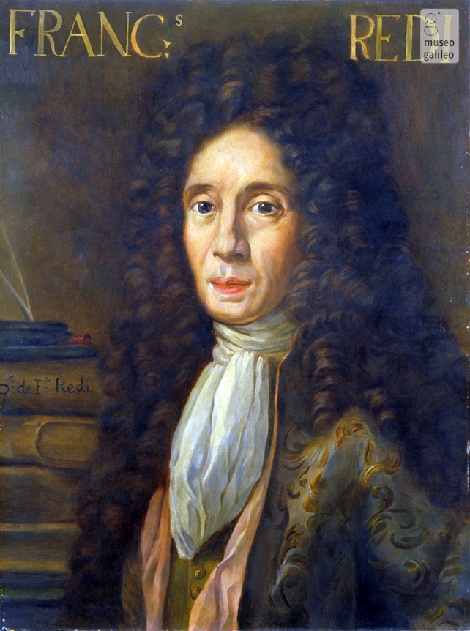
A BRIEF HISTORY OF SPONTANEOUS GENERATION
Francesco Redi, an Italian physician questioned the idea of “spontaneous generation”, saying that the materials would have to be isolated from the surroundings in order to have a valid outcome. He placed meat into sealed jars and allowed the meat to decay. No maggots formed nor did mice, although the meat did still spoil.
The scientist of the day said that it was only because the air supply was also cut off that no animals were produced in the jar.

Slide 59
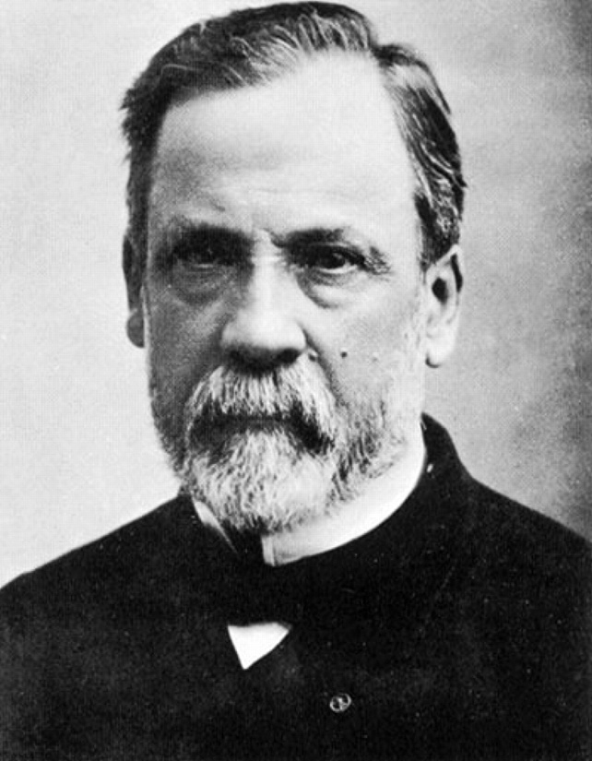
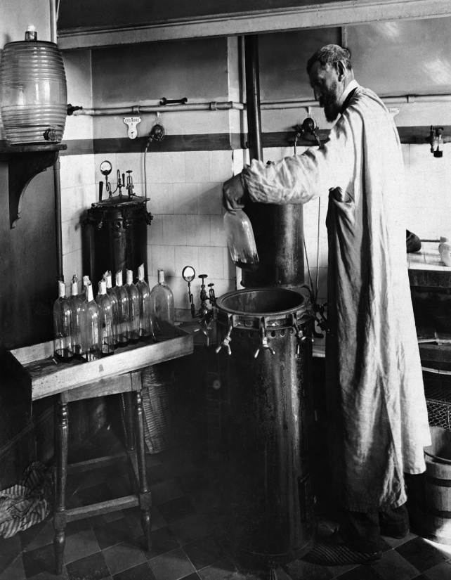
A BRIEF HISTORY OF SPONTANEOUS GENERATION
So the basic idea that creatures simply immerged into being from unrelated materials persisted for a couple of hundred years into the 1800s when Louis Pasteur finally demonstrated by his experiments that a sample material could be spoiled by air-born micro organisms.
Louis Pasteur showed conclusively that these invisible creatures were the cause of the decay and that there was nothing that, in reality, “spontaneously generated”.

Slide 60
SPONTANEOUS GENERATION PERSIST INTO DARWINS’ THEORY
In the 1800s the idea was still very prevalent and was integrated into Darwin’s theory of Evolution by which “simple” life forms are supposed to arise spontaneously from random chemical combinations.
Fast forward to today and what do you think is being taught throughout the world by those thought to be the smartest people on the planet, “spontaneous generation”. It has never been observed in the real world nor repeated in experiments and is therefore unscientific and yet believed and taught by many as though proven as fact.

Slide 61
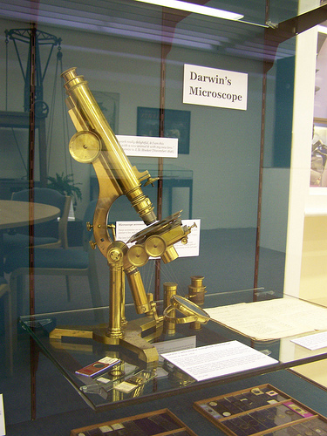
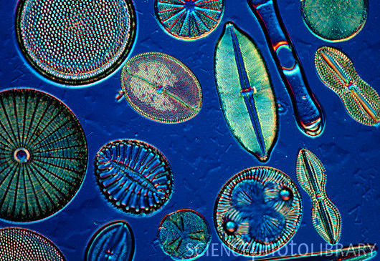
SPONTANEOUS GENERATION PERSIST INTO DARWINS’ THEORY
In the 1800’s Darwin assumed that small life forms were simple and large life forms were complex, in the 1800’s that seemed reasonable.
Evolution is supposed to start with single celled organisms and gradually develop into multi-celled organisms. By today's standards Darwin’s microscope was primitive, cells seemed little more than stains through his eyes, incapable of comprehending the complexity of the cellular, molecular, or chemical level of life.

Slide 62
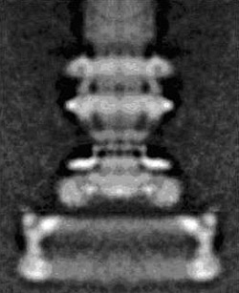
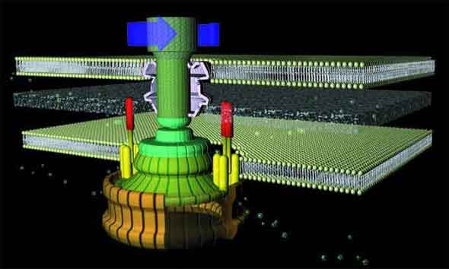
SPONTANEOUS GENERATION PERSIST INTO DARWINS’ THEORY
With today's electron microscope among other imaging tools we can now see these highly complex molecular machines in amazing detail. The single celled bacterial flagellum, for example, boast a rotary propeller and has the most efficient motor known to man. The filament rotates to 100,000 RPM’s, it can start or stop and go in forward and reverse, they are so small that 8,000,000 of them can fit in the cross section of a human hair. Needless to say, there are no “simple” life forms.

Slide 63
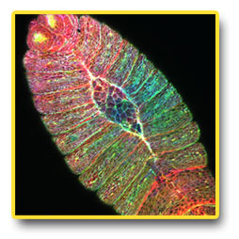
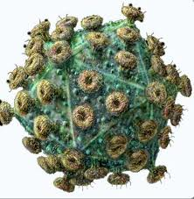
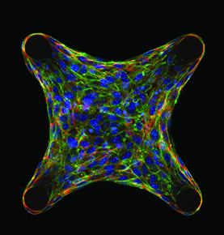
SPONTANEOUS GENERATION PERSIST INTO DARWINS’ THEORY
Here is the point, the smallest living things are extremely complicated designs which live, move, eat, and reproduce through complicated codes, that is, genetic information.
All human knowledge and experience tells us that complex coded information comes only from intelligence, never from blind chance. The theory of evolution does not and can not explain the source of this highly organized information that is inherent and obvious in the smallest of life forms.

Slide 64
Next in our examination we have:
“ LIVING ORGANISM EVOLVING INTO ALL LIVING AND EXTINCT PLANTS AND ANIMALS INCLUDING MAN”
This assertion contradicts the laws of science, genetics , biology, paleontology and numerous other disciplines.
f
The Law of Entropy which states that all things tend from order to disorder, to break down over time rather than build up, applies here. Evolution contradicts this well established law, the non-living become living and the living constantly add new information creating more and more complex life, from no knowledge or will.

Slide 65
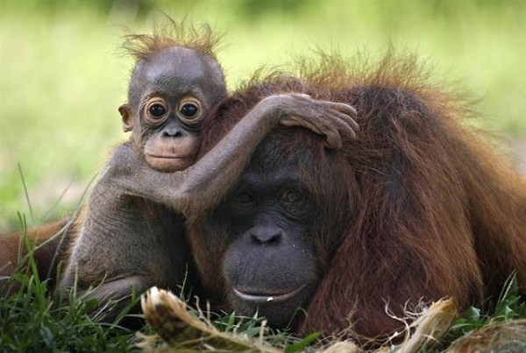
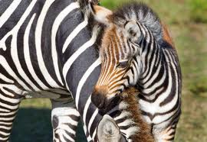
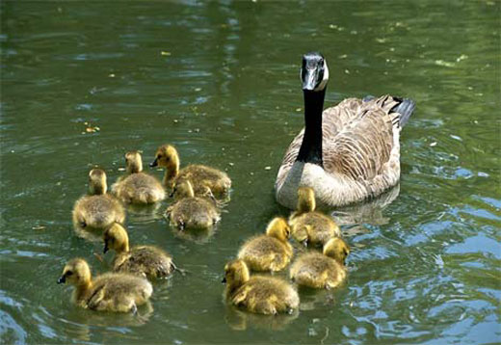
NEW SPECIES EVOLVING?
One species evolving into a new and different species contradicts the Law of Bio-genesis which states that life only comes from life like itself, or in the words of Genesis 1, “after its own kind”.
Again the Genesis account is in perfect agreement with the facts as found in the real world, evolution is not. There are limited variations within the genetic code of each kind which was designed to promote the adaptability and survival of each kind, but one kind never becomes another kind.

Slide 66
NEW SPECIES EVOLVING?
Notice these Bible verses from;
1 CORINTHIANS 15:38,39
³⁸ But God gives it a body as He pleases, and to each seed its own body.
³⁹ All flesh is not the same flesh, but there is one kind of flesh of men, another flesh of animals, another of fish, and another of birds.
Different kinds of plants and animals are extremely well defined and complete from the start, there is no evidence of gradual development either now or in the fossil record of the past, which leads us to the next subject for consideration.

Slide 67
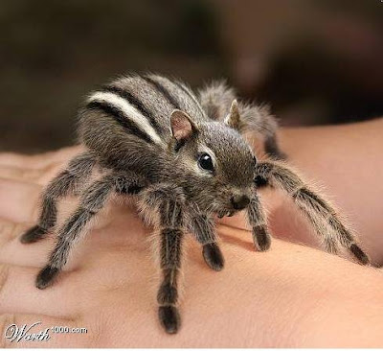
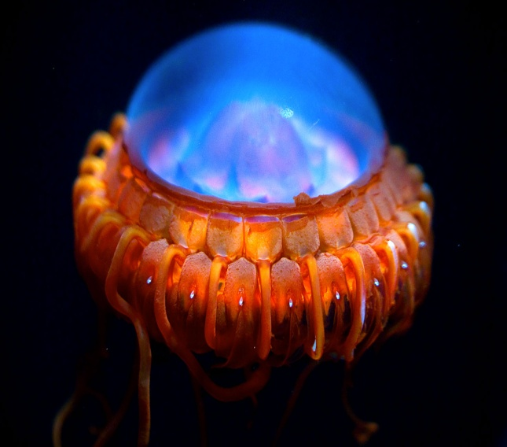
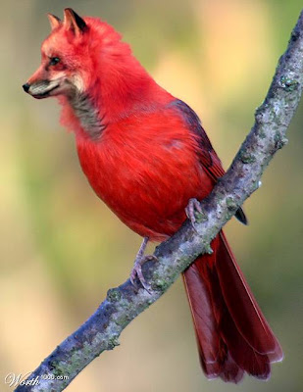
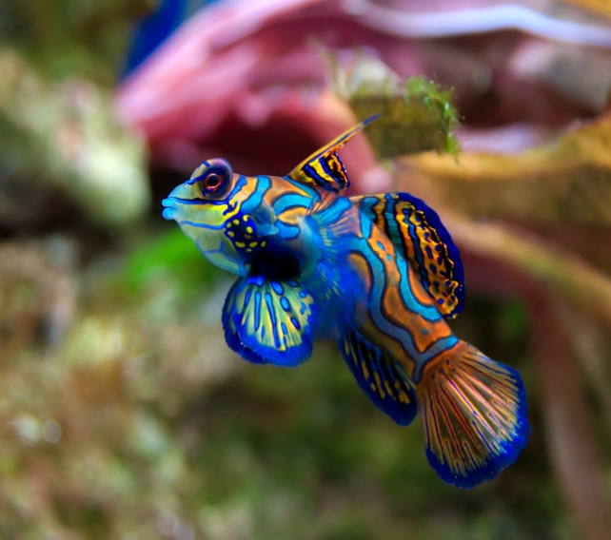
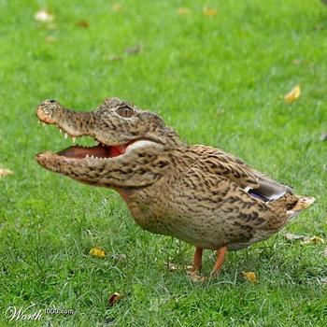
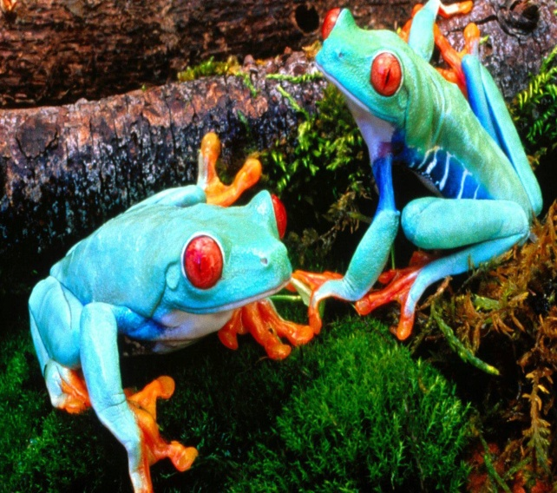
THE FOSSIL RECORD
The evidence that the evolutionists’ needs to establish his claims are fossils showing a gradual step by step development of single- celled organisms into larger multi-celled life forms. These fossils of transitional forms of life would be needed between every major plant and animal kind. Examples of these intermediate stages should be numerous if, as they claim, the process took millions of years.
When we compare the two models of origins to the facts as found in the real world, once again , the evidence between the two piles up neatly on one side.

Slide 68
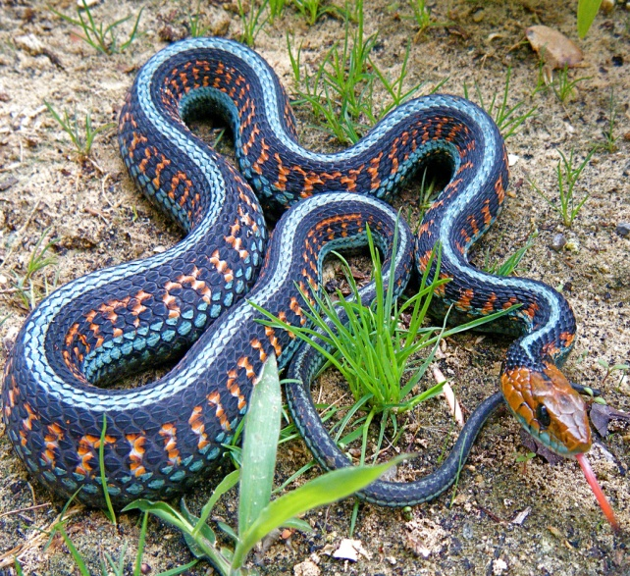
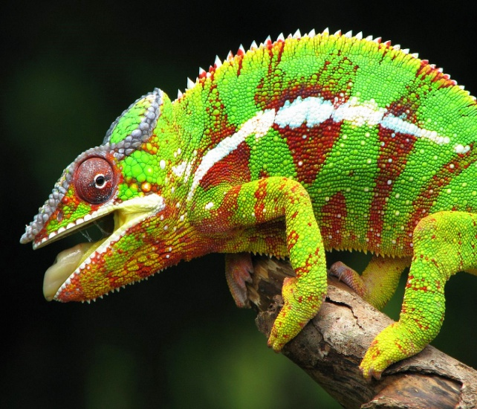
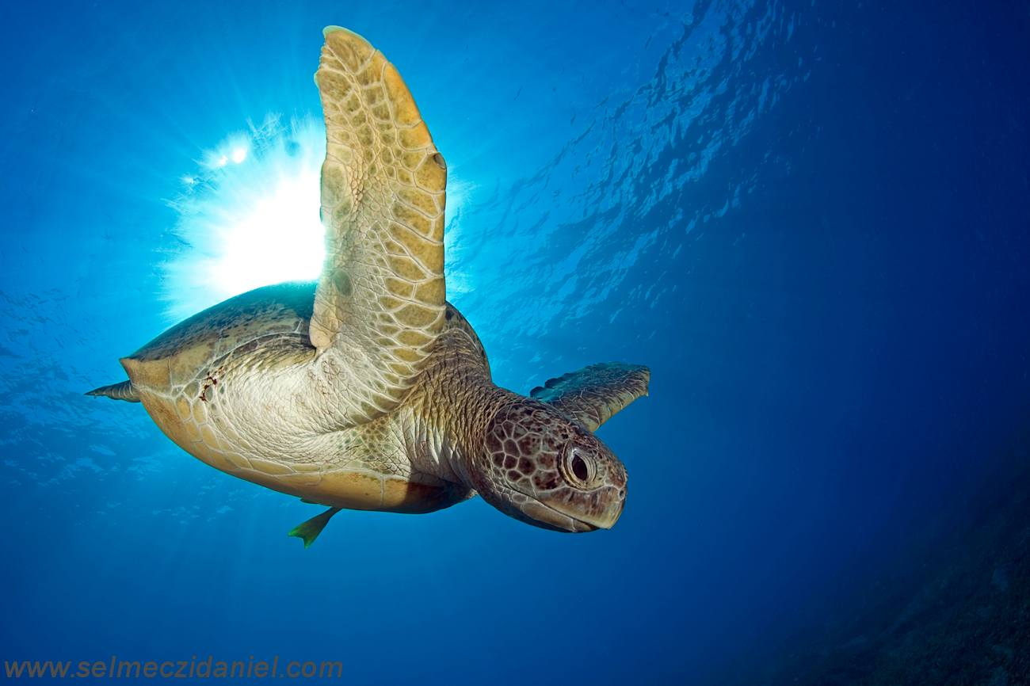
WHICH MODEL FITS THE FACTS ?
THE EVOLUTIONARY MODEL predicts innumerable transitional forms that link previous ones should be found in the fossil record. New kinds should be seen arising gradually showing incomplete bones and organs in transitional stages plus left over parts from previous stages.
THE CREATION MODEL predicts complex life forms appearing suddenly in the fossil record in great varieties with no linking forms and no incomplete bones or organs. Both living and extinct plants and animals should be well defined and complete.

Slide 69
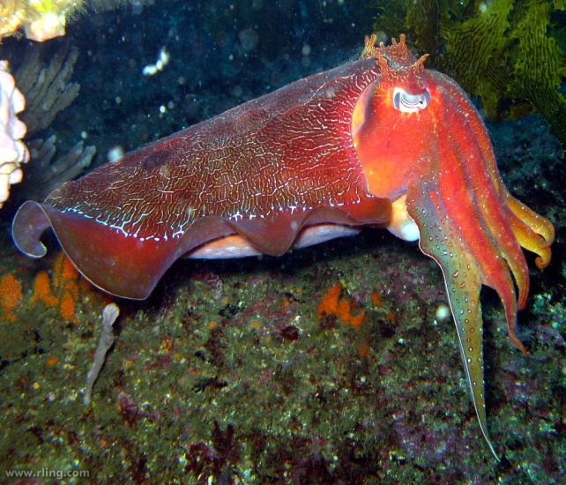
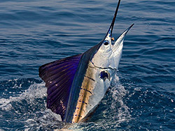
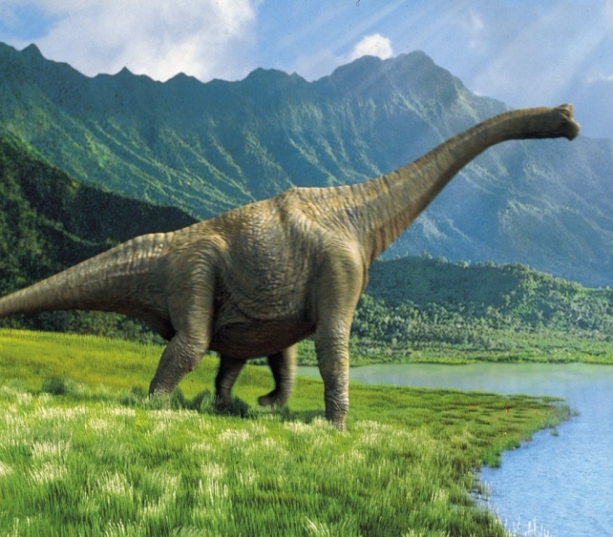
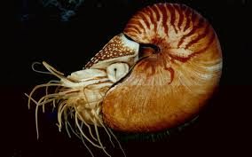
WHICH MODEL FITS THE FACTS ?
The fossil record settles the issue conclusively, it shows that all life forms appeared suddenly, very complex and fully developed with no left over parts.
The “missing link” that evolutionists have been searching for since the time of Darwin is still missing, in fact the whole chain is missing, not only between monkeys and men, but between every species in the micro-organism, plant, insect, invertebrate, vertebrate, fish, amphibian, reptile, bird, mammal and man kinds, not to mention extinct kinds like the dinosaurs which appear out of no where, nothing preceding them and nothing like them following, they're simply there.

Slide 70
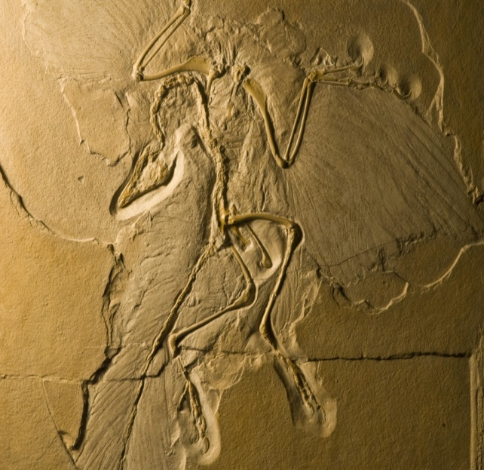
THE FOSSIL RECORD
Is this the missing link between reptile and bird? NO. This is a bird! The Archaeopteryx had wings, feathers, and it flew. Feathers are highly specialized structures that have a hook and eyelet design for the zippering and unzippering necessary for efficient flight, the Archaeopteryx feathers offer no clues as to how a reptile scale could evolve into a bird feather. The fact that it had claws on its wings doesn’t prove that it is of reptilian ancestry, so does the Ostrich and the Hoatzin but no one is claiming that they are “missing links”.

Slide 71
THE FOSSIL RECORD
To further widen the gap, consider that reptiles are cold blooded while birds are warm blooded, reptile bones are solid while birds are hollow, birds have different respiratory systems than any other animal, reptiles have five toes while birds have four, reptiles have a three chambered heart while birds have four, plus birds fly while reptiles don’t (flying is really hard and lizards don’t know how).
Beside of all of this, the living bird known as the Hoatzin shares many of the same qualities as the Archaeopteryx. Reptiles are reptiles and birds are birds and there is no evidence that one became another.

Slide 72
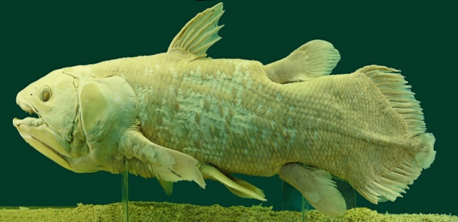
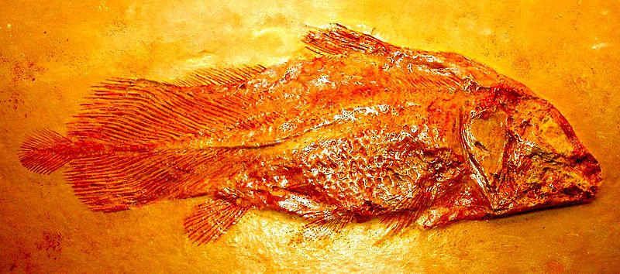
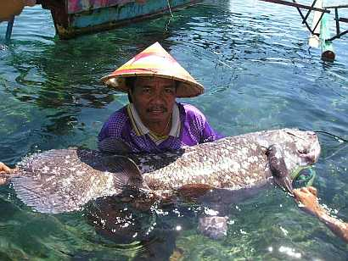
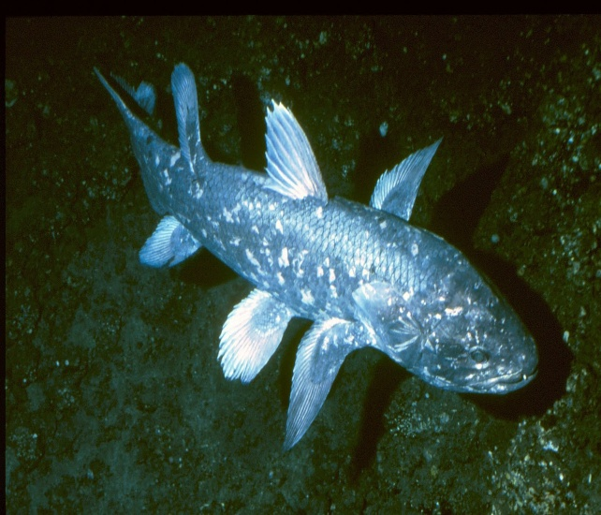
THE FOSSIL RECORD
Is this the missing link between fish and amphibian? NO. The Coelacanth is a fish! It has fins not feet, gills not lungs, swims doesn’t walk, has scales not skin, has a continuous backbone without a pelvis, unlike amphibians, has a two chambered heart rather than three as amphibians do and no elbow joint on any fin. Besides all of this, there is no difference between the supposed 400,000,000 year old fossils and the living Coelacanths caught regularly by fishermen, in other words, where’s the evolution? It is not in the fossil record.
The “missing link” that evolutionists have been searching for since the time of Darwin is still missing, in fact the whole chain is missing, not only between monkeys and men, but between every species in the micro-organism, plant, insect, invertebrate, vertebrate, fish, amphibian, reptile, bird, mammal and man kinds, not to mention extinct kinds like the dinosaurs which appear out of no where, nothing preceding them and nothing like them following, they're simply there.

Slide 73
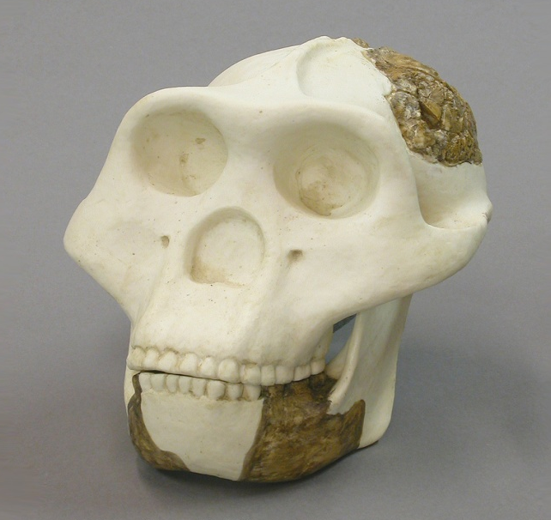
THE FOSSIL RECORD MONKEY TO MAN
Although it would take much time to do a thorough examination of each of the proposed links between apes and men, we can get a feel for this field of study with a brief review of the most popular candidates.
Is this the missing link between ape and man? NO. Based on a few teeth and jaw fragments, Ramapithecus was considered to be a man-like ape, Dr. Tolley has recently reported that a species of Baboon in Ethiopia has the same dental and jaw characteristics. Other anthropologist have agreed that Ramapithecus was simply an ape.

Slide 74
THE FOSSIL RECORD MONKEY TO MAN
Is this the missing link between ape and man? NO. These are the bone fragments of an ape! Found in 1924, Australopithecines where thought to have both ape and man like features. Dr Richard Leakey published evidence that indicated that they were long armed, short legged knuckle walkers very similar to living African apes. Don’t let the facts get in the way of a fertile human imagination.

Slide 75
THE FOSSIL RECORD MONKEY TO MAN
Is this the missing link between ape and man? NO. This is the knee bone of an extinct elephant! The race of java man was built from a leg bone three teeth and what was thought to be a skull cap found sixty feet apart where human sculls where also found. Newspapers announced, ”Perfect scull found of prehistoric man”, “Missing link found”, this was repeated in school text books. Thirty-two years later Dr. Alex Herdlicka exposed the “Perfect scull” to be the knee bone of an extinct elephant.

Slide 76
THE FOSSIL RECORD MONKEY TO MAN
Is this the missing link between ape and man? NO. This was the scull of a man! At the International Congress of Zoology,1958, Dr. A.J. Cave said that his examination showed the Neanderthal skeleton found in France was that of an old man who suffered from arthritis. Later Sir Fred Hoyle, paleontologist for Britain's Natural History Museum stated, “there is no evidence that Neanderthal man was in any way inferior to ourselves”.

Slide 77
THE FOSSIL RECORD MONKEY TO MAN
Is this the missing link between ape and man? NO. This is the scull of a man! One of the earliest and best established fossils, Cro-magnon man was at least equal in physique and brain capacity to modern man, … so what is the difference?

Slide 78
THE FOSSIL RECORD MONKEY TO MAN
Is this the missing link between ape and man? NO. This is a pigs tooth! At the famous Scopes trial in Dayton, Tennessee, the Nebraska man was presented by leading scientific authorities as proof of evolution. They scoffed and laughed at William Bryan when he protested at the scanty evidence. The evidence was that of a tooth that was supposed to have come from pre-historic man from which they built a whole race of man, being confident of where they lived and what they looked like. Years later, when more fossils were unearthed, Nebraska man turned out to be a pig.

Slide 79
THE FOSSIL RECORD MONKEY TO MAN
Is this the missing link between ape and man? NO. This was a hoax! In 1912 Charles Dawson brought forth the Piltdown man. A piece of a jaw, two teeth and a piece of scull was the evidence claimed by experts as that of an ape-man who was about 500,000 years old. But in 1953 the hoax was exposed. The jawbone was that of an ape, the teeth filed down and bones artificially colored to deceive the public. The ease with which this fraud fooled the world’s greatest authorities illustrates the powerful influence of preconceived ideas among evolutionist.

Slide 80
THE FOSSIL RECORD CONCLUTION
All of these supposed transitional forms were based on 98% (or more) imagination and wishful thinking, the evolutionists’ are grasping for straws to make their theory seem credible and forcing bone scraps to say what they refuse to say.
“Why if species have descended from other species by fine graduations, do we not see everywhere innumerable transitional forms? Why is all nature not in confusion instead of species being, as we see them, well defined” ? CHARLES DARWIN

Slide 81
THE FOSSIL RECORD
As a footnote to this section, evolutionist make much of the similarities between various creatures in such disciplines as Embryology, Homology, and Morphology, claiming that these likenesses show a common ancestry.
There are also similarities between different kinds of cars and trucks, that is because they are all designed to carry passengers on roads safely, that is why some parts are common to all of them.
So why are there some similarities between many animal species; because they were all designed to live on the same planet, breath the same air, eat the same foods and share the same resources.

Slide 82
All creatures that live on earth are designed for life on earth, although there are striking differences between species for which there are no transitional forms as previously observed. Similarities does not mean that life on earth has a single common ancestor but rather a single common Creator.
In reality, Darwin’s “ tree of life” is completely up-side-down, the numbers and diversity of life is not increasing but rather constantly decreasing. Each time the last specimen of a plant or animal dies on earth its unique DNA code is lost forever, never to return, this is what the fossil record shows, a steady decline in genetic information not a steady increase. Permanent extinction, no new kinds evolving.

Slide 83
THE FOSSIL RECORD A word about “ Theistic Evolution”
Many well meaning people attempt to unify the two opposing explanations of origins by interpreting the Genesis account of creation as figurative or symbolic. This idea makes as much sense as trying to unify Atheism and Theism, it is futile.
In Matthew 19 : 4 , Jesus affirms that Adam and Eve were made at the “beginning”, male and female, they did not come after millions of years of misfits!

Slide 84
THE FOSSIL RECORD A word about “ Theistic Evolution”
The Evolutionary model would also require millions of years of death and decay which the Bible clearly denies in Romans 5 : 12 “¹² Therefore, just as through one man sin entered the world, and death through sin, and thus death spread to all men, because all sinned—”
There is no way to harmonize these two opposing views, one is completely right and the other is completely wrong.

Slide 85
STILL REPRODUCING AFTER THEIR OWN KIND
You are not descended from a long line of misfits, you are descended from Adam and Eve and therefore made in the image of God!
MONKEY – GOOD MANKIND – GOOD HALF-MONKEY HALF-MAN – NOT GOOD, NOT FOUND!

Slide 86
THE TELEOLOGICAL ARGUMENT
If you were hiking through the woods and you saw a candy wrapper lying among the leaves, you would recognize instantly that this object was designed by a person somewhere, and also someone had been there before you arrived.
One of the reasons you would have identified the candy wrapper instinctively is because it is symmetrical, that is, the same on both sides, perhaps rectangle in shape with a printed pattern.

Slide 87
THE TELEOLOGICAL ARGUMENT
Would you have noticed that the leaves lying all around the candy wrapper were also symmetrical and required a designer that dropped them there before you arrived? That’s Teleology, the logical conclusion that design requires a designer and the greater the design, the greater the designer.

Slide 88
THE TELEOLOGICAL ARGUMENT
We all recognize design instinctively from childhood forward, but how?
The following is a list that is an intellectual rather than intuitive breakdown of design criteria that separates purposeful and intentional design from objects of random forms of matter, like the difference between a rock and an arrow head. One has no particular form whereas the other, although still a rock, was designed for a purpose.

Slide 89
DESIGN CRITERIA
An object that is IMPROBABLE, that is, outside of the laws of physical probability, exhibiting one or more of the following attributes.
Symmetry of form in size, shape, and position in relationship to an axis or center.
Coordination or organization of parts to form a whole unit.
Uniformity in style or repetition.
SPECIFICITY- information involved with an object that is outside the realm of chance occurrence.
Sequential specificity or well defined order.
Functional specificity or purpose.

Slide 90
THE TELEOLOGICAL ARGUMENT
DESIGN CRITERIA
The more complex the object, the more points of this list are demonstrated in the design, also, the greater the complexity of the design, the more remote the possibility it could have occurred by chance.
Lets look at a couple of manmade examples; first, an arrow. Even a young child can look at these three rocks and easily pick out which one has been altered from its natural form for a special purpose. Consider our checklist regarding an arrow.

Slide 91
DESIGN CRITERIA
Does it have symmetry?
As a complete arrow,(point, shaft and fletching), is there coordination of parts to form a whole?
Is there repetition?
Is there sequential specificity?
Is there functional specificity or purpose?

Slide 92
THE TELEOLOGICAL ARGUMENT
DESIGN CRITERIA
Note that the organization of parts multiplies nearly infinitely the improbability of an object occurring by chance. In this example, adding the bow that shoots the arrow as part of the coordination of components once again adds to the impossibility of chance occurrence.

Slide 93
THE TELEOLOGICAL ARGUMENT
DESIGN CRITERIA
The amount of information, skill and intellect required to achieve the simplest of human inventions is staggering when carefully considered. In this example a working knowledge of materials and their properties, weights, aerodynamics, tension and tools to name a few.
Remember that what we are testing here is whether or not these sample objects could be the result of chance random occurrence or could they only be the products of an intelligent designer and maker.

Slide 94
THE TELEOLOGICAL ARGUMENT
DESIGN CRITERIA
Consider one more manmade example.
DIGITAL VIDEO CAMERA
Is it simple or is it complex?
Remember that the greater the complexity of the object, the more remote the possibility that it could have occurred by chance.
Lets run the video camera through the same design test.

Slide 95
THE TELEOLOGICAL ARGUMENT
DESIGN CRITERIA
Does it have elements of symmetrical form?
Does it have organization and coordination of parts?
Does it have uniformity of style or repetition?
Is there specific information within the object?
Is there a well defined order within the object?
Does it have a specific function or purpose?

Slide 96
THE TELEOLOGICAL ARGUMENT
DESIGN CRITERIA
Much more detail could be given in describing the inner workings of a video camera but, in your opinion, is there any possibility that a video camera could come into existence by blind chance?
Here is another question, if all of the individual parts of the video camera were placed in a shoe box and shaken randomly for a thousand years could this video camera reassemble itself by chance?
What if it was shaken for a million years?
What if it was shaken for a billion years?

Slide 97
THE TELEOLOGICAL ARGUMENT
(A note about time)
The point is that even if the matter exist and all of the parts are there, there is nothing magical about time that can design, organize and assemble even the simplest of objects much less those of great complexity. There is an automatic assumption in evolutionary ideology that something mysterious and grand happened in the past that is not happening in the present but immense faith is given to time to cover these miraculous events of the past with little need to explain it in the present.

Slide 98
THE TELEOLOGICAL ARGUMENT
(A note about time)
Time is the hopeful god of the evolutionist, if you remove the element of time then the absurdity and impossibility of the theory is clearly revealed.
Mutation and natural selection are typically sited as the mechanisms for evolution but these require already existing complex living organisms to mutate or select from. The survival of the fittest has nothing to do with the arrival of the fit for which the theory gives no rational cause .

Slide 99
THE TELEOLOGICAL ARGUMENT
(A note about time)
For the evolutionists, time is the magic potion that is supposed to solve all of the innumerable problems with the theory. Time is the great creator, (god), that brings about innumerable galaxies from an invisible and unknowable “infinitely small” dot, (their words not mine), creating order from chaos, life from non-life, increase of genetic information from no knowledge and complexity and diversity from no designer .

Slide 100
THE TELEOLOGICAL ARGUMENT
DESIGN CRITERIA
Now back to design criteria.
We’ll consider just one example from life that we’re all familiar with.
The digital video camera that we’ve just looked at is the closest manmade object comparable to our next examination. Can you guess what it is?

Slide 101
THE HUMAN EYE
For the sake of time, the most abbreviated description is given in the following slides for our purposes.
First, the job of the eye is to condense and convert light waves from the outside world into electro-chemical connections in the back of your brain, the visual cortex, and thereby produce a full color, sharp focus, moving picture inside our heads. How does it do it?

Slide 102
THE HUMAN EYE
The Cornea begins the process of refracting light waves , it is the first lens of your eye and is a precise shape that is maintained by a pressurized fluid called the Aqueous Humor. The Cornea and the whites of your eye are constantly washed with a special anti-bacterial fluid produced by special glands and distributed by involuntary blinking to prevent infection.

Slide 103
THE HUMAN EYE
The colored part of your eye, the Iris, is a self adjusting aperture which automatically opens or closes using tiny muscles that are composed in both a radiant form for opening and a circular form for closing, this also happens automatically while maintaining a perfect circle to allow just the right amount of light in. This function is controlled by a network of light sensitive cells that react instantly to changing conditions.

Slide 104
THE HUMAN EYE
Behind the Iris is the second lens that refines and finishes the job of refracting light waves to focus on things near or far away. This transparent lens is suspended in exactly the right place by a myriad of microscopic, clear ligaments that stretch or condense the lens form for sharp focus in varying distances instantly and again automatically, you have no awareness of it happening.

Slide 105
THE HUMAN EYE
The light waves pass through another pressurized, transparent, gel-like substance called the Vitreous Humor which helps to hold the precise shape of the eye so that there is no distortion as the image crosses and lands up-side down on the perfectly curved back of the eye called the Retina.

Slide 106
THE HUMAN EYE
In the analogy of the camera, the Retina is like the digital back of the camera with all of its light receiving pixels.
The multi-layered Retina is filled with precisely arranged photo receptor cells that perceive both black and white, (Rods), and color, (Cones), light waves. There are about 375 million of these rods and cones, needless to say any digital camera would be envious of such high definition!

Slide 107
THE HUMAN EYE
All of these photo receptor cells are attached to optic nerve fibers that bundle into the central optic nerve which is positioned slightly low on the sphere of the Retina to avoid a potential blind spot in your vision.
The Macula is a special place positioned within the center of your field of vision that is highly packed with Rods and Cones and at the center of the Macula is the Fovea where the Rods thin out completely and a dense concentration of Cones create the sharpest focus area of your vision.

Slide 108
THE HUMAN EYE
We haven’t even touched on the chemistry of vision wherein there is a cascade of chemical processes difficult to describe or imagine, and besides all of this our knowledge of what happens in the visual cortex of the brain where all of those millions of bundled nerve fibers are redistributed into precise destinations remains a mystery.

Slide 109
IS IT SIMPLE OR IS IT COMPLEX?
The fact that the eye meets the design criteria is obvious, there is symmetry, coordination of parts, repetition, specific information, sequential specificity and purpose.
If we can discern intellect, planning, and design in an arrowhead or a camera, how is it that we can fail to recognize it in something infinitely more complex and living?

Slide 110
IS IT SIMPLE OR IS IT COMPLEX?
This is an insurmountable problem for the evolutionist because there are no simple eyes in any creature, just as there are no simple living creatures.
All creatures that have eyes, have eyes that are custom made for their particular needs, the differences in eyes shows clearly that they did not “evolve” from a common eye. Housefly eyes are best for houseflies, hawk eyes are best for hawks, squid eyes are best for squids, and human eyes are best for humans.

Slide 111
IS IT SIMPLE OR IS IT COMPLEX?
Just as there are different kinds of cameras designed for different needs, we would never conclude that because there are different kinds of cameras, none were designed! This thinking is ridicules , just as evolutionary explanations are ridicules.
Notice that we keep saying “eyes” not “eye”. If it is impossible to get one eye from blind chance, two identical eyes evolving in the same head for every species on earth multiplies infinitely the odds against it!

Slide 112
IS IT SIMPLE OR IS IT COMPLEX?
Our two eyes move in tandem together perceiving exact distances such as you need to thread a needle.
What about the possibility of one ear, which is equally as complex as one eye evolving by blind chance in the same head for every species on earth, and then another identical ear, every tiny complex part reversed, evolving by blind chance on the other side. Are you beginning to see the absurdity of this scenario? Right eye left eye, right ear left ear, right hand left hand, right foot left foot, every bone, muscle, vein, etcetera, perfectly mirrored.

Slide 113
IS IT SIMPLE OR IS IT COMPLEX?
You can see why evolutionists continue to conveniently overlook these facts, these facts are impossible to reconcile by any naturalistic approach to origins.
Lets compound some more problems by noting that eyes cannot function by themselves, they must have the brain to interpret; but the brain cannot function by itself, it must have oxygen provided by the lungs; but the lungs cannot function by themselves, they must have the heart to distribute the oxygen and nutrients throughout the body etc.

Slide 114
IS IT SIMPLE OR IS IT COMPLEX?
The simple fact is that unless the whole body is complete, with the organs and all of the complex systems of the human body existing and functioning, nothing works, because the systems of the body are inter- dependant, not independent. This is true not only of the human body but of every other body that exist now and has existed in the past. The same principle is true of the entire ecology of the earth, the life that exist here is interdependent , not independent.

Slide 115
IS IT SIMPLE OR IS IT COMPLEX?
Do you think it’s reasonable to believe that the undirected element of chance chemical combinations could have ever created the individually complex components of your body as well as assembled them together in their precise order to produce such a marvel as your body? The theory of evolution says it’s reasonable and it happened, all by itself.

Slide 116
FEARFULLY AND WONDERFULLY MADE
Here’s the truth, you are fearfully and wonderfully made by the Creator of all the universe who wants you to get to know Him through his inspired Word.
Unfortunately, many people relinquish their thinking to the “ experts “ when it comes to theoretical science, they assume others know more about it and therefore common sense has no legitimate place in the discussion of origins.

Slide 117
FEARFULLY AND WONDERFULLY MADE
Let us not become so open-minded that our brains fall out! The Bible says that it is a fool who says in his heart, there is no God, (Psalm 14:1), and that there would be oppositions of science, falsely so called,( 1 Timothy 6 : 20, 21) , and that mankind would become futile and foolish in their thoughts while at the same time professing themselves to be wise and then exchange the truth of God for a lie and worship and serve the creature rather than the Creator because they did not like to retain God in their knowledge,( Romans 1: 21- 28 ).

Slide 118
“IN THE BEGINNING GOD CREATED THE HEAVENS AND THE EARTH”
The truth about origins cannot be determined independent of Gods revealed Word. No matter how much money is spent, intellects applied, larger telescopes and finer microscopes constructed, mankind, left to himself, will never know the origin of the universe. The proof of this assertion is found in the dead- end, out-dated, unscientific, irrational, delusional theory of evolution that no evidence supports but that the whole world seems committed to believe, even though it most likely that Charles Darwin himself would reject if he knew what we know today.

Slide 119
Today’s evolutionary scientist should learn to be at least as skeptical as their founder and allow the facts to dictate their conclusions rather than being bogged down by preconceived ideas that have long since been proven wrong.
Our Creator sized up such foolish men by the prophets long ago, consider their words.
“ Hear, O heavens, and give ear O earth! For the Lord has spoken: I have nourished and brought up children, and they have rebelled against Me; The ox knows its owner and the donkey its master’s crib; but Israel does not know, My people do not consider.” Isaiah 1:2-3

Slide 120
Isaiah 29 : 14-16 ...For the wisdom of their wise men shall perish, And the understanding of their prudent men shall be hidden.”
¹⁵ Woe to those who seek deep to hide their counsel far from the Lord, And their works are in the dark; They say, “Who sees us?” and, “Who knows us?” ¹⁶ Surely you have things turned around! Shall the potter be esteemed as the clay; For shall the thing made say of him who made it, “He did not make me”? Or shall the thing formed say of him who formed it, “He has no understanding”?

Slide 121
Psalm 100 : 3-5
³ Know that the Lord, He is God; It is He who has made us, and not we ourselves; We are His people and the sheep of His pasture.
⁴ Enter into His gates with thanksgiving, And into His courts with praise. Be thankful to Him, and bless His name. ⁵ For the Lord is good; His mercy is everlasting, And His truth endures to all generations.

Slide 122
Proverbs 1 : 7
⁷ The fear of the Lord is the beginning of knowledge, But fools despise wisdom and instruction.

Slide 123
THE PHILOSOPHY OF EVOLUTION
As we have seen, belief in the Creator is based on what we do know while evolution is based on what we do not know, in other words, ignorance.
At its core, Evolution is not as much a science as it is a philosophical system. It is a religion, more accurately, that places mankind in the center of the universe as the most highly evolved creature on the evolutionary tree.
And so, if man is the measure of all things, there are no limits to the perverted philosophies, attitudes, and behaviors to which mankind can descend.

Slide 124
THE PHILOSOPHY OF EVOLUTION
Selective breeding of man, infanticide, moral relativism, situational ethics, changing definitions of what is right and wrong are but a few of the natural consequences of this teaching.
How would the philosophy of social Darwinism answer the big questions that we posed earlier in the lesson?
1. Who am I ? ( What am I worth ?) Answer; Nothing. You are randomly assembled bits of protoplasm, a problem for the environment, a drain on resources, you are overpopulating the planet and therefore an undesirable intruder on earth.

Slide 125
THE PHILOSOPHY OF EVOLUTION
2. Where did I come from ? You are the product of self existent matter that , over billions of years of random clashes with other matter resulted in a thing that eats, moves, and reproduces.
3. Why am I here ? ( What is my purpose. ) There is no purpose, no reason, no plan nor any goals for your existence, there are no rules nor any absolute laws to guide you.
4. Where am I going ? ( What happens when I die? ) Your life will end in death and then you will decay and become food for worms and bacteria and fertilizer for plants, there is nothing more.

Slide 126
READY FOR SOME HOPE ?
When we simply accept the overwhelming evidence that the Bible is true, then everything begins to fall into place like the pieces of a thousand piece puzzle, the Bible is like the photograph on the box cover that shows you the big picture so that all the pieces fit together and make sense.
We don’t have to guess what the answers are to life’s big questions, or accept the answers of foolish men, we can know with absolute certainty what the answers are because the God of the universe has told us. Lets take a second look at these four big questions trusting that God knows the answers.

Slide 127
-
LET GOD ANSWER THE BIG QUESTIONS
1 & 2. Who are you and where did you come from? You are the special creation of God, made after his image and his likeness, you are a descendent of Adam and Eve who were the parents of all people on earth today.
3. Why are you here? To come to know and to love and to listen to the God of creation who brings blessings and truth and abundance to your life.
4. Where am I going? When you have a relationship with God, He has promised eternal life in heaven where He is and has prepared a place for all of the faithful who put their trust in Him and His son Jesus.

Slide 128
CONCLUSION
You were created with everything you need to have a relationship with your Creator whom you’ve already begun to know through His creation. Let us end this lesson with a few beautiful verses from a Psalm of David.
“ The heavens declare the glory of God and the firmament shows His handiwork.
Day unto day utters speech, and night unto night reveals knowledge.” Psalm 19 : 1,2
With lessons 1 & 2 accomplished we’re now ready to launch into the stories, principles, and prophecies of the Old Testament text next in lesson 3.

