Slide 1
LESSON 1
60 REASONS YOU CAN TRUST THE BIBLE

Slide 2
introduction
As we begin, let us observe that we human beings are different in many ways to every other creature on earth. We think about things, big things, and the same big questions that little children ask of their parents are the same big questions that every thoughtful adult keeps asking. Were did I come from ? (question of origins) Why am I here ? (question of purpose)
Where am I going ? (what happens when I die)

Slide 3
Introduction
There are many voices in the world today that speculate endlessly about the answers to these kinds of fundamental questions of life, but there is only one source that declares with absolute certainty what the answers are.
That one source is the Bible.

Slide 4
introduction
Without it our existence here would be a dark mystery with no standard to live by and nothing to look forward to but a meaningless death as an end to a life of confusion.
God knew that we needed truthful knowledge that supported sound faith that produced real hope for the future, both here and hereafter.

Slide 5
Notice in the following passages that the Bible is not just a book of nice sayings that can be taken or left as one might do with other writings of men, but the claims of the Bible demand extraordinary investigation.

Slide 6
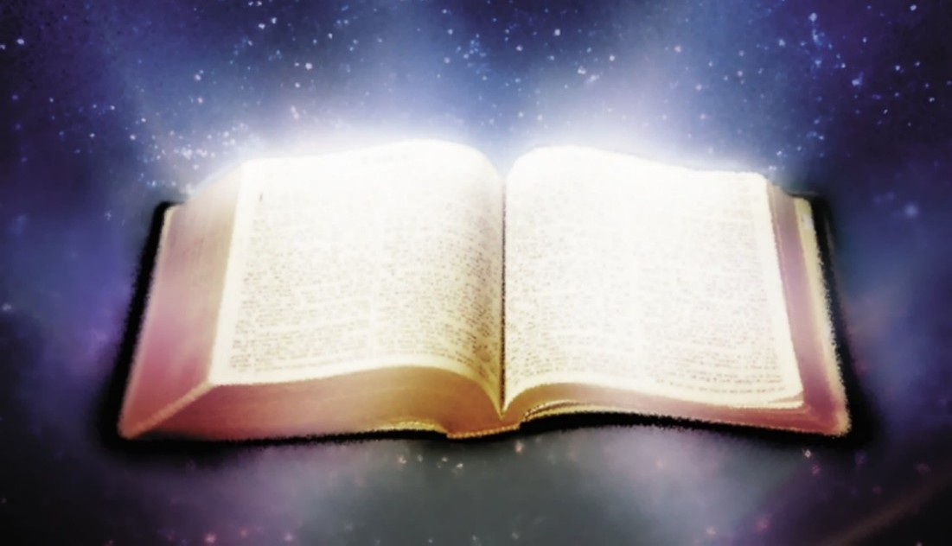
Psalms 19:7-11
⁷ The law of the LORD is perfect, converting the soul; The testimony of the LORD is sure, making wise the simple; ⁸ The statutes of the LORD are right, rejoicing the heart; The commandment of the LORD is pure, enlightening the eyes; ⁹ The fear of the LORD is clean, enduring forever; The judgments of the LORD are true and righteous altogether.

Slide 7
Psalms 19:7-11
¹⁰ More to be desired are they than gold, Yea, than much fine gold; Sweeter also than honey and the honeycomb. ¹¹ Moreover by them Your servant is warned, And in keeping them there is great reward.

Slide 8
Hebrews 4 :12-13
¹² For the word of God is living and powerful, and sharper than any two-edged sword, piercing even to the division of soul and spirit, and of joints and marrow, and is a discerner of the thoughts and intents of the heart. ¹³ And there is no creature hidden from His sight, but all things are naked and open to the eyes of Him to whom we must give account.

Slide 9
1 PETER 1:23-25
²³ having been born again, not of corruptible seed but incorruptible, through the word of God which lives and abides forever, ²⁴ because “ All flesh is as grass, And all the glory of man as the flower of the grass. The grass withers, And its flower falls away, ²⁵ But the word of the LORD endures forever.”

Slide 10
In the next passages of scripture you will see how that men were guided or inspired to write Gods message . These men were not giving their opinions but rather were recording the words being revealed to them by the Holy Spirit.

Slide 11
2 TIMOTHY 3:16-17
¹⁶ All Scripture is given by inspiration of God, and is profitable for doctrine, for reproof, for correction, for instruction in righteousness, ¹⁷ that the man of God may be complete, thoroughly equipped for every good work.

Slide 12
2 peter 1:20-21
²⁰ knowing this first, that no prophecy of Scripture is of any private interpretation,²¹ for prophecy never came by the will of man, but holy men of God spoke as they were moved by the Holy Spirit.

Slide 13
Here are a few examples showing that Bible characters spoke by inspiration.

Slide 14
Exodus 20:22
²² Then the LORD said to Moses, “Thus you shall say to the children of Israel: ‘You have seen that I have talked with you from heaven.

Slide 15
Isaiah 51:16
¹⁶ And I have put My words in your mouth; I have covered you with the shadow of My hand, That I may plant the heavens, Lay the foundations of the earth, And say to Zion, ‘You are My people.’”

Slide 16
John 17:8,14
⁸ For I have given to them the words which You have given Me; and they have received them, and have known surely that I came forth from You; and they have believed that You sent Me.
¹⁴ I have given them Your word; and the world has hated them because they are not of the world, just as I am not of the world.

Slide 17
John 16:13
¹³ However, when He, the Spirit of truth, has come, He will guide you into all truth; for He will not speak on His own authority, but whatever He hears He will speak; and He will tell you things to come.

Slide 18
1 Corinthians 2:7-13
⁷ But we speak the wisdom of God in a mystery, the hidden wisdom which God ordained before the ages for our glory, ⁸ which none of the rulers of this age knew; for had they known, they would not have crucified the Lord of glory. ⁹ But as it is written: “ Eye has not seen, nor ear heard, Nor have entered into the heart of man The things which God has prepared for those who love Him.”

Slide 19
1 Corinthians 2:7-13
¹⁰ But God has revealed them to us through His Spirit. For the Spirit searches all things, yes, the deep things of God. ¹¹ For what man knows the things of a man except the spirit of the man which is in him? Even so no one knows the things of God except the Spirit of God.

Slide 20
1 Corinthians 2:7-13
¹² Now we have received, not the spirit of the world, but the Spirit who is from God, that we might know the things that have been freely given to us by God. ¹³ These things we also speak, not in words which man’s wisdom teaches but which the Holy Spirit teaches, comparing spiritual things with spiritual.

Slide 21
Galations 1:11,12
¹¹ But I make known to you, brethren, that the gospel which was preached by me is not according to man. ¹² For I neither received it from man, nor was I taught it, but it came through the revelation of Jesus Christ.

Slide 22
The claim both presumed and stated in the Bible from beginning to end is that God having created all things including man then revealed Himself and His will through inspired men in the Holy Scriptures .

Slide 24
Unity of the bible
We think of the Bible as one book but it is actually 66 books written by about 40 men over a period of approximately 1500 years. These writers had different backgrounds, spoke different languages and lived in different areas, yet their writings make a complete and harmonious whole, the unfolding story of God’s love in redeeming mankind through his son Jesus the Christ.

Slide 26
The unity of the scriptures could not have been achieved by uninspired men who had limited knowledge, short life spans, narrow earthly perspective and little or no access to what others had written. The only reasonable explanation is that these men were guided by the same mind, one who had all knowledge, unlimited lifespan and was present everywhere at all times.

Slide 27
Fulfilled prophecy
The prophecies of the Old Testament, written hundreds of years in advance of the events foretold ,yet fulfilled in minute detail, constitute one of the strongest proofs for the inspiration of the Bible.

Slide 28
Isaiah 46:9-10
⁹ Remember the former things of old, For I am God, and there is no other; I am God, and there is none like Me, ¹⁰ Declaring the end from the beginning, And from ancient times things that are not yet done, Saying, ‘My counsel shall stand, And I will do all My pleasure,’

Slide 29
John 5:39,45-47
³⁹ You search the Scriptures, for in them you think you have eternal life; and these are they which testify of Me.
⁴⁵ Do not think that I shall accuse you to the Father; there is one who accuses you—Moses, in whom you trust. ⁴⁶ For if you believed Moses, you would believe Me; for he wrote about Me. ⁴⁷ But if you do not believe his writings, how will you believe My words?”

Slide 30
examples
Here are a couple of examples of prophecies foretold and fulfilled in the Old Testament period that involve well documented wars that have evidence remaining even to today. More examples are available in this series.

Slide 31
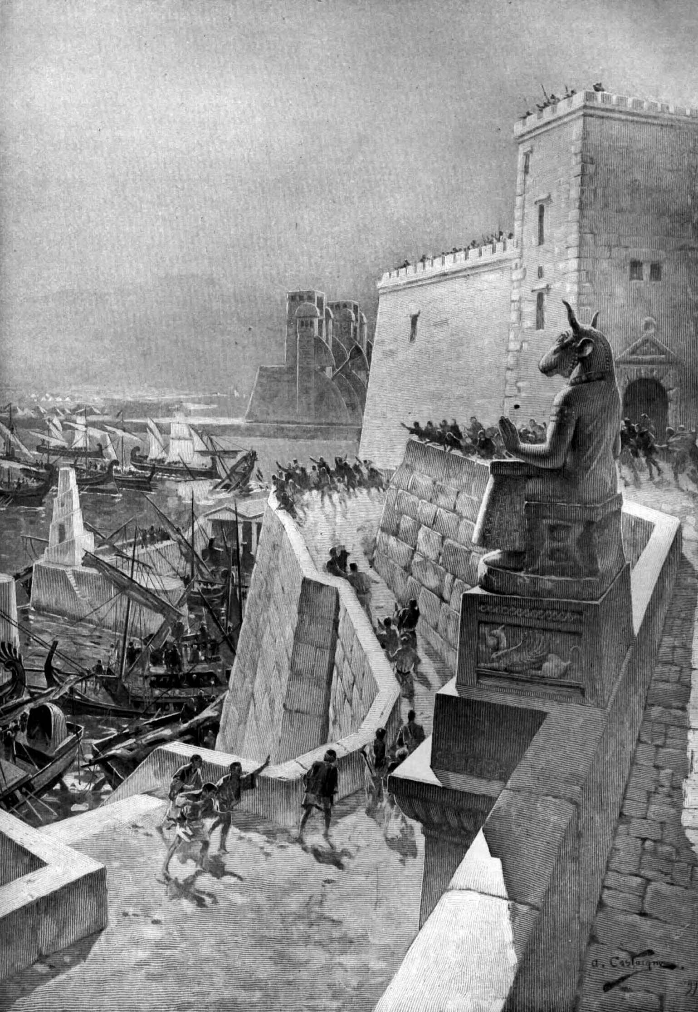
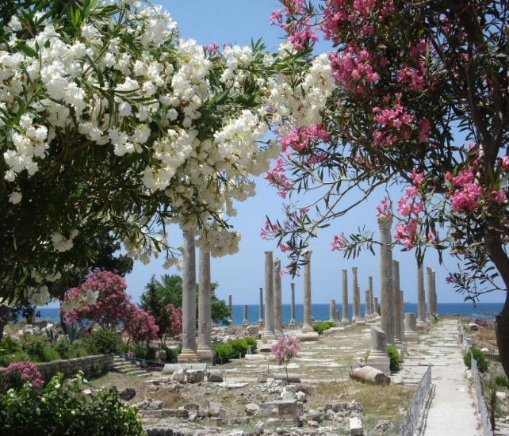
Ezekiel 26 and tyre
³ “Therefore thus says the Lord GOD: ‘Behold, I am against you, O Tyre, and will cause many nations to come up against you, as the sea causes its waves to come up. ⁴ And they shall destroy the walls of Tyre and break down her towers; I will also scrape her dust from her, and make her like the top of a rock. ⁵ It shall be a place for spreading nets in the midst of the sea, for I have spoken,’ says the Lord GOD; ‘it shall become plunder for the nations. ⁶ Also her daughter villages which are in the fields shall be slain by the sword. Then they shall know that I am the LORD.’

Slide 32
Ezekiel 26 and tyre
⁷ “For thus says the Lord GOD: ‘Behold, I will bring against Tyre from the north Nebuchadnezzar king of Babylon, king of kings, with horses, with chariots, and with horsemen, and an army with many people. ⁸ He will slay with the sword your daughter villages in the fields; he will heap up a siege mound against you, build a wall against you, and raise a defense against you.

Slide 33
Ezekiel 26 and tyre
¹² They will plunder your riches and pillage your merchandise; they will break down your walls and destroy your pleasant houses; they will lay your stones, your timber, and your soil in the midst of the water.¹³ I will put an end to the sound of your songs, and the sound of your harps shall be heard no more. ¹⁴ I will make you like the top of a rock; you shall be a place for spreading nets, and you shall never be rebuilt, for I the LORD have spoken,’ says the Lord GOD.

Slide 34
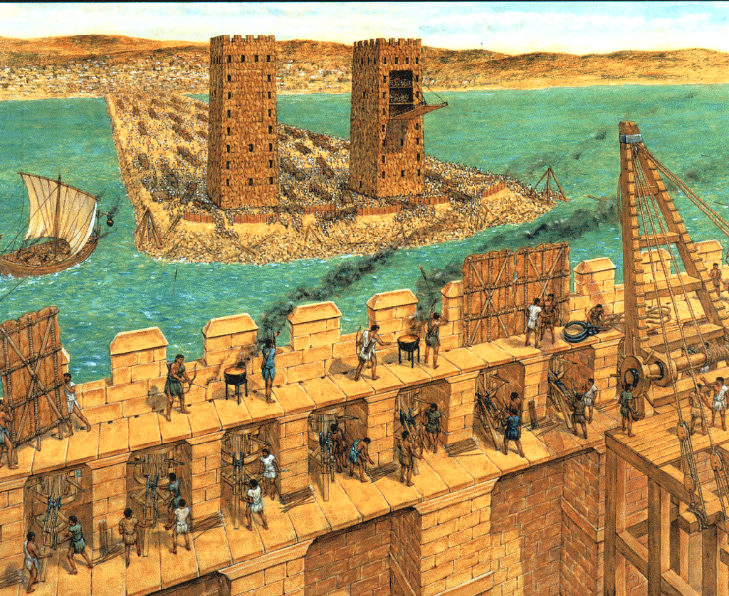
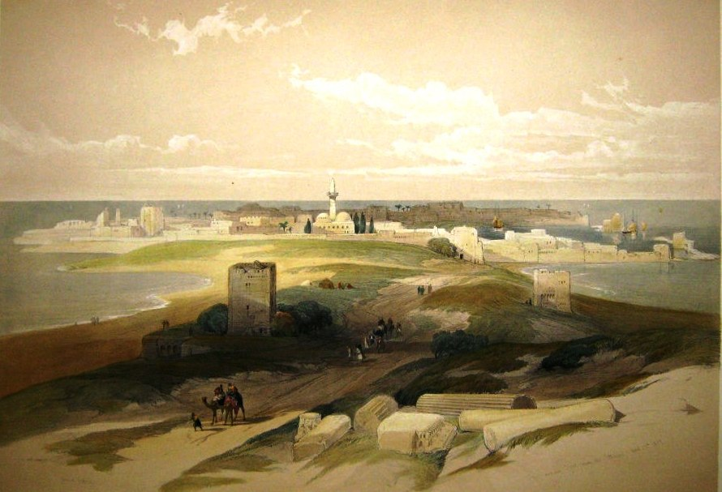
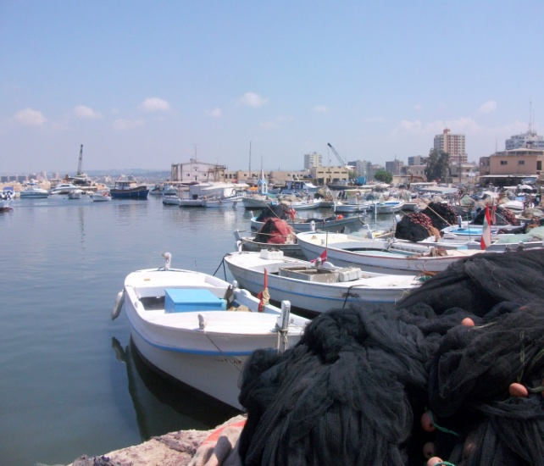
Ezekiel 26 fulfilled
The prophecies of Ezekiel about Tyre have been fulfilled in exact detail. Nebuchadnezzar destroyed the mainland city of Tyre in 573 BC; many nations were against Tyre; Alexander the Great reduced the city to ruins and threw the rubble into the water to create a causeway 200 feet wide and a half of a mile long to conquer the remaining people who lived on an island that he couldn’t get to because he had no Navy to speak of.

Slide 35
Ezekiel 26 fulfilled
This scenario would have been impossible to foresee from mans perspective. Fishermen have been spreading their nets on the ruins of ancient Tyre ever since and the old city of Tyre has never been rebuilt although many have tried.

Slide 36
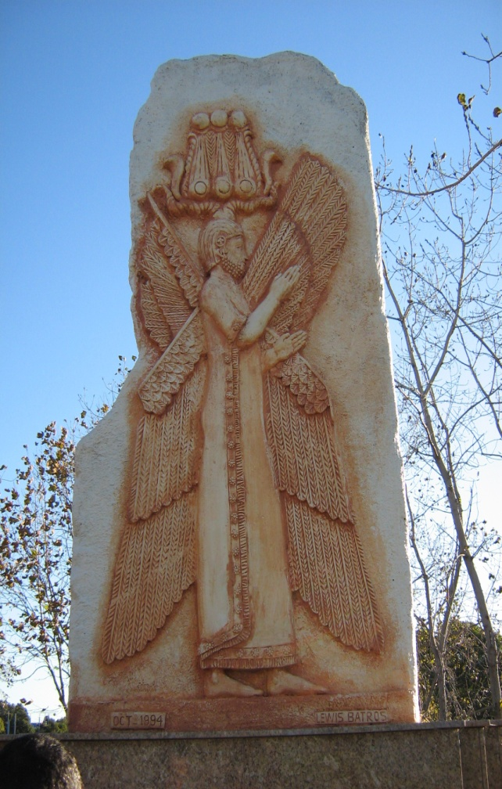
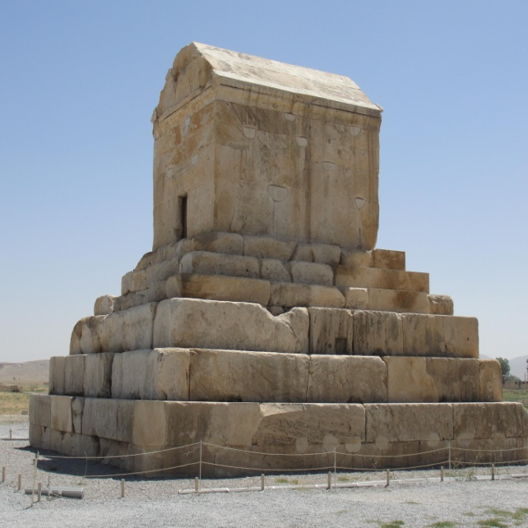
Isaiah 44 and Cyrus
²⁴ Thus says the LORD, your Redeemer, And He who formed you from the womb: “I am the LORD, who makes all things, Who stretches out the heavens all alone, Who spreads abroad the earth by Myself; ²⁵ Who frustrates the signs of the babblers, And drives diviners mad; Who turns wise men backward, And makes their knowledge foolishness; ²⁶ Who confirms the word of His servant, And performs the counsel of His messengers; Who says to Jerusalem, ‘You shall be inhabited,’ To the cities of Judah, ‘You shall be built,’ And I will raise up her waste places;

Slide 37
Isaiah 44 and Cyrus
²⁷ Who says to the deep, ‘Be dry! And I will dry up your rivers’; ²⁸ Who says of Cyrus, ‘He is My shepherd, And he shall perform all My pleasure, Saying to Jerusalem, “You shall be built,” And to the temple, “Your foundation shall be laid.”’
¹ “Thus says the LORD to His anointed, To Cyrus, whose right hand I have held— To subdue nations before him And loose the armor of kings, To open before him the double doors, So that the gates will not be shut:

Slide 38
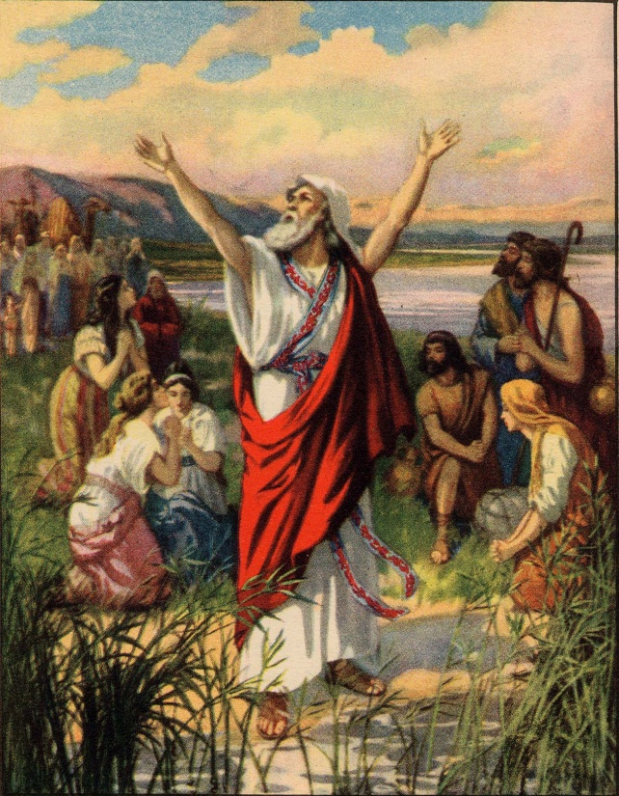
Fulfillment of isaiah 44
Cyrus the Great was a Persian king who did not know the Lord but yet God would use him to achieve the release of the Jews from Babylonian captivity, gather them back to Jerusalem, lay the ground work for rebuilding the temple and pave the way for the fulfillment of the promised Messiah.

Slide 39
Fulfillment of isaiah 44
Israel had been conquered,(also prophesied in the Bible) by the Babylonians in 586 BC and their city and temple destroyed in 587 BC. Cyrus conquered the Babylonians in 539 BC and instituted policies that allowed the conquered peoples of the empire to practice their own religions and rebuild their cities and temple which is what the prophecy of Isaiah is about.

Slide 40
Fulfillment of isaiah 44
What is sometimes overlooked when reading through the text of Isaiah is the time difference. Isaiah spoke the name of the Persian king long before he was ever born! Isaiah prophesied during the reign of Uzziah, Jotham, Ahaz and Hezekiah between 740-701 BC, about one hundred and fifty years before Cyrus came to the throne in 559 BC. See Ezra 1:1-4

Slide 41
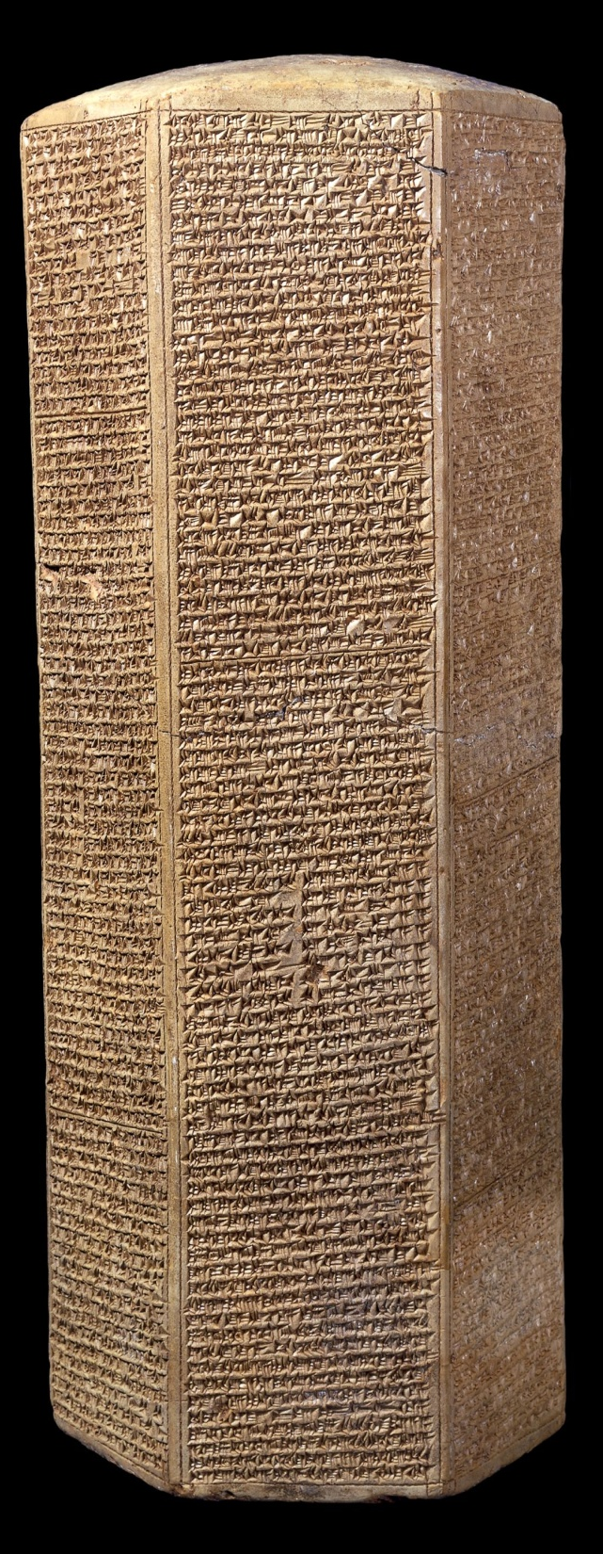
Sennacherib vs Hezekiah (plus one)
After conquering nearly all neighboring nations like ,Sidon, Joppa, Eltekeh, Ekron, Egyptian forces and 46 strong cities of Palestine in 701 BC, Sennacherib set his military against Jerusalem. Hezekiah bought time by paying tribute even to the stripping of the temple treasures while Sennacherib sent ultimatums to Hezekiah. Hezekiah made this a matter of prayer and the prophet Isaiah brought him Gods assurance of deliverance even though there seemed to be no hope of overcoming the huge Assyrian armies.

Slide 42
Sennacherib vs Hezekiah (plus one)
In one of the famous clay prisms of Sennacherib, the Taylor prism documents this Assyrian account, “as to Hezekiah, the Jew, he did not submit to my yoke, I laid siege to 46 of his strong cities … and conquered them. Himself I made prisoner in Jerusalem, his royal residence, like a bird in a cage. I surrounded him in order to take those who were leaving his cities gate… Hezekiah himself did send me later, to Nineveh, my lordly city, together with 30 talents of gold, 800 talents of silver… his daughters, servants and musicians. In order to deliver the tribute… he sent his personal messenger.”

Slide 43
The lord speaks
II KINGS 18-19
¹³ And in the fourteenth year of King Hezekiah, Sennacherib king of Assyria came up against all the fortified cities of Judah and took them.
³² “Therefore thus says the Lord concerning the king of Assyria:
‘He shall not come into this city, Nor shoot an arrow there, Nor come before it with shield, Nor build a siege mound against it. ³³ By the way that he came, By the same shall he return; And he shall not come into this city,’ Says the Lord. ³⁴ ‘For I will defend this city, to save it For My own sake and for My servant David’s sake.’

Slide 44
The lord speaks
II KINGS 18-19
Here is the question, why did Sennacherib not go on to take the city of Jerusalem when his armies were poised to finish the job completely? Secular historians puzzle over this mystery but the Bible tells us exactly what happened.

Slide 45
His word fulfilled
II KINGS 19:35
³⁵ And it came to pass on a certain night that the angel of the Lord went out, and killed in the camp of the Assyrians one hundred and eighty-five thousand; and when people arose early in the morning, there were the corpses—all dead.
It was further foretold that the Assyrian king would return to his own land and there fall by the sword.

Slide 46
His word fulfilled
II KINGS 19:7
⁷ Surely I will send a spirit upon him, and he shall hear a rumor and return to his own land; and I will cause him to fall by the sword in his own land.”
Some 20 years later he was assassinated by his own two sons who smote him with the sword, while he was worshiping in his pagan temple.

Slide 47
His word fulfilled
ISAIAH 37:37-38
³⁷ So Sennacherib king of Assyria departed and went away, returned home, and remained at Nineveh. ³⁸ Now it came to pass, as he was worshiping in the house of Nisroch his god, that his sons Adrammelech and Sharezer struck him down with the sword; and they escaped into the land of Ararat. Then Esarhaddon his son reigned in his place.

Slide 48
In the following slides are solid evidences that validate the extraordinary claims that the Bible makes regarding it’s divine authorship.
We’ll began with some amazing archeological discoveries that confirm the accuracy of the Bible record and insures its trustworthiness.

Slide 49
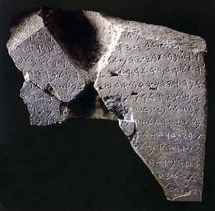
Tel dan stele
This black basalt stone slab from Tel Dan Israel is dated from the 9 century BC and contains the inscription “house of David ”. It was a victory stele erected by an Aramaean king north of Israel, commemorating his victory over Israel. The author is most likely Hazael or his son, Ben Hadad the II or III, who were kings of Damascus, and enemies of the kingdom of Israel.
I KINGS 2:11
¹¹ The period that David reigned over Israel was forty years; seven years he reigned in Hebron, and in Jerusalem he reigned thirty-three years.

Slide 50
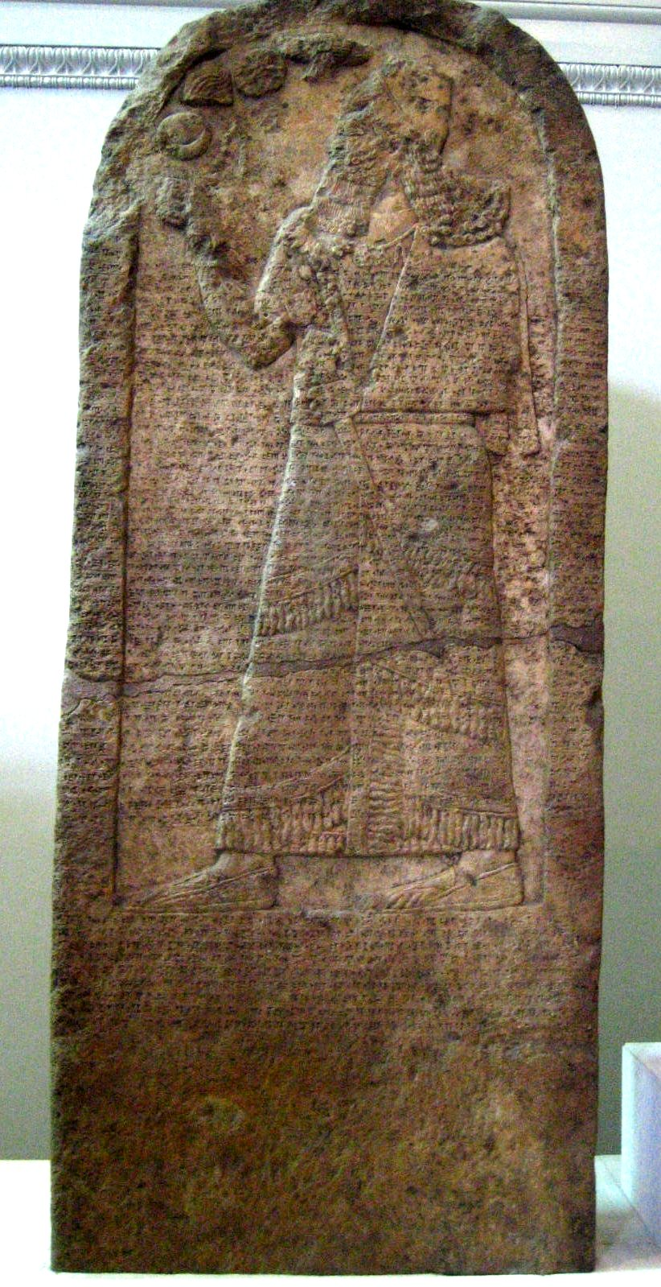
The kurkh monolith picturing shalmaneser iii
This relief confirms the reign of Ahab king of Israel and also his coalition with the Syrian King Hadadezer of Damascus.
The context of this historical period is described in the Bible in I Kings 16 through II Kings 10.

Slide 51
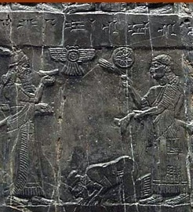
The black obelisk of shalmanezer iii
Front panels recording the tribute of King Jehu, son of Omri. It shows Jehu bowing before the Assyrian king, and this is the only contemporary picture we have of any Israelite king. Jehu still had 10 years of reign after this relief carving was made of him. The black obelisk fully supports every detail of the Bible regarding this period.

Slide 52
The black obelisk of shalmanezer iii
2 KINGS 10:31-32
³¹ But Jehu took no heed to walk in the law of the LORD God of Israel with all his heart; for he did not depart from the sins of Jeroboam, who had made Israel sin.
³² In those days the LORD began to cut off parts of Israel; and Hazael conquered them in all the territory of Israel

Slide 53
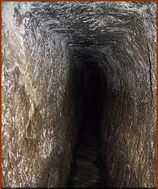
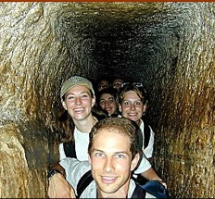
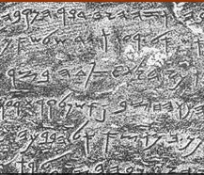
Hezekiah’s tunnel
When the King of Assyria, Sennacherib sieged Jerusalem in 701 BC their strategy was to sit and wait while the Israelites ran out of water and supplies, Israel faced certain ruin, except they had a secret. Hezekiah had dug tunnels to bring water into Jerusalem while cutting off water to the Assyrian army. The main tunnel was 1750 ft long and 131 ft under ground. The inscription to the left was found inside the tunnel and describes how the tunnel was made.

Slide 54
Hezekiah’s tunnel
2 KINGS 20:20
²⁰ Now the rest of the acts of Hezekiah—all his might, and how he made a pool and a tunnel and brought water into the city—are they not written in the book of the chronicles of the kings of Judah?

Slide 55
Hezekiah’s tunnel
2 CHRONICLES 32:2-4
² And when Hezekiah saw that Sennacherib had come, and that his purpose was to make war against Jerusalem, ³ he consulted with his leaders and commanders to stop the water from the springs which were outside the city; and they helped him. ⁴ Thus many people gathered together who stopped all the springs and the brook that ran through the land, saying, “Why should the kings of Assyria come and find much water?”

Slide 56
The cylinder of Cyrus king of persia
This cylinder tells of the Kings capture of Babylon and his liberation of captive peoples including the Jews.

Slide 57
The cylinder of Cyrus king of persia
EZRA 1:1,2
¹ Now in the first year of Cyrus king of Persia, that the word of the LORD by the mouth of Jeremiah might be fulfilled, the LORD stirred up the spirit of Cyrus king of Persia, so that he made a proclamation throughout all his kingdom, and also put it in writing, saying,² Thus says Cyrus king of Persia:
All the kingdoms of the earth the LORD God of heaven has given me. And He has commanded me to build Him a house at Jerusalem which is in Judah.

Slide 58
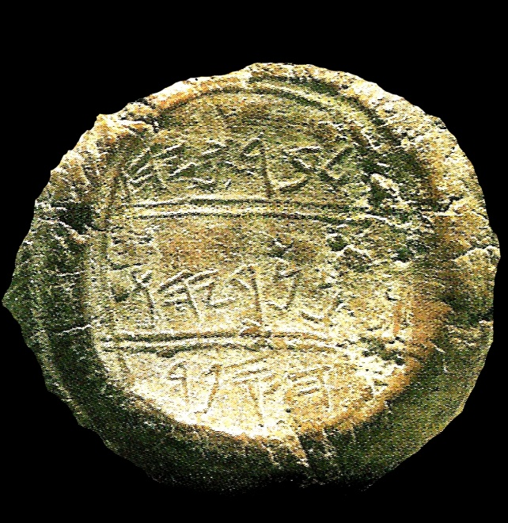
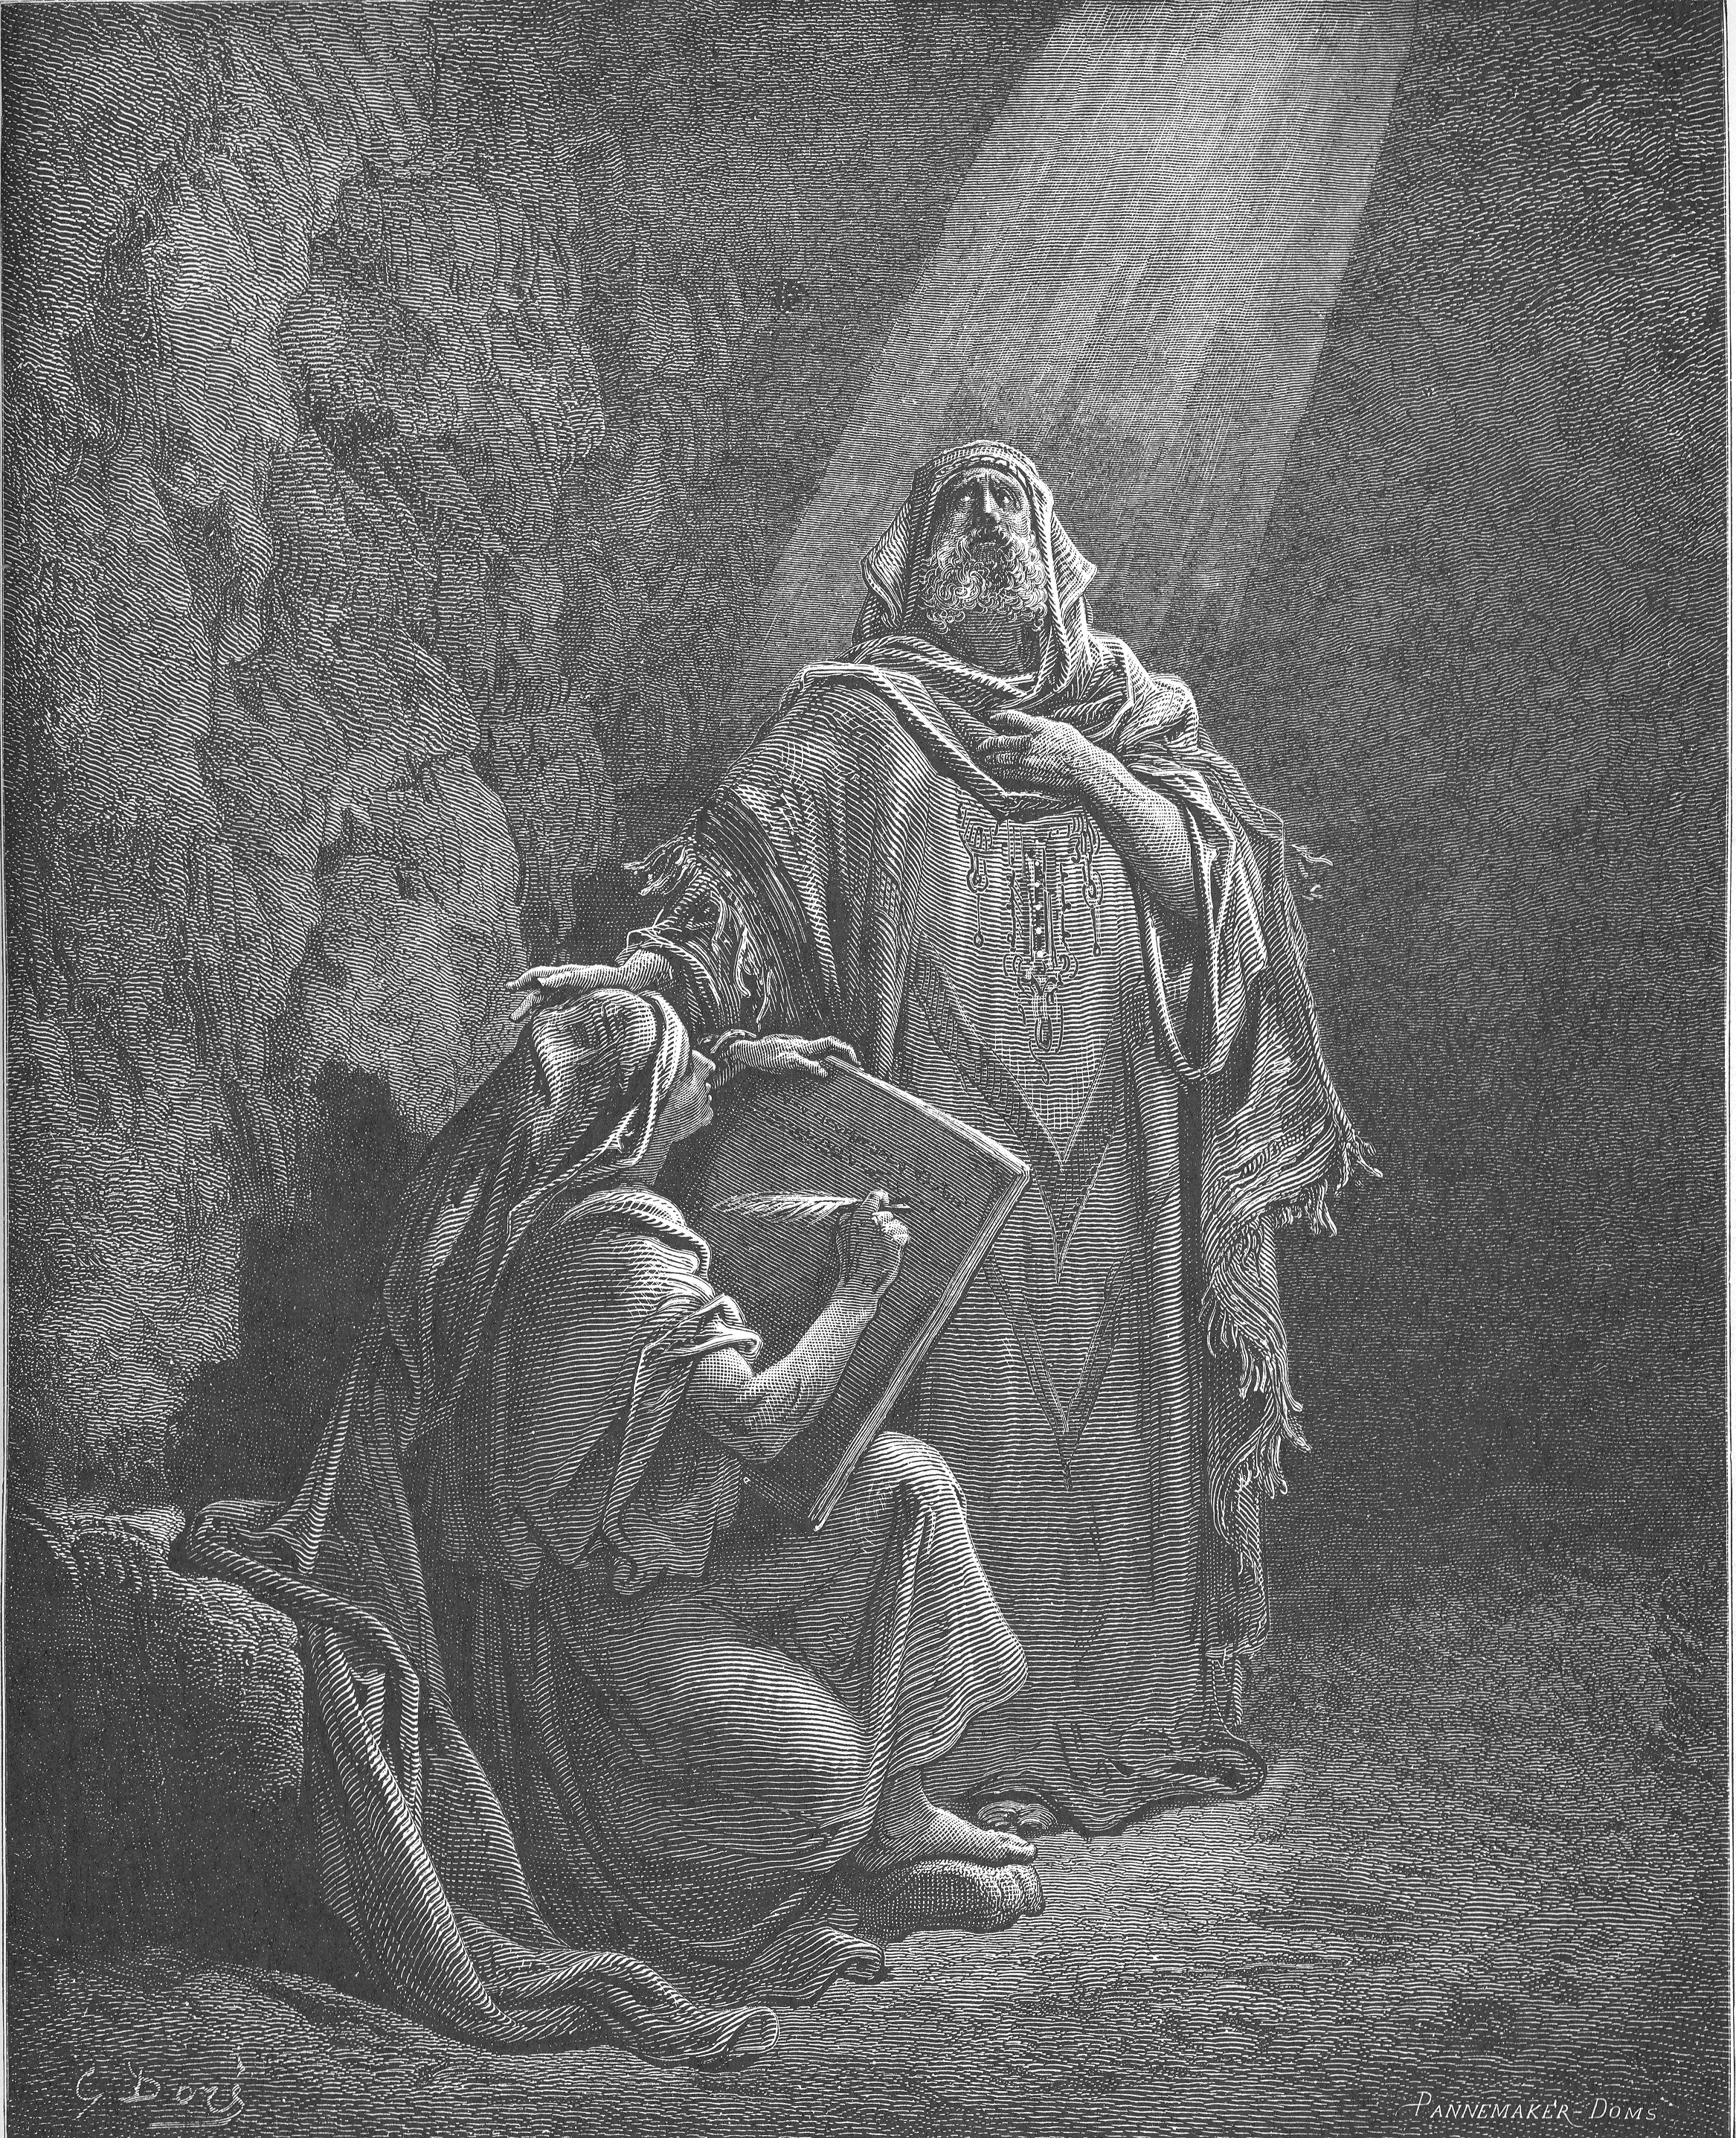
The seal of baruch Jeremiah's scribe
In 1975 the first few pieces of 200 clay bulla were discovered in the shop of an antiquities dealer in east Jerusalem. Bulla are lumps of clay which were attached to documents and impressed with a seal. From the shape of its Hebrew characters, scholars date the collection to the 6th century BC, the time of Jeremiah. Within this collection are two bulla apparently belonging to Baruch.

Slide 59
The seal of baruch Jeremiah's scribe
The three lines on the bulla read “belonging to Berekhyahu, the son of Neriyahu, the scribe”. The suffix yahu was commonly attached to names in Judah, meaning “blessed of Jehovah”. The bulla is now displayed in the Israel museum in Jerusalem.

Slide 60
The seal of baruch Jeremiah's scribe
JEREMIAH 36:4
⁴ Then Jeremiah called Baruch the son of Neriah; and Baruch wrote on a scroll of a book, at the instruction of Jeremiah, all the words of the LORD which He had spoken to him.

Slide 61
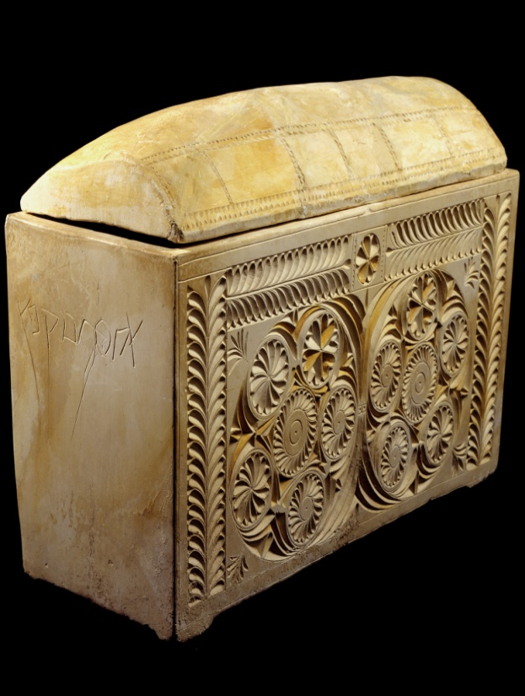
Ossuary of Caiaphas
This is one of twelve bone boxes, discovered in a burial cave in south Jerusalem in November 1990. This especially beautiful box is twice inscribed “ Joseph, son of Caiaphas” and held the bones of a sixty year old man. It is believed to have belonged to Joseph a son of Caiaphas , known as the high priest in the New Testament.

Slide 62
Ossuary of Caiaphas
MATTHEW 26:3
³ Then the chief priests, the scribes,and the elders of the people assembled at the palace of the high priest, who was called Caiaphas,

Slide 63
Ossuary of Caiaphas
JOHN 11:48-50
⁴⁸ If we let Him alone like this, everyone will believe in Him, and the Romans will come and take away both our place and nation.” ⁴⁹ And one of them, Caiaphas, being high priest that year, said to them, “You know nothing at all, ⁵⁰ nor do you consider that it is expedient for us that one man should die for the people, and not that the whole nation should perish.

Slide 64
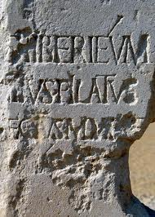
the Pilate stone
This is one of the most remarkable discoveries of all biblical archeology. The Pilate stone was uncovered in 1961 by an Italian archaeologist at Caesarea Maritima, Israel. On the face is a monumental inscription written in Latin which is part of a larger dedication to Tiberius Caesar which clearly says that it was from “Pontius Pilate, prefect of Judea”. Pilate was also mentioned by the Jewish historian Josephus.

Slide 65
the Pilate stone
MATTHEW 27:2
² And when they had bound Him, they led Him away and delivered Him to Pontius Pilate the governor.

Slide 66
Pre-scientific knowledge
Although the Bible is not written to be a science book as such , scientific truths were stated as facts hundreds of years in advance of the discovery of these truths by men. Many could be given ,here are a few examples.

Slide 67
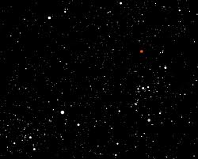
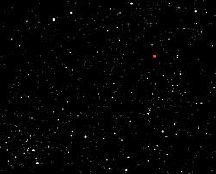
Roundness of earth
People of the ancient world all the way through medieval times had various ideas about the shape of the earth they lived on, some more accurate than others. Many during the time of Christopher Columbus believed that the earth was flat and that a ship sailing too close to the edge could fall off. No one really know for sure unless they had access to the Bible which revealed the pre-scientific truth that the earth was round.

Slide 68
Roundness of earth
ISAIAH 40:22
²² It is He who sits above the circle of the earth, And its inhabitants are like grasshoppers, Who stretches out the heavens like a curtain, And spreads them out like a tent to dwell in.

Slide 69
Matthew maury father of oceanography
1806-1873 Matthew Maury’s daughter was reading a portion of the Bible to him and he was alerted to the phrase “paths of the sea” as she read. Maury took God at his word and went looking for these paths. By trusting the accuracy of the Bible record he discovered the realty of the warm and cold continental currents. His book on Oceanography is still considered a basic text on the subject and is still used in universities today. This statue is in Richmond, Virginia on Monument Avenue.

Slide 70
Matthew maury father of oceanography
PSALM 8:8
“…and the fish of the sea That pass through the paths of the seas.”

Slide 71
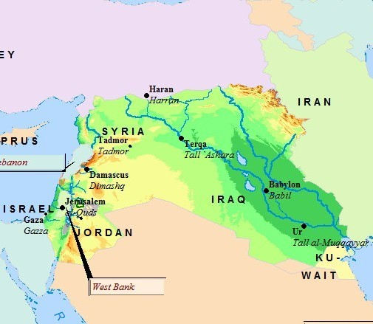
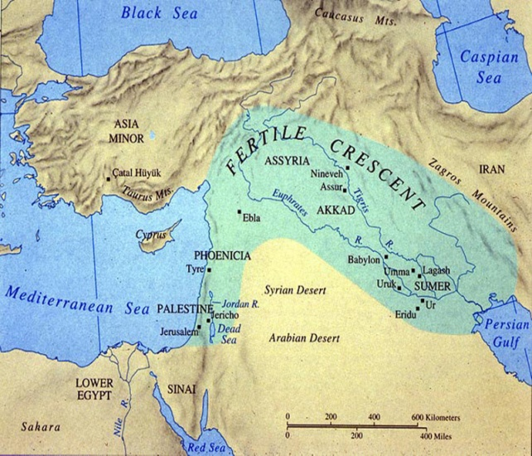
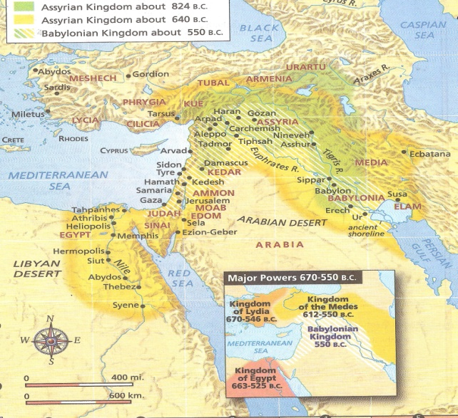
The cradle of civilization and the fertile crescent
The oldest known historical records, human artifacts and human civilizations can all be traced back to biblical lands. The empires of Egypt , Babylon, Hittite and Assyrian civilizations all coincide and interact with the biblical place of mans origin in the region of the Tigris and Euphrates rivers. All of Old Testament history, its people, cultures and events confirm the center of human origin and expansion and this fact is undisputed among both secular and Bible historians and archeologist.

Slide 72
The cradle of civilization and the fertile crescent
GENESIS 2:8,10,14
⁸ Now the LORD God had planted a garden in the east, in Eden; and there he put the man he had formed.
¹⁰ A river watering the garden flowed from Eden; from there it was separated into four headwaters.
¹⁴ The name of the third river is the Tigris; it runs along the east side of Asshur. And the fourth river is the Euphrates.

Slide 73
Flawless land and people specificity
In his monumental work “lands of the Bible”, J.W. McGarvey made this argument
“ a fictitious narrative, located in a country with which the writer is not personally familiar, must either avoid local allusions or be found frequently in conflict with the peculiarities of place and of manners and of customs. By this conflict the fictitious character of the narrative is exposed.”
The Bibles specificity authenticates its accuracy.

Slide 74
Flawless land and people specificity
In Acts, Luke mentions 32 countries, 54 cities, 95 persons, 62 of which are not named elsewhere in the New Testament. And his references have been found to be always correct. This is truly remarkable in view of the fact that the political /territorial situation of his day was in a state of constant change.

Slide 75
Flawless land and people specificity
In the late 1800’s Sir William Ramsay, a scholar who was skeptical of the authenticity of the book of Acts set out upon an archaeological expedition in Asia Minor with the declared intention of disproving the historicity and accuracy of Luke's narrative. After years of research, literally digging up the evidence, Ramsey was forced to conclude that the book of Acts was historically accurate.

Slide 76
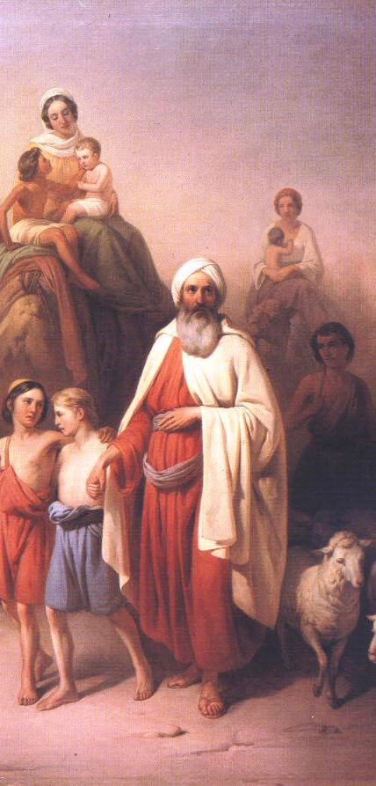
The Jewish people
The people scattered around the globe today, known as the Jews, are from an ancient linage that goes back about 4000 years. God called a Man named Abram out of his country and gave him detailed promises as follows.

Slide 77
The Jewish people
GENESIS 12:1-3
¹ Now the LORD had said to Abram: “Get out of your country, From your family And from your father’s house, To a land that I will show you. ² I will make you a great nation; I will bless you And make your name great; And you shall be a blessing.
³ I will bless those who bless you, And I will curse him who curses you; And in you all the families of the earth shall be blessed.”

Slide 78
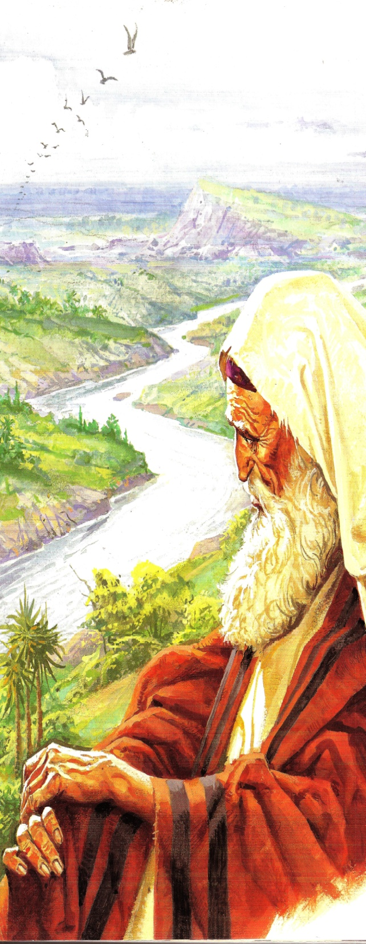
Genesis 12:6-7
⁶ Abram passed through the land to the place of Shechem, as far as the terebinth tree of Moreh. And the Canaanites were then in the land. ⁷ Then the LORD appeared to Abram and said, “To your descendants I will give this land.” And there he built an altar to the LORD, who had appeared to him.

Slide 79
GENESIS 13:14-15
¹⁴ And the LORD said to Abram, after Lot had separated from him: “Lift your eyes now and look from the place where you are—northward, southward, eastward, and westward; ¹⁵ for all the land which you see I give to you and your descendants forever.

Slide 80
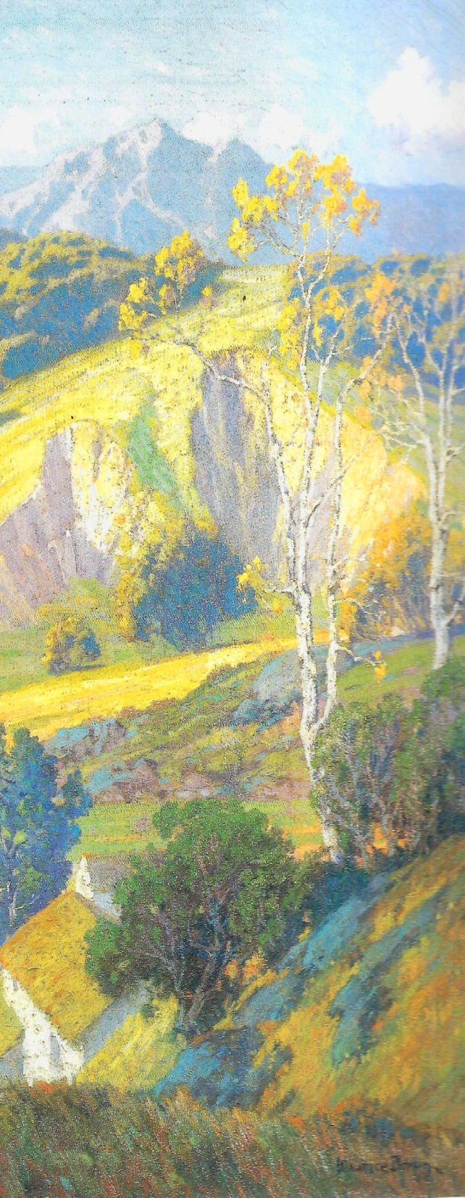
Promises fulfilled
After several hundred years, the descendents of Abram (Abraham) had indeed grown into millions during the time of Egyptian bondage, fulfilling the great nation promise.
After God had delivered them from the Egyptians by parting the Red Sea, he provided for them in the wilderness until they eventually entered into the land of Canaan or the promised land.

Slide 81
Promises fulfilled
God gave them victory over the Canaanites as long as they were faithful to Him. The Israelites did go in and possessed the land of promise just as God had declared, however, God had given stern warnings against disobedience promising that He would use other nations to remove them from the land if they were unfaithful to him. Deuteronomy 28-33

Slide 82
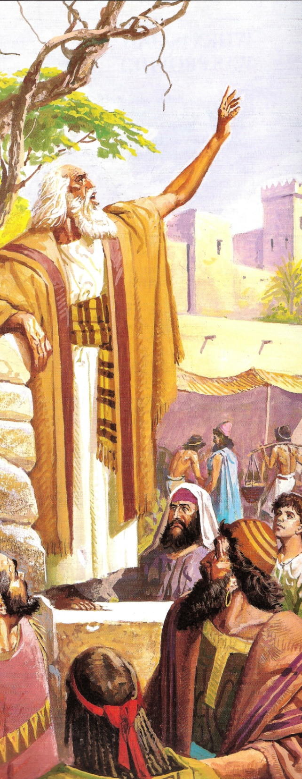
Joshua’s farewell address
JOSHUA 23:1,3,4,6
¹ Now it came to pass, a long time after the LORD had given rest to Israel from all their enemies round about, that Joshua was old, advanced in age.
³ You have seen all that the LORD your God has done to all these nations because of you, for the LORD your God is He who has fought for you. ⁴ See, I have divided to you by lot these nations that remain, to be an inheritance for your tribes, from the Jordan, with all the nations that I have cut off, as far as the Great Sea westward. ⁶ Therefore be very courageous to keep and to do all that is written in the Book of the Law of Moses, lest you turn aside from it to the right hand or to the left,

Slide 83
Joshua’s address
JOSHUA 23:14-16
¹⁴ “Behold, this day I am going the way of all the earth. And you know in all your hearts and in all your souls that not one thing has failed of all the good things which the LORD your God spoke concerning you. All have come to pass for you; not one word of them has failed. ¹⁵ Therefore it shall come to pass, that as all the good things have come upon you which the LORD your God promised you, so the LORD will bring upon you all harmful things, until He has destroyed you from this good land which the LORD your God has given you.

Slide 84
Joshua’s address
JOSHUA 23:14-16
¹⁶ When you have transgressed the covenant of the LORD your God, which He commanded you, and have gone and served other gods, and bowed down to them, then the anger of the LORD will burn against you, and you shall perish quickly from the good land which He has given you.”

Slide 85
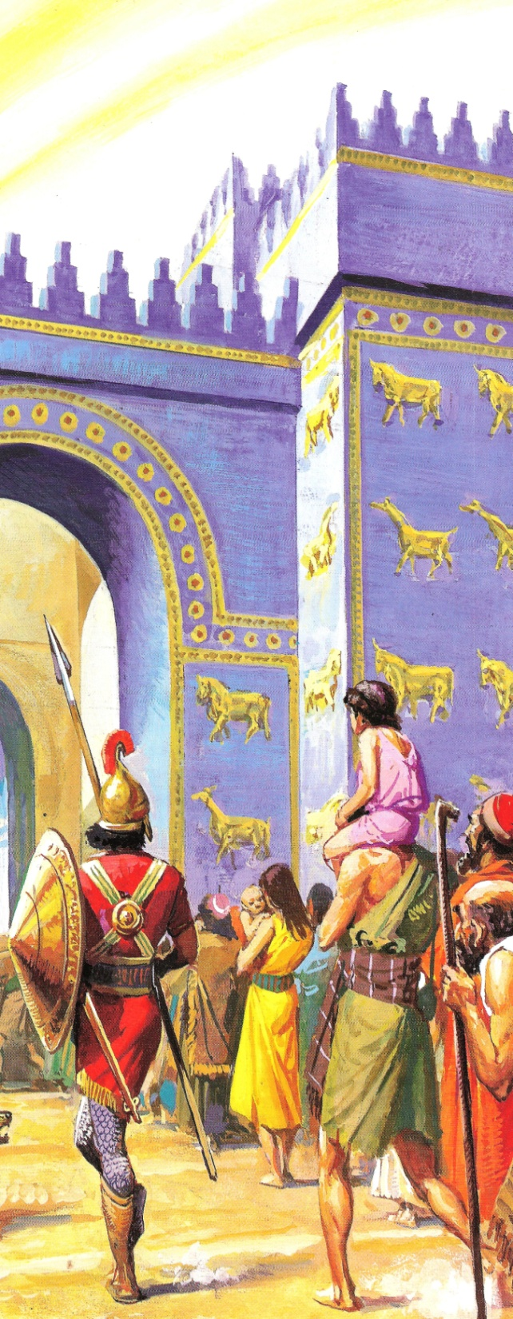
What happened to the Jewish people?
The children of Israel did fall into idolatry and they were removed from their home land.
In 606 BC Nebuchadnezzar took the people captive to Babylon and returned in 586 BC at which time he burned the city and the temple.
However, as God had promised he allowed those who desired to return to the land to go back in 537-536 BC. (Ezra 1)

Slide 86
What happened to the Jewish people?
That remnant that returned were among the ancestors of those who lived in Jerusalem and surrounding areas during the time that Jesus arrived on the scene.
Many other details could be cited but the fact that the Jewish people exists today along with their customs and traditions are an undeniable living link to the truth of Bible history.

Slide 87
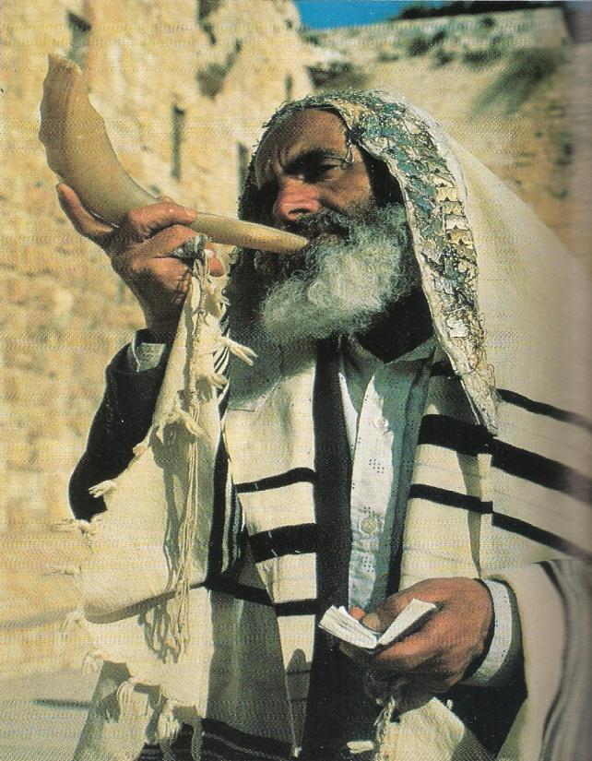
Jewish observances
THE SABBATH
The keeping of the Sabbath Day is a living testimony to the fact of the six day creation, God having then rested on the seventh day. Our seven day week is based on the days of creation just as the Jewish observance of the Sabbath Day has its origin in creation and the law of Moses.

Slide 88
Jewish observances
GENESIS 2:2,3
² And on the seventh day God ended His work which He had done, and He rested on the seventh day from all His work which He had done. ³ Then God blessed the seventh day and sanctified it, because in it He rested from all His work which God had created and made.

Slide 89
Jewish observances
^{EXODUS 20:8-10}
⁸ “ Remember the Sabbath day, to keep it holy. ⁹ Six days you shall labor and do all your work, ¹⁰ but the seventh day is the Sabbath of the LORD your God. In it you shall do no work: you, nor your son, nor your daughter, nor your male servant, nor your female servant, nor your cattle, nor your stranger who is within your gates.

Slide 90
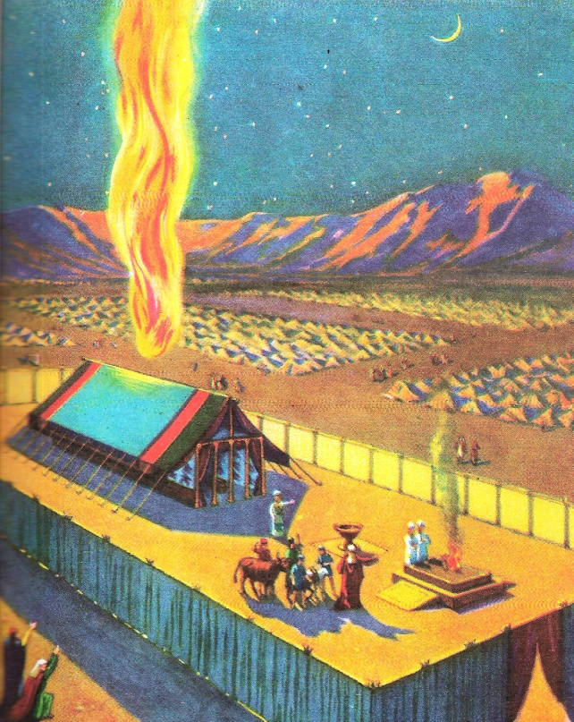
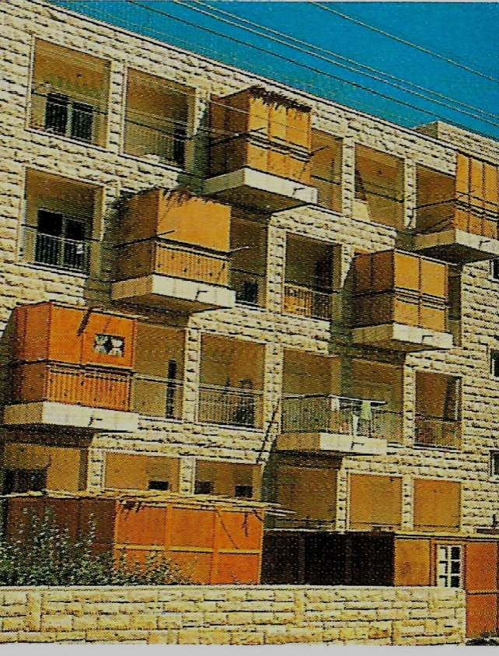
Feast of booths
The Sukkot feast is reminiscent of the period during the forty years of wandering in the dessert after God delivered the Israelites from Egyptian slavery. The booths are intended to be like the fragile dwellings they lived in through their wilderness journey.

Slide 91
Feast of booths
DEUTERONOMY 16:13,14
¹³ “You shall observe the Feast of Tabernacles seven days, when you have gathered from your threshing floor and from your winepress. ¹⁴ And you shall rejoice in your feast, you and your son and your daughter, your male servant and your female servant and the Levite, the stranger and the fatherless and the widow, who are within your gates.

Slide 92
Feast of booths
LEVITICS 23:42,43
⁴² You shall dwell in booths for seven days. All who are native Israelites shall dwell in booths, ⁴³ that your generations may know that I made the children of Israel dwell in booths when I brought them out of the land of Egypt: I am the LORD your God.’”

Slide 93
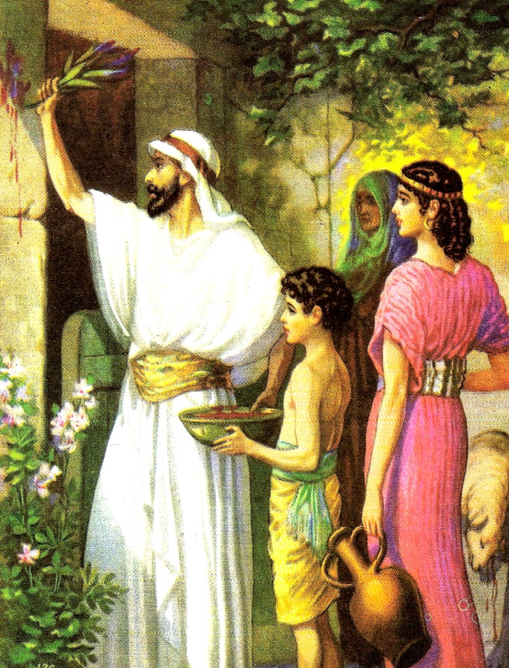
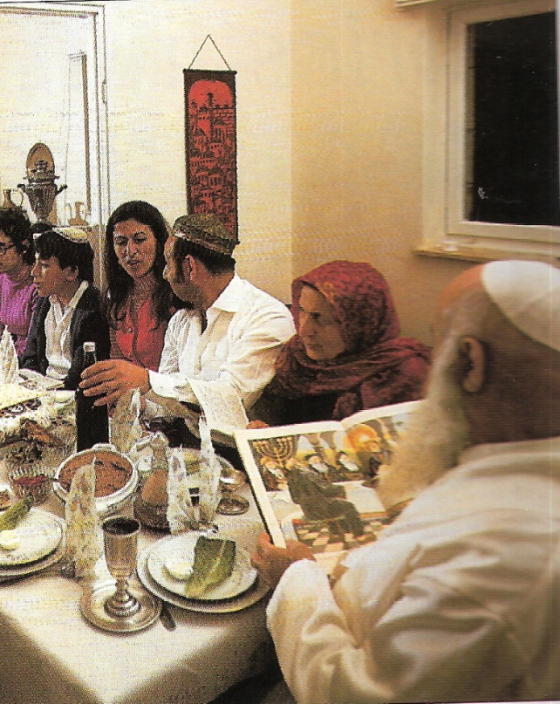
Passover
The Bible tells how God delivered the children of Israel from Egypt by inflicting ten plagues on the Egyptians, the last of which was the death of the first born. The Israelites were instructed to mark the door post of their homes with the blood of a spotless lamb. Upon seeing this, the spirit of the Lord passed over their homes and their first born were spared.

Slide 94
EXODUS 12:1,5,13,14
¹ Now the LORD spoke to Moses and Aaron in the land of Egypt, saying,
⁵ Your lamb shall be without blemish, a male of the first year. You may take it from the sheep or from the goats.
¹³ Now the blood shall be a sign for you on the houses where you are. And when I see the blood, I will pass over you; and the plague shall not be on you to destroy you when I strike the land of Egypt. ¹⁴ ‘So this day shall be to you a memorial; and you shall keep it as a feast to the LORD throughout your generations. You shall keep it as a feast by an everlasting ordinance.

Slide 95
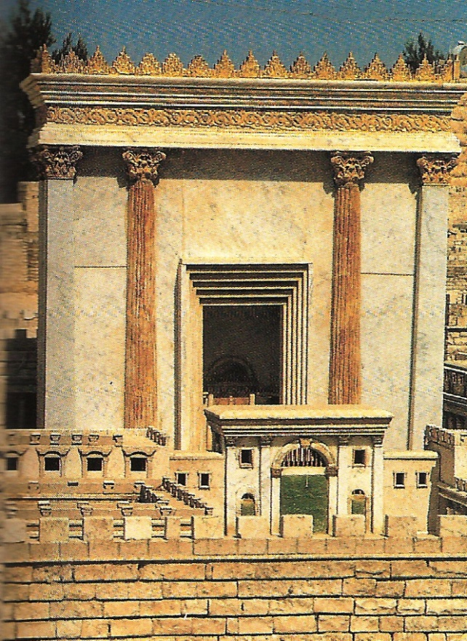
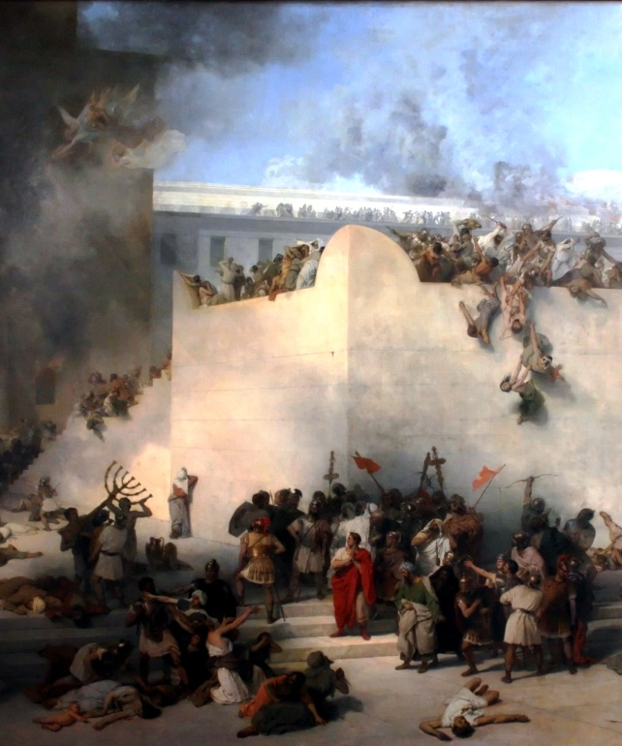
the fast of tisha B’av
Tisha B’Av is a designated day of mourning for the Jews and memorializes, among other events, the destruction of Jerusalem and the temple of Solomon by Babylon in 586 BC and the destruction of Jerusalem again by the Romans in 70 AD which also destroyed the temple built by Herod.
The details of these events are given in II Kings 25:8-11 and Matthew 24.

Slide 96
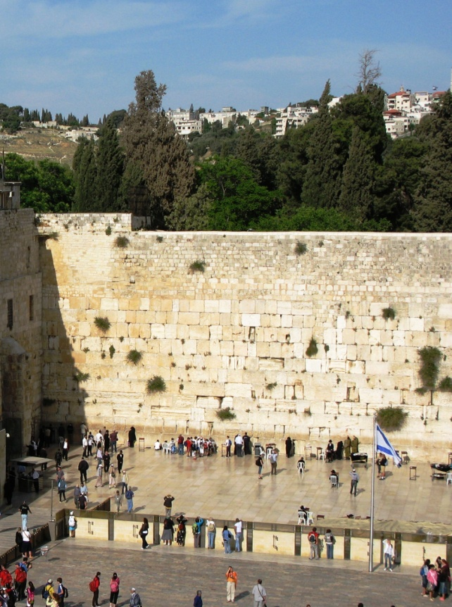
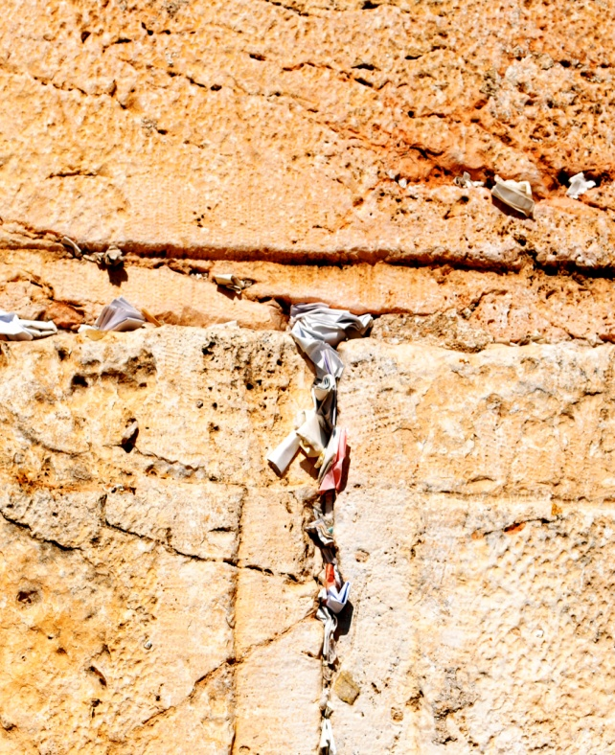
The wailing wall
The western wall is a remnant of the ancient wall that surrounded the Jewish temples courtyard, and is one of the most sacred sites in Judaism. Just about half the wall including seventeen courses located below street level, dates from the end of the second temple period and was constructed by Herod the Great around 19 BC.
The siege of Jerusalem in the year 70 AD was the decisive event of the first Jewish-Roman war. The siege ended with the sacking of the city and the destruction of its famous temple. Jesus predicted the destruction of Jerusalem in detail in both Matthew and Luke.

Slide 97
The wailing wall
MATTHEW 24:1,2
¹ Then Jesus went out and departed from the temple, and His disciples came up to show Him the buildings of the temple. ² And Jesus said to them, “Do you not see all these things? Assuredly, I say to you, not one stone shall be left here upon another, that shall not be thrown down.”

Slide 98
The preservation of the scriptures
The writers of the Bible intended to convey reliable history to its readers, and they were in a position to know what they were talking about.
The documents are self-consistent and consistent with all other reliable history as we have seen in previous slides.

Slide 99
The preservation of the scriptures
The preservation of the manuscripts themselves shows that the writers knew how important the scriptures were and that is why they were so meticulous in their copying practices.
The following slides are a sampling of some of the oldest of these copies and show how trustworthy the process of preservation has been.

Slide 100
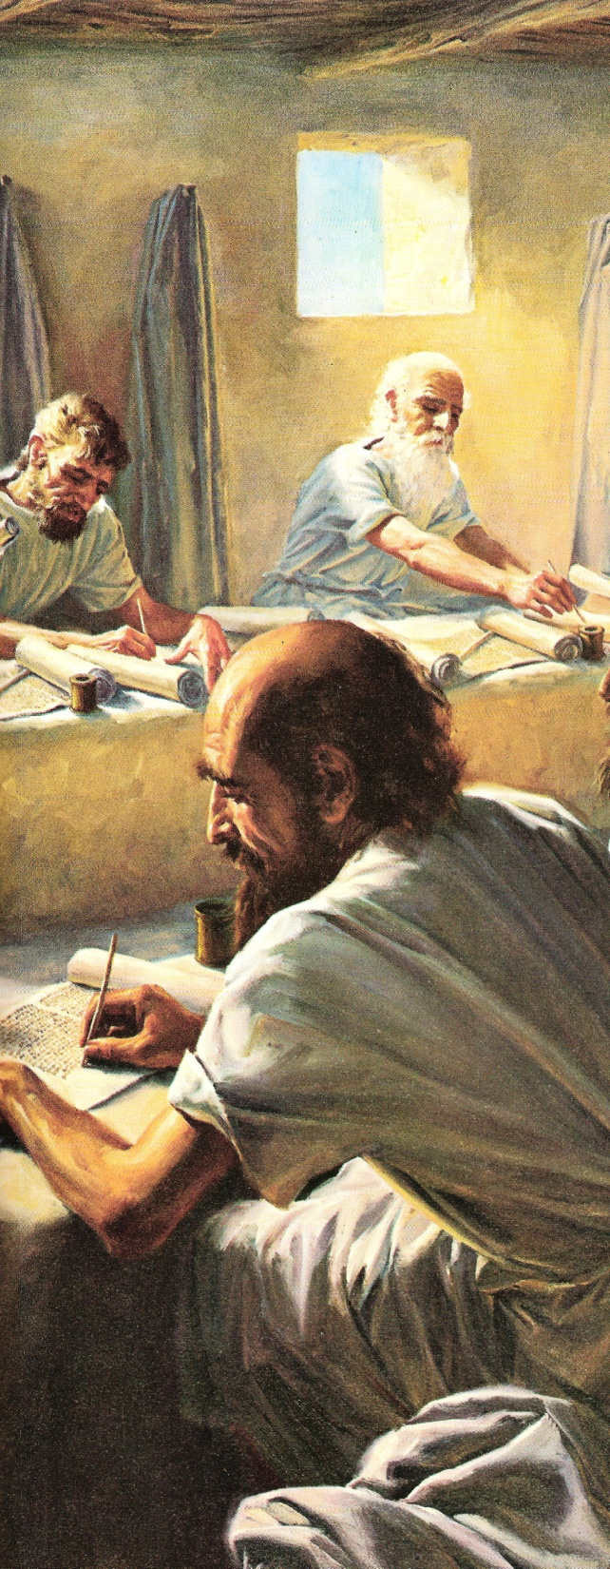
Safeguarding the sacred text
The work of copying and preserving the Scriptures was not left to chance by God or the ancient scribes as described in the following passages

Slide 101
Safeguarding the sacred text
EZRA 7:6,11
⁶ this Ezra came up from Babylon; and he was a skilled scribe in the Law of Moses, which the LORD God of Israel had given. The king granted him all his request, according to the hand of the LORD his God upon him.
¹¹ This is a copy of the letter that King Artaxerxes gave Ezra the priest, the scribe, expert in the words of the commandments of the LORD, and of His statutes to Israel:

Slide 102
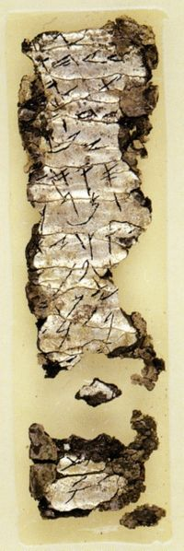
The ketef hinnom amulets
Two tiny silver scrolls were discovered at a burial cave at Ketef Hinnom. Written in ancient Hebrew script dated to the seventh century BC, the scrolls comprise the earliest known fragments of a biblical text and pre-date the earliest scrolls from Qumran by more than 300 years. A form of what is known as the priestly blessing is contained in the scroll to the left.

Slide 103
The ketef hinnom amulets
NUMBERS 6:24,26
²⁴“The LORD bless you and keep you;
²⁵ The LORD make His face shine upon you, And be gracious to you;
²⁶ The LORD lift up His countenance upon you, And give you peace.”’

Slide 104
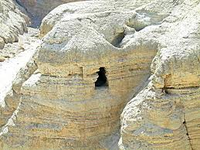
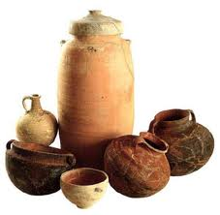
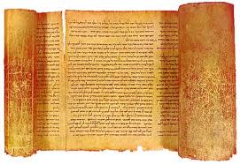
The dead sea scrolls
In 1947 a Bedouin shepherd boy went looking for his sheep on the cliffs overlooking the Dead Sea, what he found was a cave containing many sealed pottery vessels that held the meticulously written words of the Old Testament books. The scrolls turned out to predate nearly every other existing manuscript by a thousand years. Eventually archeologist discovered ten more caves and in each one the fragments of every book of the Old Testament except Ester.

Slide 105
The dead sea scrolls
The significance of this find is hard to overemphasize because there were over forty thousand pieces, and whole books which all but completely reconstructed the entire Old Testament and validated the prophecies concerning Christ that were fulfilled in minute detail having been spoken hundreds of years before their fulfillment.
Also, the accuracy of the wording of the Old Testament manuscripts existing before the discovery of the Dead Sea scrolls was authenticated by comparisons to the ancient text.

Slide 106
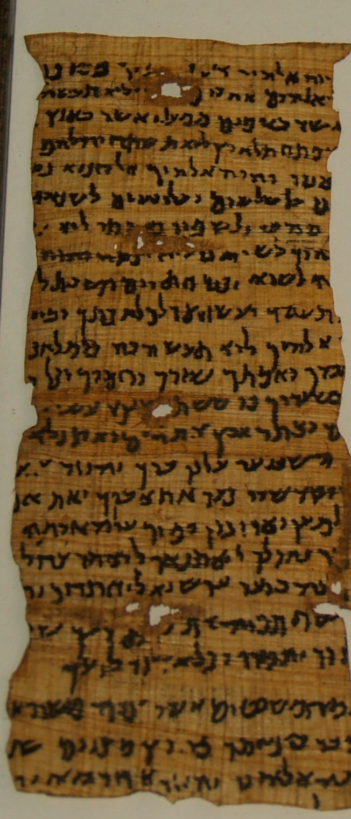
Nash papyrus
A collection of 4 papyrus fragments acquired in Egypt in 1898 dated back to 150-100 BC and contains 24 lines including the Ten Commandments from Exodus 20 and also parts of Deuteronomy 5. It is held in the Cambridge University Library.

Slide 107
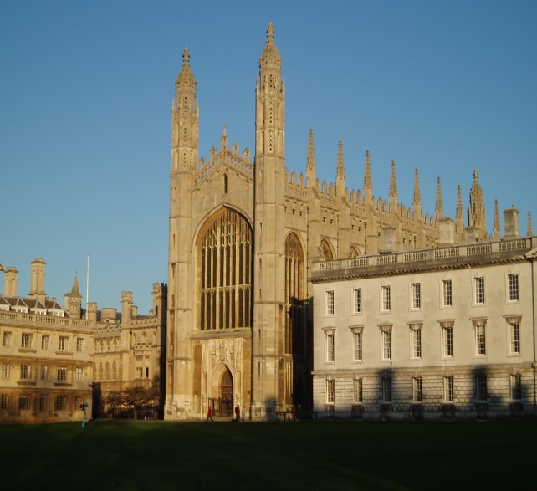
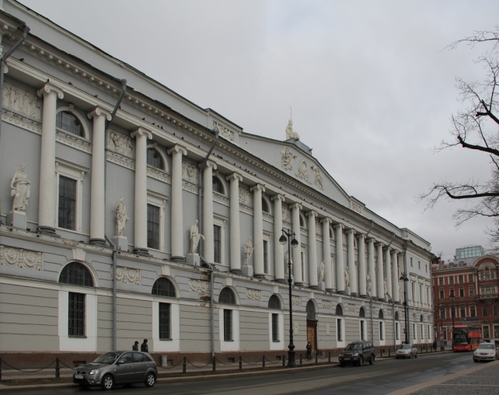
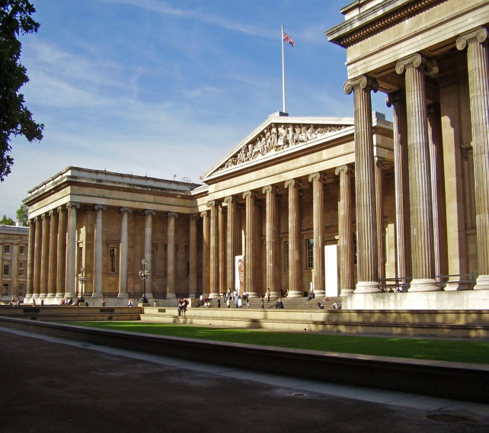
Major collections of old testament manuscripts
Of the 200,000 Cairo Geniza manuscript fragments, some 100,000 are housed at Cambridge University.
The largest organized collection of Hebrew manuscripts in the world is the Second Firkovitch Collection at the Russian National Library in Saint Petersburg. It contains 1,532 complete parchments plus 1,200 important fragments.

Slide 108
Major collections of old testament manuscripts
The British Museum catalog lists 146 Old Testament manuscripts, also at Oxford about the same number.
In the United States alone their estimated to be tens of thousands of Semitic manuscript fragments and more than 500 complete Old Testament manuscripts.

Slide 109
The massorites and the old testament text
Most of the surviving early manuscripts were copied by the Massorites from AD 500 to 1000. This group of scribes took their name from the Massorah, the authoritative traditions concerning the work of the scribe.
Here are some of their rules for copying the sacred text;

Slide 110
The massorites and the old testament text
1. they numbered words, letters and verses of each book and then counted each of them to validate the exact numbers.
2. They counted the number of times each letter was used in each book and verified that number after copying.
3. They calculated the middle verse, middle word and middle letter of each book and checked these to assure their manuscript was accurate.

Slide 111
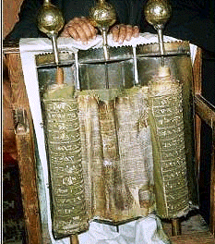
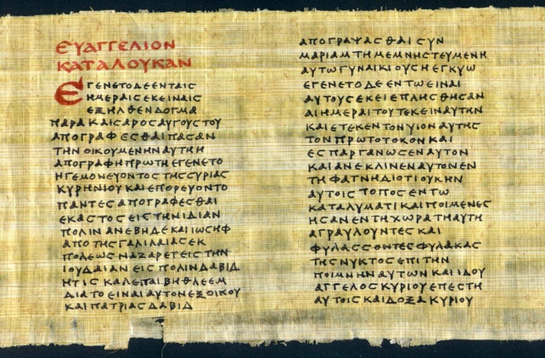
Older text which are used to compare to the massoretic text
Samaritan Pentateuch Hebrew text from about 400 BC. This is one of the best preserved complete copies from the Middle Ages.
The Septuagint The translation of the Hebrew text into Greek from 250-150 BC. This text was most often quoted by Jesus and the inspired New Testament writers.

Slide 112
Older text which are used to compare to the massoretic text
The Aramaic Targums Paraphrases of the Hebrew Scriptures in Aramaic which became the language of the Jews following Babylonian captivity.
The Latin Vulgate The old Latin translation of the Old Testament dates back to 150 AD. Jerome translated the Latin text directly from the Hebrew.

Slide 113
Important old and new testament manuscripts
VATICAN CODEX B Considered the earliest and most exact , this 4th century manuscript contains nearly all of the Old and New Testaments.
SINAIATIC Dates from the middle of the 4th century and contains the complete New Testament and major parts of the Old.
ALEXANDRIAN CODEX A Contains most of both Old and New Testaments and dates from the 5th century.

Slide 114
The new testament preservation
The New Testament has overwhelming manuscript evidence attesting to its accurate preservation. The writers themselves were very aware of the need to have a permanent record of their inspired Scriptures as well as the need to spread the information from church to church. The following passages clearly show their intentions .

Slide 115
The new testament preservation
LUKE 1:1-4
¹ Inasmuch as many have taken in hand to set in order a narrative of those things which have been fulfilled among us, ² just as those who from the beginning were eyewitnesses and ministers of the word delivered them to us, ³ it seemed good to me also, having had perfect understanding of all things from the very first, to write to you an orderly account, most excellent Theophilus, ⁴ that you may know the certainty of those things in which you were instructed.

Slide 116
JOHN 20:30-31
³⁰ And truly Jesus did many other signs in the presence of His disciples, which are not written in this book; ³¹ but these are written that you may believe that Jesus is the Christ, the Son of God, and that believing you may have life in His name.

Slide 117
II PETER 1:13-16
¹³ Yes, I think it is right, as long as I am in this tent, to stir you up by reminding you, ¹⁴ knowing that shortly I must put off my tent, just as our Lord Jesus Christ showed me. ¹⁵ Moreover I will be careful to ensure that you always have a reminder of these things after my decease.
¹⁶ For we did not follow cunningly devised fables when we made known to you the power and coming of our Lord Jesus Christ, but were eyewitnesses of His majesty.

Slide 118
COLOSSIANS 4:16
¹⁶ Now when this epistle is read among you, see that it is read also in the church of the Laodiceans, and that you likewise read the epistle from Laodicea.
I THESSALONIANS 5:27
²⁷ I charge you by the Lord that this epistle be read to all the holy brethren.

Slide 119
new testament manuscript evidence
Beside those handwritten text already mentioned , there are approximately 5700 more early Greek manuscripts dating from 50 years to 1500 years from the original autographs. This is far more than any other work of classical antiquity such Homers Iliad which comes in second place with 643 early copies, nearly all others acknowledged by scholars as genuine are based on fewer than 10 copies.

Slide 120
new testament manuscript evidence
Add to these Latin, Coptic, Syriac, Armenian, Gothic, Georgian, and Arabic translations that date from just a few hundred years of the original writing, and the numbers grow to about 11000 New Testament manuscripts dating from 130 AD into the Middle Ages. From these come the Textus Receptus, (received text) from which most of our good English translations have come.
The point is that there is an unbroken line of authority contained in the 27 books of the New Testament that make up the Canon, (greek kanon or measuring rod) , which were all included in lists as early as 140 AD.

Slide 121
Non-Biblical references
There are also non-christian sources that were not intended by their writers to confirm the gospel accounts but in a broader context do just that. Because these men were not preachers nor believers, their purposes in documenting the events and people of Jesus day was a matter of historical archival for them and did not represent a personal or emotional relationship with their subjects. Here are three such men.

Slide 122
Non-Biblical references
Cornelius Tacitus, Roman historian AD 55-120 His work “Annals” cover the period from AD 14 to AD 68, see annals 15.44.
Suetonius, Roman historian, chief secretary to Emperor Hadrian AD 117-138. His account of the Jews at Rome causing disturbances over the teaching of Christ is paralleled in Acts 18:1-2.
Josephus, Well known Jewish historian, AD 37-97, court historian for Emperor Vespasian. See Antiquities 18

Slide 123
Conclusion
There will be many other faith building evidences through the course of our study ,but this first lesson is intended to show the expansive nature of the reasons to believe the Bible.
We can have utmost confidence that the Bible is the complete and uncorrupted word of God faithfully preserved by God’s providence for us to read and thereby know the God who made us.

