Slide 1
AN INTRODUCTION

Slide 2
ANSWERS
What is the Christian’s responsibility to the Law?
What purpose did the Law serve? What was its intent?
How does the Law relate to God’s promises to Abraham?
How does the gospel relate to God’s promises to Abraham?
What value does the Law now serve?

Slide 3
ANSWERS
Be diligent to present yourself approved to God as a workman who does not need to be ashamed, handling accurately the word of truth.
2 Tim. 2:15

Slide 4
AUTHOR
The Apostle Paul
Even critical liberals acknowledge the Pauline authorship of this book. There is nothing within the book or the writings of the Church Fathers that would cause anyone to question its authenticity. The author called himself Paul twice (1:1; 5:2). The many historical references can be harmonized with the events of Acts and of the other Epistles: his Pharisaical Jewish heritage (1:13–14; cf. Acts 22:3), his persecution of the church (1:13; cf. Acts 7:58; 8:1–3), his dramatic conversion on the way to Damascus (1:15–17; cf. Acts 9:1–25), his visit to Jerusalem (1:18; cf. Acts 11:30), his identification with Titus and Barnabas (2:1; cf. Acts 13:1–2; 2 Cor. 8:16), his home church at Antioch (2:11; cf. Acts 13:1), his physical problems (4:15; 6:11; cf. 2 Cor. 12:7–10), and persecutions (6:12, 17; cf. 2 Cor. 11:23–27).
(Gromacki, R.G. (1974) New Testament Survey)

Slide 5
AUTHOR
The Apostle Paul
And when they had driven him out of the city, they began stoning him, and the witnesses laid aside their robes at the feet of a young man named Saul.
Acts 7:58

Slide 6
AUTHOR
The Apostle Paul
But Saul began ravaging the church, entering house after house; and dragging off men and women, he would put them in prison.
Acts 8:3

Slide 7
AUTHOR
The Apostle Paul
…although I myself might have confidence even in the flesh. If anyone else has a mind to put confidence in the flesh, I far more: circumcised the eighth day, of the nation of Israel, of the tribe of Benjamin, a Hebrew of Hebrews; as to the Law, a Pharisee; as to zeal, a persecutor of the church; as to the righteousness which is in the Law, found blameless.
Phil. 3:4-6

Slide 8
AUTHOR
The Apostle Paul
Acts 22:1-21 (Paul’s Conversion)

Slide 9
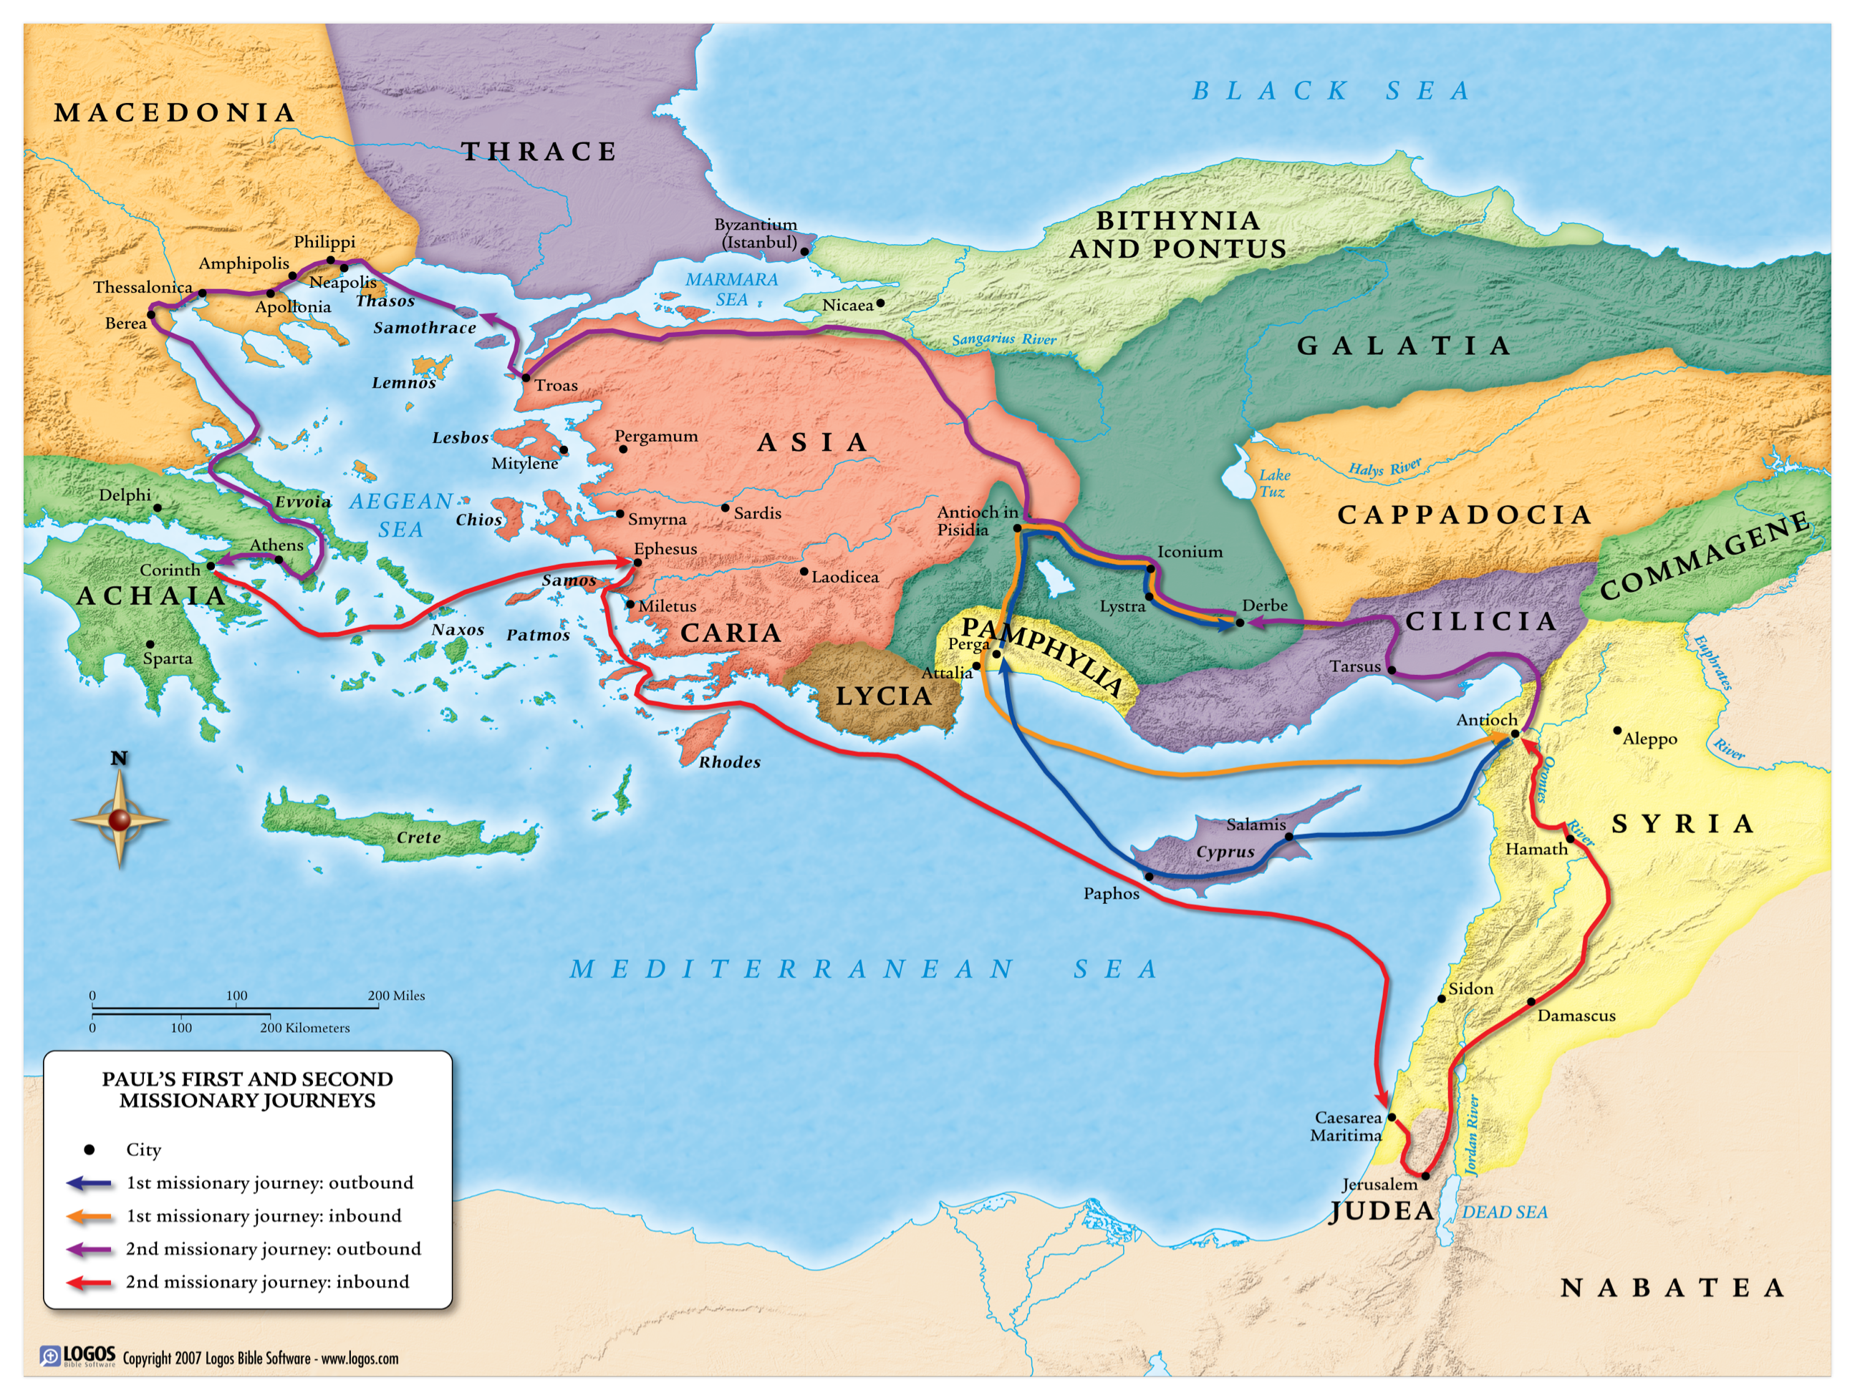

Slide 10
AUDIENCE
Acts 13:1-5 (Antioch of Syria)
Acts 13:13-14 (Antioch of Pisidia)
Acts 13:42-23 (Initial response to Paul’s preaching)
Acts 13:44-52 (Another response to Paul’s preaching)
Acts 13:48-14:7 (Iconium)
Acts 14:8-18 (Lystra)
Acts 14:19-28 (Derbe)

Slide 11
TIME OF WRITING

Slide 12
PURPOSE
…nevertheless knowing that a man is not justified by the works of the Law but through faith in Christ Jesus, even we have believed in Christ Jesus, that we may be justified by faith in Christ, and not by the works of the Law; since by the works of the Law shall no flesh be justified.
Gal. 2:16

