Slide 1

Chapter 4:12-5:6

Slide 2
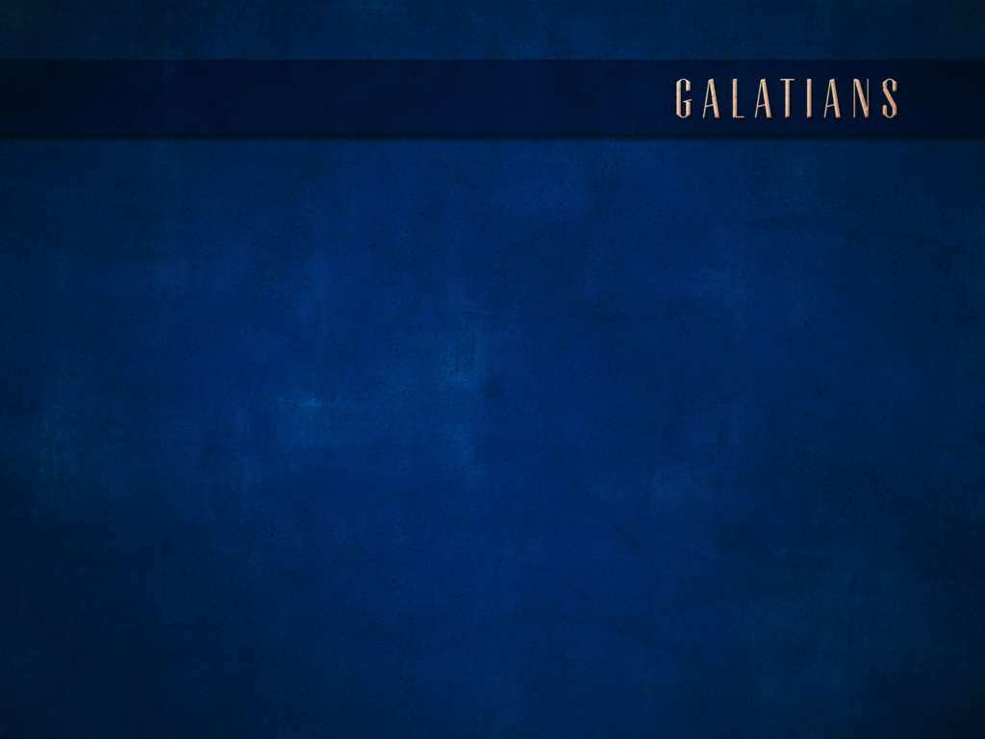

CHAPTER 4:21-25
²¹ Tell me, you who want to be under law, do you not listen to the law?²² For it is written that Abraham had two sons, one by the bondwoman and one by the free woman.²³ But the son by the bondwoman was born according to the flesh, and the son by the free woman through the promise.²⁴ This is allegorically speaking: for these women are two covenants, one proceeding from Mount Sinai bearing children who are to be slaves; she is Hagar.²⁵ Now this Hagar is Mount Sinai in Arabia, and corresponds to the present Jerusalem, for she is in slavery with her children.

Slide 3
CHAPTER 4:26-31
²⁶ But the Jerusalem above is free; she is our mother.²⁷ For it is written, “Rejoice, barren woman who does not bear; Break forth and shout, you who are not in labor; For more are the children of the desolate Than of the one who has a husband.” ²⁸ And you brethren, like Isaac, are children of promise.²⁹ But as at that time he who was born according to the flesh persecuted him who was born according to the Spirit, so it is now also.³⁰ But what does the Scripture say? “Cast out the bondwoman and her son, For the son of the bondwoman shall not be an heir with the son of the free woman.” ³¹ So then, brethren, we are not children of a bondwoman, but of the free woman.

Slide 4
CHAPTER 4:21-25
²¹ Tell me, you who want to be under law, do you not listen to the law?²² For it is written that Abraham had two sons, one by the bondwoman and one by the free woman.²³ But the son by the bondwoman was born according to the flesh, and the son by the free woman through the promise.²⁴ This is allegorically speaking: for these women are two covenants, one proceeding from Mount Sinai bearing children who are to be slaves; she is Hagar.²⁵ Now this Hagar is Mount Sinai in Arabia, and corresponds to the present Jerusalem, for she is in slavery with her children.

Slide 5
CHAPTER 4:21-25
²¹ Tell me, you who want to be under law, do you not listen to the law?²² For it is written that Abraham had two sons, one by the bondwoman and one by the free woman.²³ But the son by the bondwoman was born according to the flesh, and the son by the free woman through the promise.²⁴ This is allegorically speaking: for these women are two covenants, one proceeding from Mount Sinai bearing children who are to be slaves; she is Hagar.²⁵ Now this Hagar is Mount Sinai in Arabia, and corresponds to the present Jerusalem, for she is in slavery with her children.

Slide 6
CHAPTER 4:21-25
²¹ Tell me, you who want to be under law, do you not listen to the law?²² For it is written that Abraham had two sons, one by the bondwoman and one by the free woman.²³ But the son by the bondwoman was born according to the flesh, and the son by the free woman through the promise.²⁴ This is allegorically speaking: for these women are two covenants, one proceeding from Mount Sinai bearing children who are to be slaves; she is Hagar.²⁵ Now this Hagar is Mount Sinai in Arabia, and corresponds to the present Jerusalem, for she is in slavery with her children.

Slide 7
CHAPTER 4:26-31
²⁶ But the Jerusalem above is free; she is our mother.²⁷ For it is written, “Rejoice, barren woman who does not bear; Break forth and shout, you who are not in labor; For more are the children of the desolate Than of the one who has a husband.” ²⁸ And you brethren, like Isaac, are children of promise.²⁹ But as at that time he who was born according to the flesh persecuted him who was born according to the Spirit, so it is now also.³⁰ But what does the Scripture say? “Cast out the bondwoman and her son, For the son of the bondwoman shall not be an heir with the son of the free woman.” ³¹ So then, brethren, we are not children of a bondwoman, but of the free woman.

Slide 8
CHAPTER 4:26-31
²⁶ But the Jerusalem above is free; she is our mother.²⁷ For it is written, “Rejoice, barren woman who does not bear; Break forth and shout, you who are not in labor; For more are the children of the desolate Than of the one who has a husband.” ²⁸ And you brethren, like Isaac, are children of promise.²⁹ But as at that time he who was born according to the flesh persecuted him who was born according to the Spirit, so it is now also.³⁰ But what does the Scripture say? “Cast out the bondwoman and her son, For the son of the bondwoman shall not be an heir with the son of the free woman.” ³¹ So then, brethren, we are not children of a bondwoman, but of the free woman.

Slide 9
CHAPTER 4:26-31
²⁶ But the Jerusalem above is free; she is our mother.²⁷ For it is written, “Rejoice, barren woman who does not bear; Break forth and shout, you who are not in labor; For more are the children of the desolate Than of the one who has a husband.” ²⁸ And you brethren, like Isaac, are children of promise.²⁹ But as at that time he who was born according to the flesh persecuted him who was born according to the Spirit, so it is now also.³⁰ But what does the Scripture say? “Cast out the bondwoman and her son, For the son of the bondwoman shall not be an heir with the son of the free woman.” ³¹ So then, brethren, we are not children of a bondwoman, but of the free woman.

Slide 10
CHAPTER 4:26-31
²⁶ But the Jerusalem above is free; she is our mother.²⁷ For it is written, “Rejoice, barren woman who does not bear; Break forth and shout, you who are not in labor; For more are the children of the desolate Than of the one who has a husband.” ²⁸ And you brethren, like Isaac, are children of promise.²⁹ But as at that time he who was born according to the flesh persecuted him who was born according to the Spirit, so it is now also.³⁰ But what does the Scripture say? “Cast out the bondwoman and her son, For the son of the bondwoman shall not be an heir with the son of the free woman.” ³¹ So then, brethren, we are not children of a bondwoman, but of the free woman.
For you are all sons of God through faith in Christ Jesus. For all of you who were baptized into Christ have clothed yourselves with Christ. There is neither Jew nor Greek, there is neither slave nor free man, there is neither male nor female; for you are all one in Christ Jesus. And if you belong to Christ, then you are Abraham’s offspring, heirs according to promise.
Galatians 3:26-29
Therefore you are no longer a slave, but a son; and if a son, then an heir through God.
Galatians 4:7

Slide 11
CHAPTER 5:1-6
¹ It was for freedom that Christ set us free; therefore keep standing firm and do not be subject again to a yoke of slavery.² Behold I, Paul, say to you that if you receive circumcision, Christ will be of no benefit to you.³ And I testify again to every man who receives circumcision, that he is under obligation to keep the whole Law.⁴ You have been severed from Christ, you who are seeking to be justified by law; you have fallen from grace.⁵ For we through the Spirit, by faith, are waiting for the hope of righteousness.⁶ For in Christ Jesus neither circumcision nor uncircumcision means anything, but faith working through love.

Slide 12
CHAPTER 5:1-6
¹ It was for freedom that Christ set us free; therefore keep standing firm and do not be subject again to a yoke of slavery.² Behold I, Paul, say to you that if you receive circumcision, Christ will be of no benefit to you.³ And I testify again to every man who receives circumcision, that he is under obligation to keep the whole Law.⁴ You have been severed from Christ, you who are seeking to be justified by law; you have fallen from grace.⁵ For we through the Spirit, by faith, are waiting for the hope of righteousness.⁶ For in Christ Jesus neither circumcision nor uncircumcision means anything, but faith working through love.
“Now therefore why do you put God to the test by placing upon the neck of the disciples a yoke which neither our fathers nor we have been able to bear?”
Acts 15:10

Slide 13
CHAPTER 5:1-6
¹ It was for freedom that Christ set us free; therefore keep standing firm and do not be subject again to a yoke of slavery.² Behold I, Paul, say to you that if you receive circumcision, Christ will be of no benefit to you.³ And I testify again to every man who receives circumcision, that he is under obligation to keep the whole Law.⁴ You have been severed from Christ, you who are seeking to be justified by law; you have fallen from grace.⁵ For we through the Spirit, by faith, are waiting for the hope of righteousness.⁶ For in Christ Jesus neither circumcision nor uncircumcision means anything, but faith working through love.

Slide 14
CHAPTER 5:1-6
¹ It was for freedom that Christ set us free; therefore keep standing firm and do not be subject again to a yoke of slavery.² Behold I, Paul, say to you that if you receive circumcision, Christ will be of no benefit to you.³ And I testify again to every man who receives circumcision, that he is under obligation to keep the whole Law.⁴ You have been severed from Christ, you who are seeking to be justified by law; you have fallen from grace.⁵ For we through the Spirit, by faith, are waiting for the hope of righteousness.⁶ For in Christ Jesus neither circumcision nor uncircumcision means anything, but faith working through love.

Slide 15
CHAPTER 5:1-6
¹ It was for freedom that Christ set us free; therefore keep standing firm and do not be subject again to a yoke of slavery.² Behold I, Paul, say to you that if you receive circumcision, Christ will be of no benefit to you.³ And I testify again to every man who receives circumcision, that he is under obligation to keep the whole Law.⁴ You have been severed from Christ, you who are seeking to be justified by law; you have fallen from grace.⁵ For we through the Spirit, by faith, are waiting for the hope of righteousness.⁶ For in Christ Jesus neither circumcision nor uncircumcision means anything, but faith working through love.

Slide 16
CHAPTER 5:1-6
¹ It was for freedom that Christ set us free; therefore keep standing firm and do not be subject again to a yoke of slavery.² Behold I, Paul, say to you that if you receive circumcision, Christ will be of no benefit to you.³ And I testify again to every man who receives circumcision, that he is under obligation to keep the whole Law.⁴ You have been severed from Christ, you who are seeking to be justified by law; you have fallen from grace.⁵ For we through the Spirit, by faith, are waiting for the hope of righteousness.⁶ For in Christ Jesus neither circumcision nor uncircumcision means anything, but faith working through love.

Slide 17
CHAPTER 5:1-6
¹ It was for freedom that Christ set us free; therefore keep standing firm and do not be subject again to a yoke of slavery.² Behold I, Paul, say to you that if you receive circumcision, Christ will be of no benefit to you.³ And I testify again to every man who receives circumcision, that he is under obligation to keep the whole Law.⁴ You have been severed from Christ, you who are seeking to be justified by law; you have fallen from grace.⁵ For we through the Spirit, by faith, are waiting for the hope of righteousness.⁶ For in Christ Jesus neither circumcision nor uncircumcision means anything, but faith working through love.

Slide 18
CHAPTER 5:7-12
⁷ You were running well; who hindered you from obeying the truth?⁸ This persuasion did not come from Him who calls you.⁹ A little leaven leavens the whole lump of dough.¹⁰ I have confidence in you in the Lord, that you will adopt no other view; but the one who is disturbing you shall bear his judgment, whoever he is.¹¹ But I, brethren, if I still preach circumcision, why am I still persecuted? Then the stumbling block of the cross has been abolished.¹² Would that those who are troubling you would even mutilate themselves.

