Slide 1

INTRODUCTION - PART II

Slide 2

ANSWERS
What is the Christian’s responsibility to the Law?
What purpose did the Law serve? What was its intent?
How does the Law relate to God’s promises to Abraham?
How does the gospel relate to God’s promises to Abraham?
What value does the Law now serve?
REVIEW

Slide 3
AUTHOR
The Apostle Paul
REVIEW

Slide 4
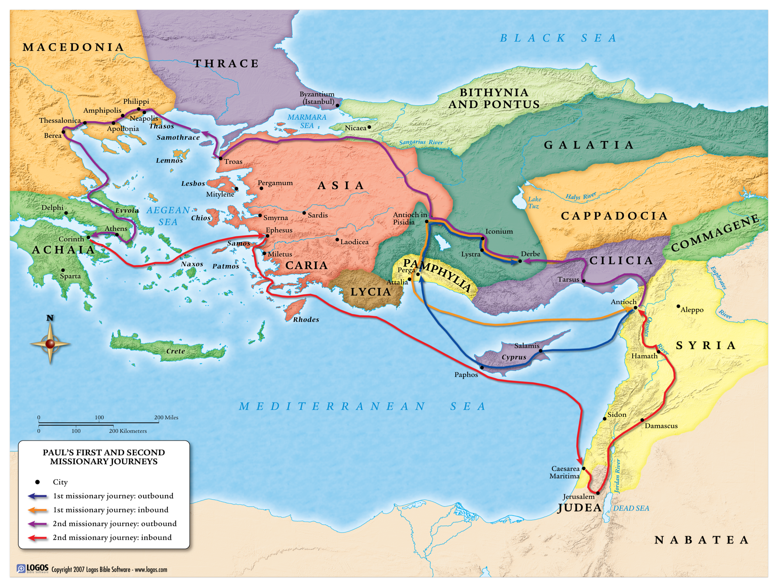

Slide 5
AUDIENCE
The Churches of Galatia
Acts 13:1-5 (Beginning of first Missionary Journey)
Acts 13:13-14 (Antioch of Pisidia)
Acts 13:42-43 (Converts)
Acts 13:44-52 (Opposition)
Acts 13:48-14:7 (Iconium)
Acts 14:8-18 (Lystra)
Acts 14:19-28 (Derbe)
REVIEW

Slide 6
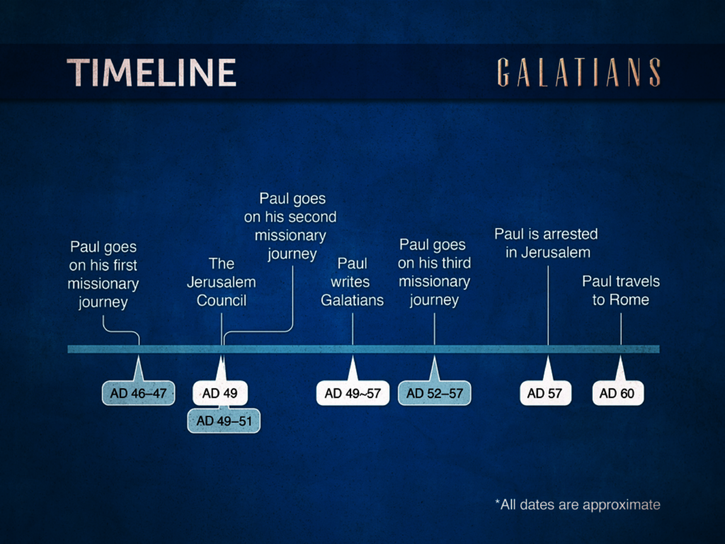
TIME OF WRITING
REVIEW

Slide 7
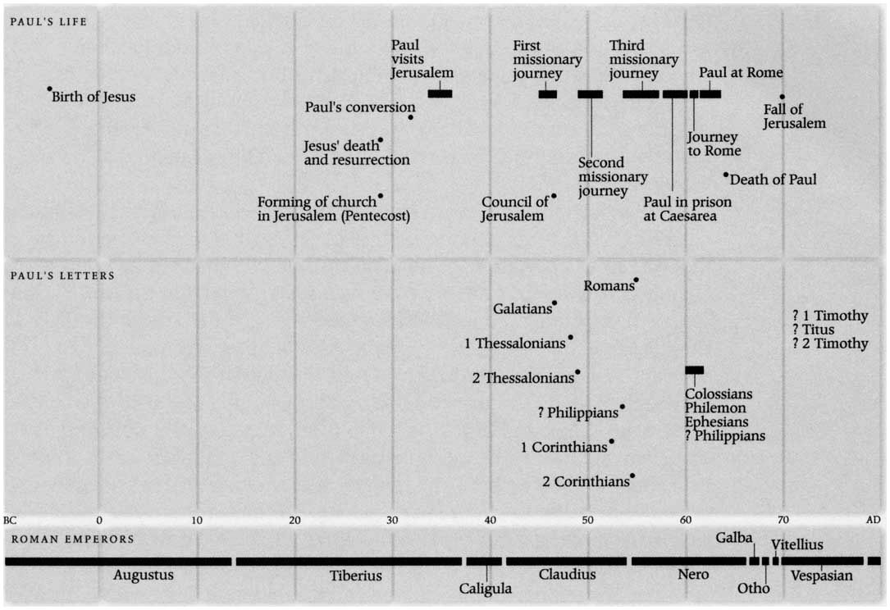

Slide 8
TIME OF WRITING
Galatians 4:13
…but you know that it was because of a bodily illness that I preached the gospel to you the first time.
REVIEW

Slide 9
TIME OF WRITING
Galatians 2:1-2
Then after an interval of fourteen years I went up again to Jerusalem with Barnabas, taking Titus along also. And it was because of a revelation that I went up; and I submitted to them the gospel which I preach among the Gentiles, but I did so in private to those who were of reputation, for fear that I might be running, or had run, in vain.
REVIEW

Slide 10
PURPOSE
Acts 15:1
And some men came down from Judea and began teaching the brethren, “Unless you are circumcised according to the custom of Moses, you cannot be saved.”
NEW MATERIAL

Slide 11
PURPOSE
Galatians 1:6-7
I am amazed that you are so quickly deserting Him who called you by the grace of Christ, for a different gospel; which is really not another; only there are some who are disturbing you, and want to distort the gospel of Christ.

Slide 12
THEME
Freedom in Christ
It was for freedom that Christ set us free; therefore keep standing firm and do not be subject again to a yoke of slavery.
Gal. 5:1

Slide 13
KEY VERSE
Galatians 2:16
…nevertheless knowing that a man is not justified by the works of the Law but through faith in Christ Jesus, even we have believed in Christ Jesus, that we may be justified by faith in Christ, and not by the works of the Law; since by the works of the Law shall no flesh be justified.

Slide 14
OUTLINE
Personal Portion: The Apostle of Liberty. Paul shows that he is an apostle equal in authority and knowledge to Peter, James, and John. Chapters 1-2.
Doctrinal Portion: The Doctrine of Liberty. Paul shows that justification is by "faith working through love" instead of by "works of law." Chapters 3-4.
Practical Portion: The Life of Liberty. Paul exhorts those "having begun in the Spirit" to "walk by the Spirit" and to bear "the fruit of the Spirit." Chapters 5-6.
R.C. Bell

Slide 15
CONTRASTS
The Gospel versus The Law
Freedom versus Bondage
Sons versus Servants
Spirit versus Flesh
Grace versus Law
Faith in Christ versus Works of the Law
New Creation versus Circumcision

Slide 16
CONSIDERATIONS
Two Extremes
First Extreme:
Works have nothing to do with our salvation. We are saved by faith alone.
"Paul’s message was salvation by grace through faith, plus nothing.”
-Alistair Begg

Slide 17
CONSIDERATIONS
Two Extremes
First Extreme:
Works have nothing to do with our salvation. We are saved by faith alone.
“The clear announcement of this letter to Christians could be put into three words: You are free. Because Christ has done it all, there remains nothing left for us to do except believe — freely and fully — in His finished work for our eternal salvation.”
-Chuck Swindall

Slide 18
CONSIDERATIONS
Two Extremes
First Extreme:
Works have nothing to do with our salvation. We are saved by faith alone.
What does Galatians teach us?
3:26-27
5:6-7
5:13
5:16
5:19-21

Slide 19
CONSIDERATIONS
Two Extremes
Second Extreme:
We can earn a place in heaven by strict compliance to a system of law keeping.
If we say that we have not sinned, we make Him a liar, and His word is not in us.
1 Jn. 1:10

Slide 20
CONSIDERATIONS
Two Extremes
Second Extreme:
We can earn a place in heaven by strict compliance to a system of law keeping.
For by grace you have been saved through faith; and that not of yourselves, it is the gift of God; not as a result of works, that no one should boast.
Eph. 2:8-9

Slide 21
CONSIDERATIONS
Two Extremes
Second Extreme:
We can earn a place in heaven by strict compliance to a system of law keeping.
“So you too, when you do all the things which are commanded you, say, ‘We are unworthy slaves; we have done only that which we ought to have done.’”
Luke 17:10

Slide 22
CONSIDERATIONS
Proper Balance
Just as Christ freed us from the bondage of the Law, we are also freed from any system of meritorious works that require our perfect compliance in order to be saved.
It was for freedom that Christ set us free; therefore keep standing firm and do not be subject again to a yoke of slavery.
Gal. 5:1

Slide 23
CONSIDERATIONS
Proper Balance
This freedom does not give us a license to sin!
For you were called to freedom, brethren; only do not turn your freedom into an opportunity for the flesh, but through love serve one another.
Gal. 5:13

Slide 24
CONSIDERATIONS
Proper Balance
What this freedom does give us is confidence in our salvation through faith in Jesus Christ.
…but if we walk in the light as He Himself is in the light, we have fellowship with one another, and the blood of Jesus His Son cleanses us from all sin.
1 Jn. 1:7

Slide 25
CONSIDERATIONS
Proper Balance
We can have no confidence whatsoever in our salvation if we choose to disobey God and willfully live in sin.
…those who practice such things shall not inherit the kingdom of God.
Gal. 5:21

Slide 26
CONSIDERATIONS
Proper Balance
Example of Baptism
For you are all sons of God through faith in Christ Jesus. For all of you who were baptized into Christ have clothed yourselves with Christ.
Gal. 3:26-27

Slide 27
CONSIDERATIONS
Proper Balance
Example of Baptism
And corresponding to that, baptism now saves you—not the removal of dirt from the flesh, but an appeal to God for a good conscience—through the resurrection of Jesus Christ.
1 Pet. 3:21

