Slide 1
Citizens of the Christ’s Kingdom
“For He has rescued us from the domain of darkness, and transferred us to the kingdom of His beloved Son.” (Colossians 1:13)

Slide 2
What Does this Mean to You?
The only “monarchy” most know is England’s.
The English have a king or queen.
They have a parliament elected by the people.
It is a “Constitutional Monarchy”
The king or queen is just a figure-head.
Jesus is not a figure-head!
He is a true Monarch
A Monarchy and a Democracy are opposites.

Slide 3
Jesus is a Reigning King
He is not a mere figure-head!
How can a King reign from heaven?
Esther 3:8-15

Slide 4
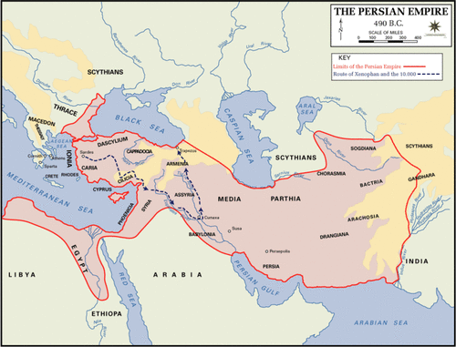
GS
GS
GS
GS
GS
GS
GS
GS
GS
GS
GS
GS
Imagine the consequences of tampering with the message!
King in Susa
Messengers carried message
Scribes
Governors, Satraps Executed
Wrote only what King dictated.

Slide 5
Ephesians 4:8,11-12 ESV
⁸“When he ascended on high he led a host of captives, and he gave gifts to men.”
He was crowned King
¹¹ And he gave the apostles, the prophets, the evangelists, the shepherds and teachers,¹² to equip the saints for the work of ministry, for building up the body of Christ,
Apostles and prophets = Scribes
Evangelists = Messengers
Shepherds and Teachers = Local servants to execute

Slide 6
Apostles and Prophets = Scribes
“But the Helper, the Holy Spirit, whom the Father will send in My name, He will teach you all things, and bring to your remembrance all things that I said to you.” (John 14:26)
“I still have many things to say to you, but you cannot bear them now. ¹³ However, when He, the Spirit of truth, has come, He will guide you into all truth; for He will not speak on His own authority, but whatever He hears He will speak; and He will tell you things to come. ¹⁴ He will glorify Me, for He will take of what is Mine and declare it to you.” (John 16:12-14)
He did not trust them to speak till the Spirit came! (Acts1:4)

Slide 7
Apostles and Prophets = Scribes
“Now we have received, not the spirit of the world, but the Spirit who is from God, that we might know the things that have been freely given to us by God. These things we also speak, not in words which man’s wisdom teaches but which the Holy Spirit teaches, comparing spiritual things with spiritual. (1 Cor. 2:13-14)
“If anyone thinks himself to be a prophet or spiritual, let him acknowledge that the things which I write to you are the commandments of the Lord.” (1 Cor. 14:37)

Slide 8
Apostles and Prophets = Scribes
Peter wrote: “This is now the second letter that I am writing to you, beloved. In both of them I am stirring up your sincere mind by way of reminder, ² that you should remember the predictions of the holy prophets and the commandment of the Lord and Savior through your apostles.” (2 Peter 3:1-2 ESV)
John wrote: ¹⁸ I warn everyone who hears the words of the prophecy of this book: if anyone adds to them, God will add to him the plagues described in this book, ¹⁹ and if anyone takes away from the words of the book of this prophecy, God will take away his share in the tree of life and in the holy city, which are described in this book.

Slide 9
Evangelists = Messengers
Paul wrote to young evangelist Timothy: “Hold fast the pattern of sound words which you have heard from me, in faith and love which are in Christ Jesus.” (2 Tim. 1:7)
“And the things that you have heard from me among many witnesses, commit these to faithful men who will be able to teach others also.” (2 Tim. 2:2)
“Preach the word.” (2 Tim. 4:2)
10 times something like: “Speak these things, exhort, and teach with all authority.” (Titus 2:15)
Peter wrote: “If anyone speaks, let him speak as the oracles of God.” (1 Pet. 4:11)

Slide 10
Shepherds and Teachers = Local servants to execute will of the King
Made overseers by the Holy Spirit (Acts 20:28)
They have no legislative authority (Titus 1:9)
Some would speak “perverse things” (Acts 20:30)
Speaking anything different from the revealed gospel places them under curse (Gal. 1:8-9).
They must give account (Hebrews 13:7)
Citizens must respect their leadership (Heb. 13:17)
They are responsible for edification (Eph. 4:12-16)
Rebellion is serious (Jude 11)

Slide 11
CHRIST, THE KING
Apostles and Prophets recorded the Laws.
Evangelists Proclaim the Laws recorded by the Apostles and Prophets
England has a Parliament elected by the people that makes its laws
Our King has made NO provision for a human lesislative body.
Shepherds
Shepherds
Shepherds
Shepherds
Shepherds
Shepherds
Execute the King’s laws locally.

Slide 12
Does Christ Rule in Any Other Way?
He does not reveal laws any other way!
I do not know all the ways He rules.
In New Testament we see Him:
-- Working with and without miracles.
-- Overruling Satan for His purpose (Acts 8)
-- Uniting seekers and teachers (Acts 8)
-- Protecting His people (2 Tim. 4:16-17)
He has “ALL Power” to do whatever He chooses!

Slide 13
Three Elements of Government
Legislative
Executive
Judicial
Our King makes all the laws!
Our King establishes the offices and sets requirements (Acts 20)
Some local (1 Cor. 5:12)
King Jesus is Final Judge (2Cor.5:10; Acts 17:30-31)

